Slide 1
Mobile Computing:
Low-power Networking and Computing
CS 655: Wireless and Mobile Computing
Parth H. Pathak

Slide 2
Low power networking and computing
IoT devices
  Rise of low-power, low-data rate sensing, computing and communication
Low power networking
  RFIDs
    NFC
  Bluetooth Low Energy (BLE)
    BLE privacy attacks
  802.15.4 and ZigBee
  IoT protocol stack and fragmentation
  Short range IoT protocols – Wireless HART, 6LowPAN, Z-Wave
  Long range IoT protocols - LORA

Slide 3
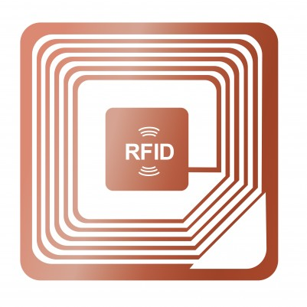
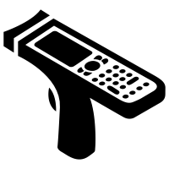
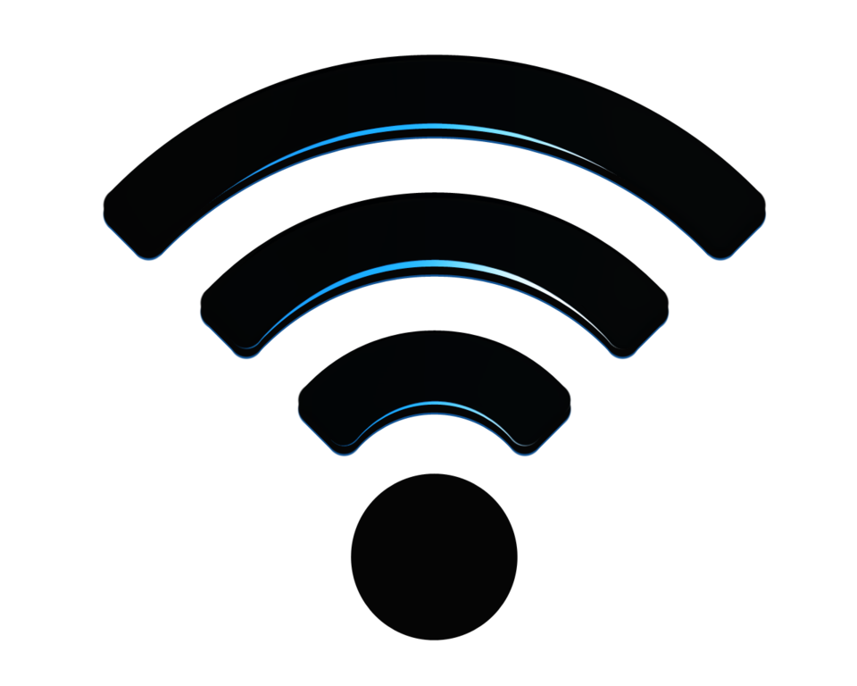
RFID
RFID system contains two main entities
  RFID reader and RFID tags
RFID tags
RFID reader

Slide 4
RFID
How does an RFID system work?
RFID tags
  The tags carry an ID (few bytes)
  ID is used to uniquely identify an object/IoT device
RFID reader
  RFID reader transmits a pulse to read the tags
  The tags respond to the pulse

Slide 5
RFID applications
RFID is commonly used in many places around us
  Supply chain
  Automatic toll collection (Ezpass)
  Asset tracking in stores
  Animal tagging
  Keyless entry

Slide 6
RFID Communication
Two types – near field and far field
Near-field communication
  Inductive coupling
  Both reader and tag antennas are coils
  Load modulation to send data from tag to the reader
[1]

Slide 7
RFID Communication
Far field communication
Back scattering
  Tag uses the RF power transmitted by the reader to power to “reflect” back the data
  Tag changes the reflection impedance to modulate the information
[1]

Slide 8
RFID frequency
Tag frequency and range
Band | Frequency | Distance | Communication
Low frequency (LF) | 125 KHz | 1-90 cm | Inductive coupling

Slide 9
RFID frequency
Tag frequency and range
Band | Frequency | Distance | Communication
Low frequency (LF) | 125 KHz | 1-90 cm | Inductive coupling
High frequency (HF) | 13.56 MHz | 1-75 cm | Inductive coupling

Slide 10
RFID frequency
Tag frequency and range
Band | Frequency | Distance | Communication
Low frequency (LF) | 125 KHz | 1-90 cm | Inductive coupling
High frequency (HF) | 13.56 MHz | 1-75 cm | Inductive coupling
Ultra high frequency (UHF) | 865-868 MHz 902-928 MHz 433 MHz | 9 m | Backscattering

Slide 11
RFID frequency
Tag frequency and range
Band | Frequency | Distance | Communication
Low frequency (LF) | 125 KHz | 1-90 cm | Inductive coupling
High frequency (HF) | 13.56 MHz | 1-75 cm | Inductive coupling
Ultra high frequency (UHF) | 865-868 MHz 902-928 MHz 433 MHz | 9 m | Backscattering
Microwave (mw) | 2.45-5.8 GHz | 1 m | Backscattering

Slide 12
RFID Tags
Three types
  Passive, semi-passive and active
Passive
Reader
Tag
No battery
Backscattering
Semi-passive
Reader
Tag
Battery
Power for tag computation
Backscattering
Active
Reader
Tag
Battery
Power for tag computation and radio

Slide 13
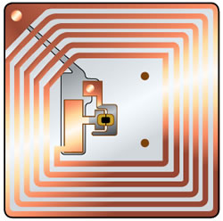
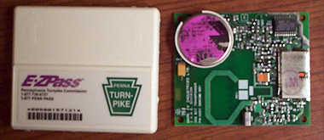
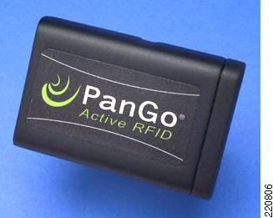
RFID Tags
Examples
Passive tags
https://daryllang.com/archive/d103/images2004/ezpass.jpg
EPC (Electronic Product Code) in retail
Semi-passive tags
Toll tags
asset tracking
Active tags

Slide 14
RFID Tag
Tag type | Passive | Semi-passive | Active
Power source | None | Battery | Battery
Communication type | Back-scattering | Back-scattering | Initiate/respond
Maximum range | 10 m | 100 m | > 100 m
Memory | Read only | Read only | Read and write
Relative cost | Least | More | Most

Slide 15
RFID Modulation
Which modulation is used in RFID passive tags?
  OOK (ON OFF Keying)
[2]

Slide 16
RFID Modulation
ON-OFF Keying on passive tags
[2]

Slide 17
RFID vs. NFC
What is the difference between RFID and NFC?
NFC
  Operates at 13.5 MHz (HF) frequency
  Similar to RFIDs in many aspects
Reader vs. tag
  NFC endpoints can have reader as well as tag functionality
  Can be battery powered
Range
  Limited to a few centimeters (< 10 cm)
Applications
  Mobile payment, keyless fobs

Slide 18
Low power networking and computing
IoT devices
  Rise of low-power, low-data rate sensing, computing and communication
Low power networking
  RFIDs
    NFC
  Bluetooth Low Energy (BLE)
    BLE privacy attacks
  802.15.4 and ZigBee
  IoT protocol stack and fragmentation
  Short range IoT protocols – Wireless HART, 6LowPAN, Z-Wave
  Long range IoT protocols - LORA

Slide 19
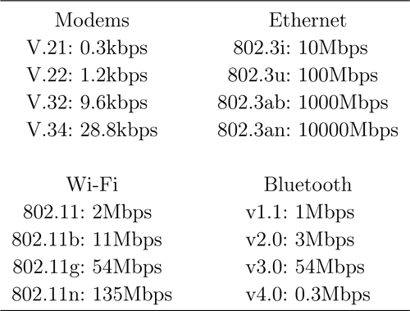
Bluetooth Low Energy (BLE)
It is not always about getting more data rates

Slide 20
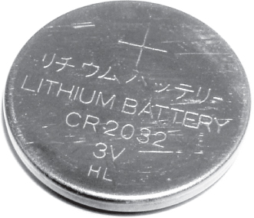
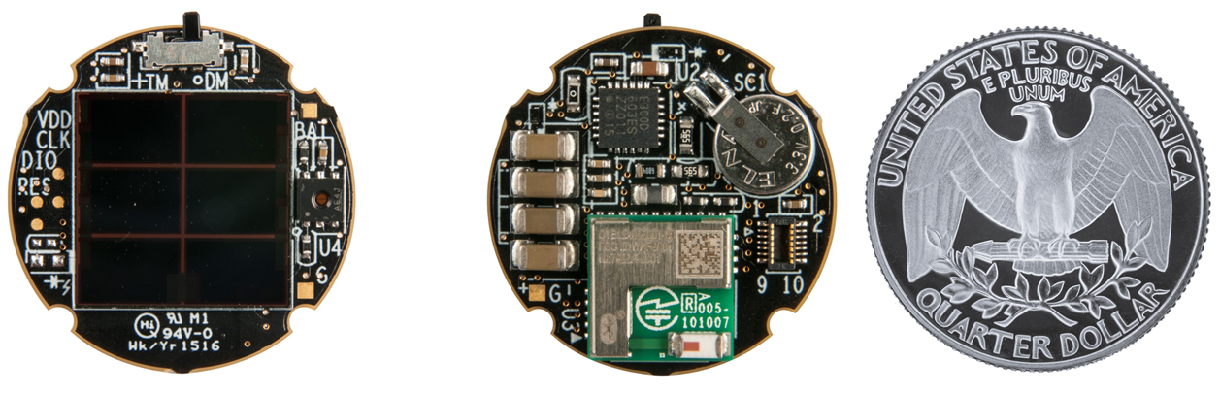
Design objectives for BLE
Low-power
  Most devices that will use BLE are likely to be powered by very small batteries
  Examples
    CR2032 button cell with energy capacity of 230mAh at 3 V
    AA/AAA batteries used in keyboard and mouse
Solar-powered IoT devices
[5]

Slide 21
Design objectives for BLE
Mostly off technology
  Send data occasionally
  Wake up to send/receive, else sleep most of the time
  Duty cycle close to zero
Faster transient connections
  Whenever there is a need to send data, don’t waste time in reconnecting
  BT required upto 20 milliseconds to reconnect, while BLE takes around 3 milliseconds
  BLE cycle
    Wake up, connect, send data, disconnect(optional) and go back to sleep
  Use of advertising channels
What is duty cycling?

Slide 22
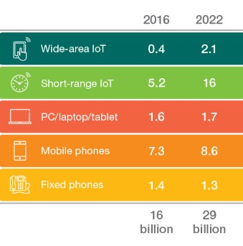
Design objectives for BLE
Scalability
  Cannot be stressed enough
  Critical as we move towards Internet-Of-Things
Design billions of low-power, low-cost devices
Thinking beyond personal computing
[6]

Slide 23
Design objectives for BLE
Simplify the networking to reduce the memory needed
  Building devices with more memory is expensive
  Shorter packets
  Shorter headers
  Simple communication protocol
  Uniform packet format all types of messages
  Simple addressing scheme
  No polling/paging (commonly used on BT)

Slide 24
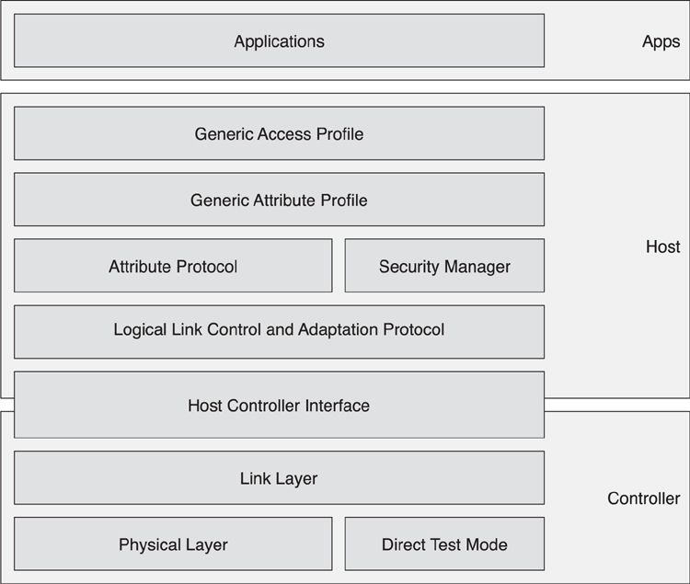
BLE Architecture

Slide 25
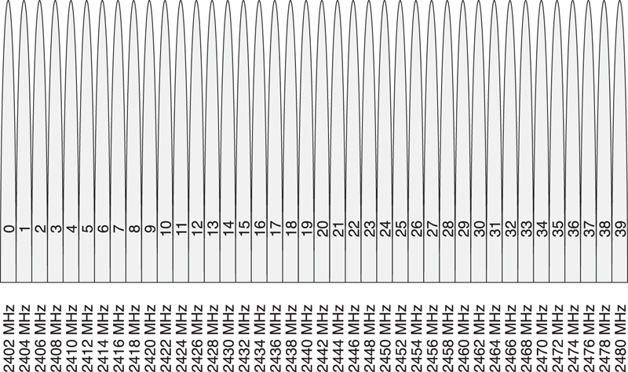
BLE PHY Layer
2.4 GHz ISM band
  40 (0-39) radio channels starting from 2.4 GHz
  Traditional Bluetooth had 79 channels
Any problems in using this band?

Slide 26
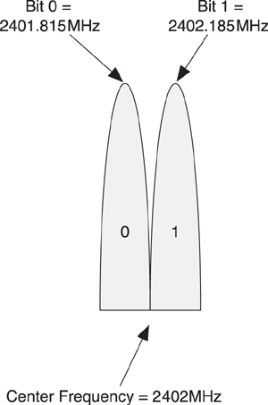
BLE PHY Layer
Modulation
  Gaussian Frequency Shift Keying (GFSK)
  +185KHz and -185KHz indicate 0 and 1 symbol

Slide 27
Tx power and receiver sensitivity
Maximum Tx power limited to 10dBm
  Minimum to be -20dBm
Receiver sensitivity -70dBm
Check for yourself: the range will be in ?? Meters
Typical data rate: 1-2 Mbps

Slide 28
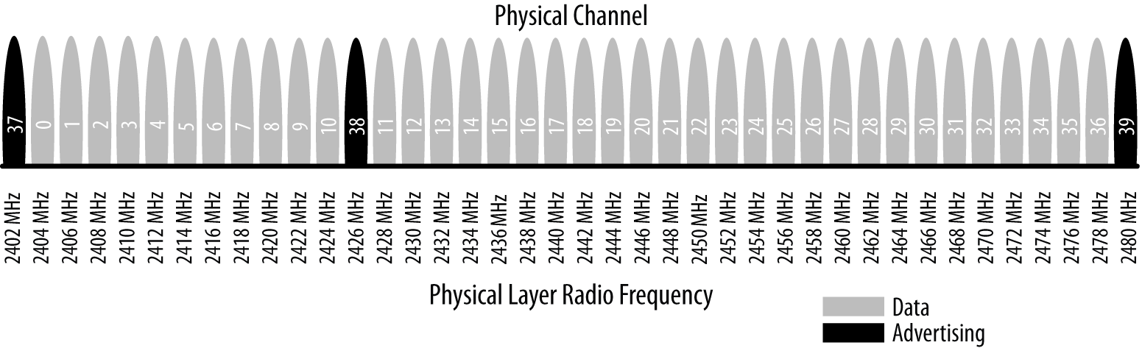
BLE PHY
Channel map
  40 channels from 2.4000 GHz to 2.4835 GHz
  37 channels for data communication
  3 channels for advertising

Slide 29
BLE PHY
Channel hopping
  BLE uses frequency hopping
  Radio hops between channels periodically using
    Next channel = (current channel + hop) mod 37
Advantages of channel hopping?
  Robustness to sniffing (security)
  Interference to other BLE links and WiFi
How do the Tx and Rx know which channel to hop to next?
  Agreed upon at the time of connection establishment
  Hop value is chosen between 5 to 16 randomly

Slide 30
BT frequency hoping
BT channels are divided into timeslots
  Each slot is 625 microseconds
Time divided channel
  Uplink and downlink data transmissions alternate
  Master sends in even timeslots
  Slave sends in odd timeslots
  Packets can be of 1, 3 or 5 slots long
[7]

Slide 31
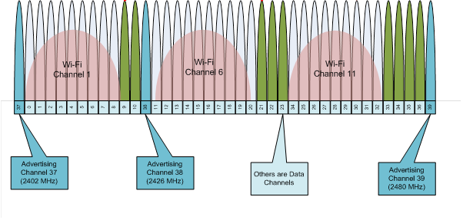
Bluetooth and WiFi
Bluetooth’s channel hoping is adaptive
  Adapts to current activity on the WiFi band
  Note that the advertising channels are carefully chosen so that they do not interfere with WiFi channels
[8]

Slide 32
Bluetooth and WiFi
Measure and tag “bad” channels
  Use RSSI, BER or SNR
  BT devices can skip these channels in their hopping sequence
  Any other approaches?
    Increase error correction rate on Bluetooth
    On-chip solutions
[7]

Slide 33
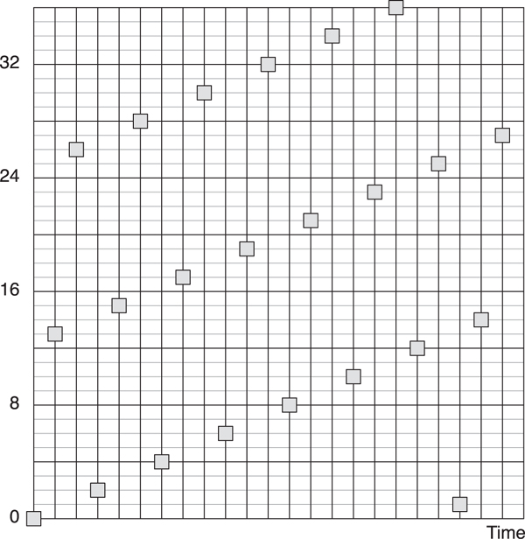
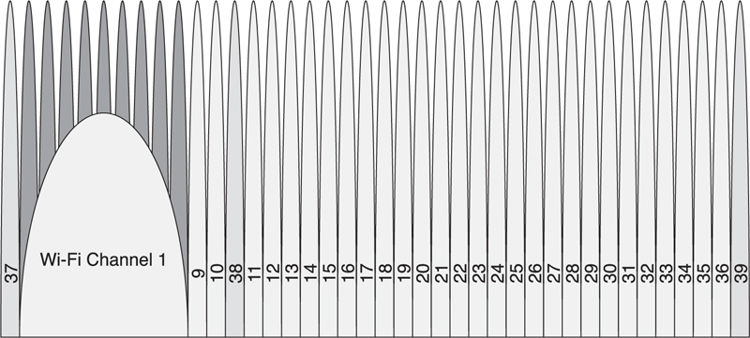
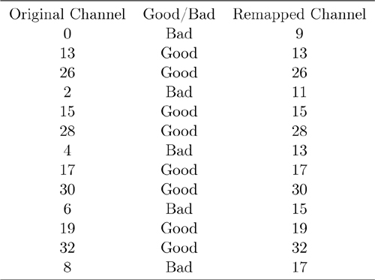
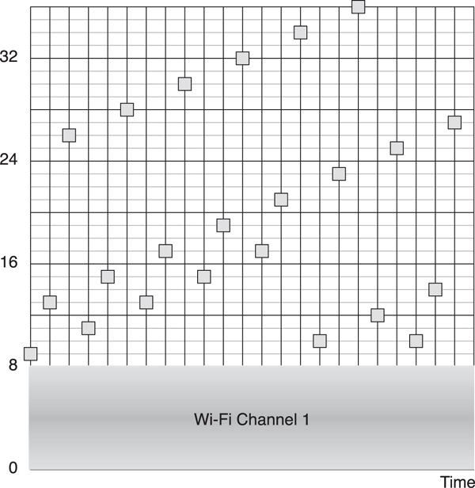
Bluetooth and WiFi
Channel remapping

Slide 34
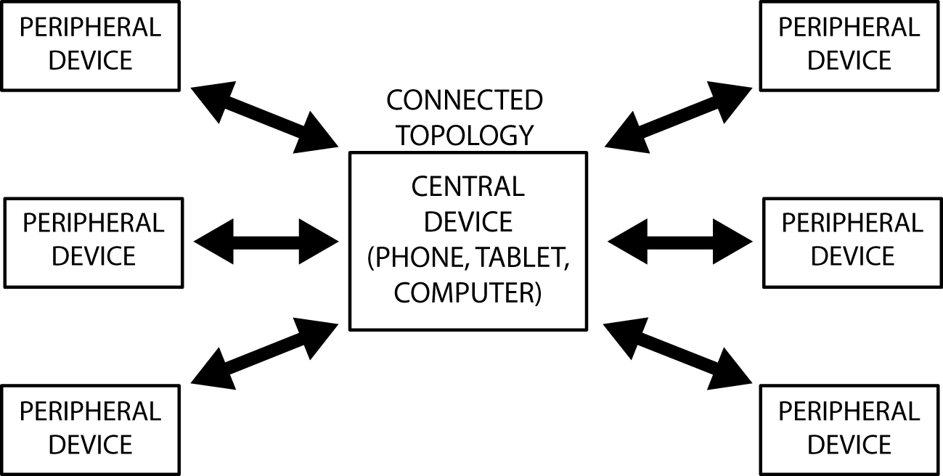
BLE master-slave model
BLE follows server-client model of connection
  Some restrictions are removed starting from specification 4.1
Traditional BT allowed one periphareal to be part of multiple masters
  Resulted in what was known as “scatternet” – multiple star topologies where the slave devices can be connected to multiple masters
[3]

Slide 35
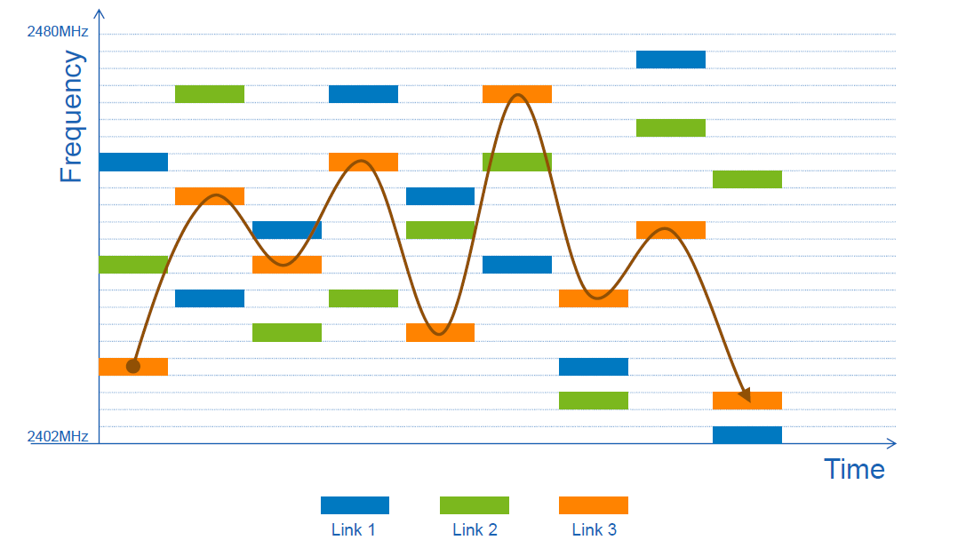
Multiple links
Channel hopping between multiple links
  Determine interference and hop accordingly
[3]

Slide 36
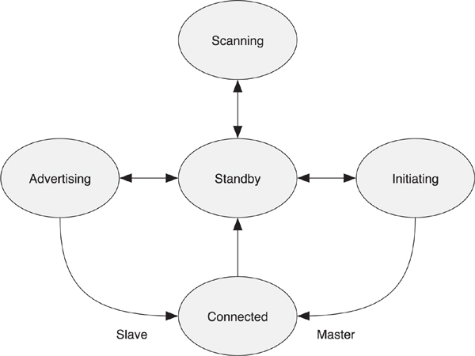
Link layer state machine
Transmit only and receiver only systems are possible with BLE
  Examples?

Slide 37
Link layer packets
What is the use preamble?
  Sequence of 1s and 0s to synchronize the transmitter and receiver
  Allows receiver to tune its frequency for GFSK
Access address
  A unique address assigned to each link layer connection
  Master and slave’s 48-bit addresses are not present in the packet

Slide 38
Link layer packets
Packet format
  The same packet format is used for both advertising packet and data packets
  How to you know if it is an advertising packet or a data packet?
Access address
  Advertising channels use fixed access address 0x8E89BED6

Slide 39
Tx and Rx pipelines
Whitening – bit scrambling
  An important limitation of GFSK – with long runs of 0s or 1s, Rx can assume that the center frequency of the channel has shifted – loss of frequency lock
  Avoid long runs of 0s and 1s
  Use random whitening – randomly generated bit sequence (or whitener) that is EX-OR with the data
Recall?
input = 00000000 : 00100000 : 00010000
whitener = 11110101 : 01000010 : 11011110
output = 11110101 : 01100010 : 11001110

Slide 40
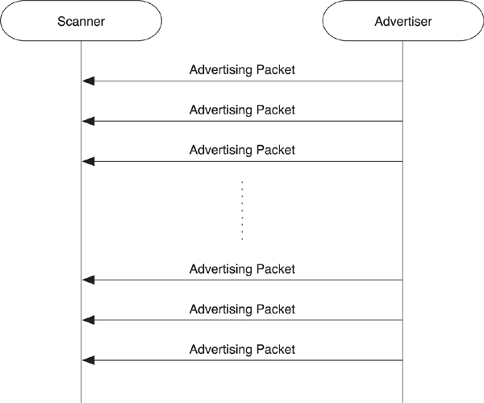
BLE advertisements
4 Types

Slide 41
BLE advertisements
Connectable Undirected Event

Slide 42
BLE advertisements
Connectable Undirected Event
Example:
  Advertising – “Hey, I am a smart thermostat”
  Phone – “Can you display temperature in Celsius?”
  Thermostat – “Yes”
  Connection established -----

Slide 43
BLE advertisements
Connectable Directed Event
Example:
  Fitbit: “I am your fitbit, want to sync my data to your phone”
  Phone accepts the connection

Slide 44
BLE advertisements
Nonconnectable Undirected Event
Example:
  Smart refrigerator: “You are running out milk, make sure to get some”
  All phones/devices in the range receive the message, without actually connecting

Slide 45
BLE advertisements
Scannable Undirected Event
Example:
  Home microwave: “Your food is being prepared”
  Phone: “When will it be ready?”
  Ask for additional information

Slide 46
BLE
BLE connection establishment procedure
  Peripheral advertises its presence periodically on 3 adv. channels
Any possible issues with device advertisements?
[4]

Slide 47
BLE
BLE data communication
  Data communication happens on 37 channels (frequency hopping)
  Start and continuation packets carry data
  Empty packets used to maintain connection, used if no data
  Control packets used for updating connection parameters
BLE uses GFSK modulation

Slide 48
BLE
Privacy in BLE advertising
  Peripheral devices (e.g. smartwatch) can constantly advertise their identity in order to connect to a smartphone
  The advertisement packet contains BLE device MAC address
Can lead to device/user tracking

Slide 49
BLE
BLE addressing
  Change MAC address periodically to prevent tracking
Three types of addresses
  Static address
    MAC address never changes or only changes at bootup
    Poor privacy – can lead to tracking
  Resolvable private address
    MAC address periodically changes
    The address can only be resolved to a unique MAC address only by connected devices
    Example: Smartwatch changes the MAC address periodically, but a connected smartphone can resolve it to know that it is the same smartwatch
    Better privacy
  Non-resolvable private address
    MAC address changes periodically
    The address cannot be resolved to a unique address by any other device

Slide 50
BLE Privacy
Evaluating BLE privacy in real world
What are the challenges in BLE packet sniffing?
How to know an advertising device is a fitness tracker?

Slide 51
BLE Privacy
Privacy-protecting private addresses are not widely used

Slide 52
BLE Privacy leakage from data packets
BLE data traffic is encrypted
  We do not attempt to decode it
Data rate is proportional to user activity intensity
    Can be used to predict users’ activity
  Idle - mostly Empty packets
  Walking - high no. of Start packets
Simple features – data rate, “start” and “empty” packets
Activity identification for one user – 97.6% (average over all users)

Slide 53
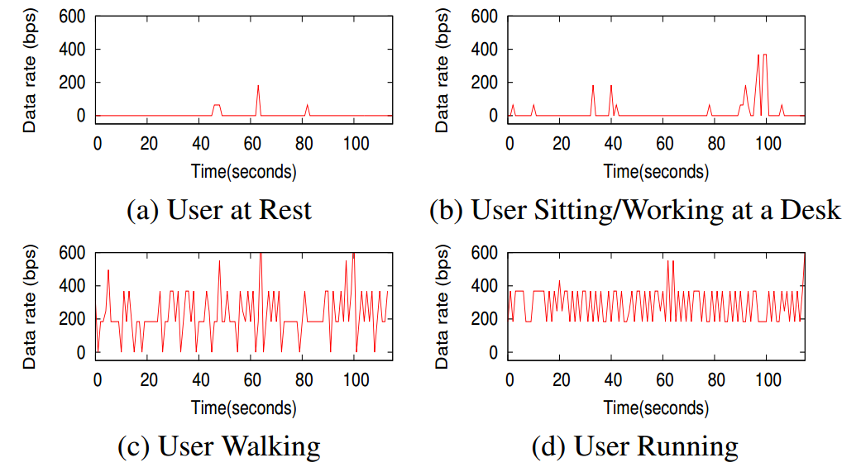
BLE Privacy leakage from data packets
Privacy-protecting private addresses are not widely used

Slide 54
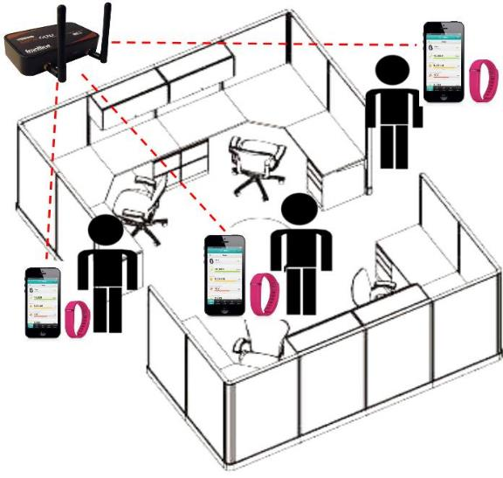
BLE privacy attack – person identification

Slide 55
BLE privacy attack – person identification
Fitbit uses accelerometer for determining users’ motion related statistics^{[6]}
Moderately high correlation between BLE network traffic features and accelerometer readings
Linear regression models built using accelerometer features
  Mean and Max Accn., Zero Crossings, Absolute Area, etc.
  To predict BLE network traffic features (like data rate)
  ~ 70% correlation between predicted and actual values
BLE network traffic can be efficient indicator of users’ “gait” and motion
  Works in scenarios like homes or small gyms

Slide 56
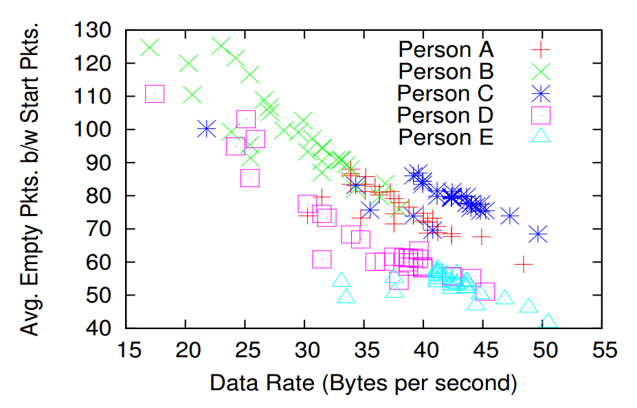
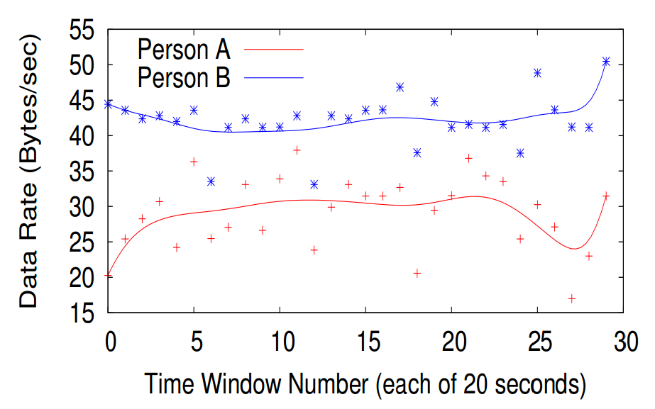
BLE privacy attack – person identification
BLE network feature based prediction
  Data-rate, Start, Empty Packets, Payload Size, Interval between Packets
89% accuracy for 5 people groups
  False positives < 5% for all combinations
  Accuracy decreases for groups of larger users – as difference in gait is less prominent
Attack possible even when MAC address is altered – small group of users, pre-trained
  Works in offices or small gyms

Slide 57
Low power networking and computing
IoT devices
  Rise of low-power, low-data rate sensing, computing and communication
Low power networking
  RFIDs
    NFC
  Bluetooth Low Energy (BLE)
    BLE privacy attacks
  802.15.4 and ZigBee
  IoT protocol stack and fragmentation
  Short range IoT protocols – Wireless HART, 6LowPAN, Z-Wave
  Long range IoT protocols - LORA

Slide 58
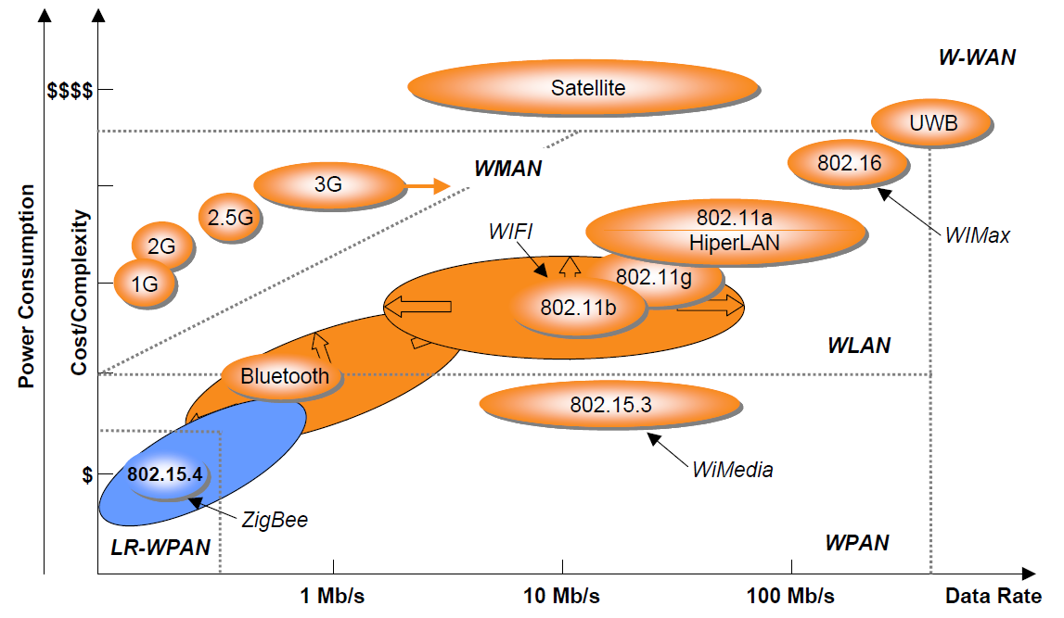
Wireless standards: where do we stand?
[9]

Slide 59
ZigBee and 802.15.4
802.15.4 and ZigBee are important, widely used protocols in wireless sensor networks and Internet-Of-Things
What is the difference between ZigBee and 802.15.4?

Slide 60
Short-range wireless

Slide 61
ZigBee: App Scenario 1
Smart home

Slide 62
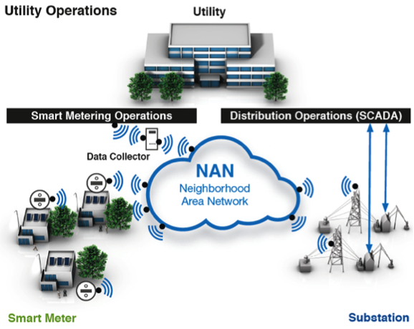
ZigBee: App Scenario 2
Utility network – smart grid
ZigBee is better suited here due to its longer range compared to BLE

Slide 63
ZigBee: App Scenario 3
Smart and connected health

Slide 64
802.15.4: Spectrum

Slide 65
ZigBee device types
FFD (Full Function Device)
  Can perform any duty in the network
  Example: can send to any other device in the network
RFD (Reduced Function Device)
  Can perform limited roles
  Example: can only send data to an FFD
  Lower energy/CPU/memory requirements

Slide 66
ZigBee topologies
Ability to generate flexible topologies is an important advantage of ZigBee

Slide 67
ZigBee topologies
Tree topologies create (loop-free) paths to send data from Node A to Node B
  PAN coordinator is responsible for creating and maintaining the topology

Slide 68
ZigBee routing
What are the factors you would consider in designing a routing protocol?
  Reactive vs. proactive, energy, delay, etc.

Slide 69
ZigBee routing
Fundamental trade-offs
What is a better choice?
  Send data over multiple hops with lower transmission power or
  Send data over few hops with higher transmission power
Delay, network throughput, interference

Slide 70
ZigBee routing
Fundamental trade-offs
Energy drainage in relaying - unfairness

Slide 71
PAN management
802.15.4 was designed to support inter-network communication
PANs
  The coordinator chooses a unique PAN ID that is not used by any other network in the communication/interference range of its devices
    PAN ID can be predetermined
  Devices can communicate with other devices in the same PAN or devices of other PANs
Each device has two addresses
  Long address: globally unique device ID (64 bit)
  Short address:
    PAN specific short ID
    16-bit
    Assigned by PAN coordinator when a node joins the PAN
Why do we need a short address?

Slide 72
Cluster heads
PAN coordinator can have assistance from other coordinators
  Typically forming clusters and assigning cluster heads
802.15.4 can support a maximum of 65K devices in a PAN
  So management of a PAN is complex

Slide 73
Medium Access
Beacon-enabled network
  802.15.4 allows beacons similar to 802.11 family of protocols
  Beacon frames are sent out by PAN coordinator, creating what is referred as super frames
  Channel access is slotted – contention based access and contention free access
    What is the advantage of contention free access?
    Which other standard we looked which had such a hybrid MAC?
    What if the PAN coordinator’s beacon does not reach the entire network?

Slide 74
Medium Access
Beacon-enabled networks
  Advantages
    Nodes not involved in communication can go to sleep, save energy
    Latency-aware scheduling
  Disadvantages
    Increases the work for coordinators
    Interoperability
Beacon-free networks
  Disadvantages
    Always contention based access
    Nodes have to listen to the medium more actively
    Increases energy consumption
  Advantages
    Seamless operations and higher interoperability
    Distributed decision making increases scalability

Slide 75
Bluetooth vs. ZigBee
Target applications
  BT/BLE: home automation, personal/wearable devices, etc.
  ZigBee: industrial automation, large sensor networks, smart-grid, etc.
 | BT/BLE | ZigBee
Range | 10-20 meters | Upto 100 meters
Data rate | High | Low
Network topologies | Star, scatternet | Mesh, star, P2P
Power consumption | High | Low
Scalability | Low | High

Slide 76
Low power networking and computing
IoT devices
  Rise of low-power, low-data rate sensing, computing and communication
Low power networking
  RFIDs
    NFC
  Bluetooth Low Energy (BLE)
    BLE privacy attacks
  802.15.4 and ZigBee
  IoT protocol stack and fragmentation
  Short range IoT protocols – Wireless HART, 6LowPAN, Z-Wave
  Long range IoT protocols - LORA

Slide 77
IoT definition and application sectors
IoT will affect virtually every part of our day-to-day life by 2025

Slide 78
IoT Protocol Stack
OSI protocol layers
Sample WiFi stack
Application layer
Transport layer
Network layer
Data link layer
Physical layer
HTTP, FTP, RTP…
TCP, UDP
IPv4, IPv6
802.11 MAC
802.11 PHY
IoT stack
CoAP, MQTT, AMQP, XMPP, HTTP-rest
TCP, UDP
IPv6/IPv4, 6LowPAN
802.15.4, Bluetooth, LORA, WirelessHART, Z-wave, ANT, 802.11, NFC, RFID…
We are moving towards IoT protocol convergence but fragmentation a huge problem
IoT stack has many candidate protocols at each layer

Slide 79
IoT has a gateway problem
Many platforms, technologies, devices, protocols
Gateways create virtual boundaries between IoT devices and Internet
Gateways can be software (e.g., Fitbit app) or hardware (e.g., energy meter)
Highly fragmented

Slide 80
Low power networking and computing
IoT devices
  Rise of low-power, low-data rate sensing, computing and communication
Low power networking
  RFIDs
    NFC
  Bluetooth Low Energy (BLE)
    BLE privacy attacks
  802.15.4 and ZigBee
  IoT protocol stack and fragmentation
  Short range IoT protocols – Wireless HART, 6LowPAN, Z-Wave
  Long range IoT protocols - LORA

Slide 81
6LowPAN
“Islands” of IoT networks connect to Internet via gateway only
  Internet and these islands talk different language
  Internet uses TCP/IP, sensor nets primarily concerned with MAC/PHY

Slide 82
6LowPAN
“Islands” of IoT networks connect to Internet via gateway only
  Internet and these islands talk different language
  Internet uses TCP/IP, sensor nets primarily concerned with MAC/PHY
  6LowPAN (IPv6 for low power PANs) defines an adaptation layer that allows IPv6 connectivity over 802.15.4 (and other wireless technologies)
  “Thread” protocol used by Google Nest Thermostat uses 6LowPAN and 802.15.4
Application layer
Transport layer
Network layer
Data link layer
Physical layer
CoAP, MQTT, AMQP, XMPP, HTTP-rest
TCP, UDP
IPv6
6LowPAN
802.15.4 MAC
802.15.4 PHY

Slide 83
6LowPAN
Use of IPv6 to address the low-power devices
  Makes it possible to uniquely send/receive data from any IoT device globally
What is the difference between IPv4 vs IPv6? Why IPv6 is more suitable for IoTs?
  IPv4: 32 bit address, 2^32 addresses
  IPv6: 128 bit address, 2^128 addresses
If we assign a unique IPv6 address to each IoT device, communication can be simplified dramatically, but
  There are many challenges
  Can you guess some?

Slide 84
6LowPAN
IPv6 over 802.15.4
Challenge 1: Packet size
  Maximum packet size in IPv6 is 1280 bytes
  Internet hosts typically send that large packets
  802.15.4 packet size is 127 bytes
Challenge 2: Header overhead
  802.15.4 packet has 25 bytes of header with 21 bytes of security parameters
  Available payload for IPv6 packet is 81 bytes
  IPv6 packet will have 40 bytes IP header and say, 8-byte UDP header
802.15.4 header | 802.15.4 security | IP header | UDP header | Actual data
25 | 21 | 40 | 8 | 33

Slide 85
6LowPAN
Header Compression
Compress IPv6 header
  Many fields in the header are common/predictable
  Does not mean that each IoT sensor has decompress and compress again to forward the packet
  Rely on 802.15.4 addressing to forward the packet

Slide 86
6LowPAN
Packet fragmentation
Divide the large IPv6 packet into many small fragments
  Each fragment carried over in a 802.15.4 frame
  Requires adding a small fragment header to properly combine all the fragments of a packet at the final destination
  Each fragment get routed independently

Slide 87
6LowPAN
Use 802.15.4 addressing
Routing in 802.15.4 mesh network
  Routing based on large 128 bit IPv6 addresses requires looking at it from the compressed IPv6 header
  Instead PANs can map IPv6 addresses to 64-bit 802.15.4 addresses

Slide 88
6LowPAN
Use 802.15.4 addressing
Routing in 802.15.4 mesh network
  Routing based on large 128 bit IPv6 addresses requires looking at it from the compressed IPv6 header
  Instead PANs can map IPv6 addresses to 64-bit 802.15.4 addresses

Slide 89
Z-Wave
An IoT protocol defined specifically for home automation
  Controlling lighting, security, HVAC, doors, etc.
Operates in 908 MHz spectrum
  Similar to ZigBee in some aspects, interoperable but has longer range
  Network is identified using a HOME ID and devices have their own device ID
Home networks
  Support for mesh topology
  Multiple controllers can be defined within a home network
Choice of spectrum increases network reliability
  Lower interference than 2.4 GHz

Slide 90
WirelessHART
Industrial IoT networks have different requirements
  Wireless sensor-actuator networks
  Sense, compute and actuate
  Example: large scale manufacturing plants
Requirement
  Hard delay guarantee
  A message generated at Node A should reach Node B within a given deadline
WirelessHART protocol
  Real-time wireless sensor networks
  Industrial IoT networks

Slide 91
WirelessHART
WirelessHART PHY layer
  802.15.4 forms the basis of PHY
  2.4 GHz, 16 channels, 250 Kbps data rate
  Channel hopping and interference-aware blacklisting
WirelessHART MAC layer
  CSMA/CA cannot guarantee bounded delay
  Channel access cannot be deterministic when there is a strict deadline
  WirelessHART relies on time-divided MAC
Centralized decision making
  Nodes are divided into clusters where each cluster makes the decision of which nodes should be assigned which time slot
  Routing equally important – in a multi-hop scenario, how to come up with a routing such that the message can make it to the destination in time

Slide 92
LPWA
The IoT networks discussed till now are PANs
  PANs are designed using low-range, low-power wireless networks
  Example technologies: BT, BLE, 802.15.4, WirelessHART, Z-wave
What are the disadvantages of using low-range networks?
  Reliance on multi-hoping
  Network management requires clusters and coordinators
  Distributed design is complex and challenging
Low Power Wide Area (LPWA) networks
  Can we design cellular-type IoT networks with long range?
  Desired range in kilometers
  IoT devices directly talk to base stations
  No multi-hoping

Slide 93
Low power networking and computing
IoT devices
  Rise of low-power, low-data rate sensing, computing and communication
Low power networking
  RFIDs
    NFC
  Bluetooth Low Energy (BLE)
    BLE privacy attacks
  802.15.4 and ZigBee
  IoT protocol stack and fragmentation
  Short range IoT protocols – Wireless HART, 6LowPAN, Z-Wave
  Long range IoT protocols - LORA

Slide 94
LPWA
Need of long range wireless IoT technologies

Slide 95
LORA
Major LPWA technologies: LORA, SigFox, NB-IoT
LORA: LOng RAnge low power wireless networking

Slide 96
LORA
PHY layer
  Operates in unlicensed spectrum
  902 to 928 MHz
  Bandwidth 500-125 KHz
  Modulation: Chirp Spread Spectrum (CSS)
  Peak data rate: 290 bps–50 kbps
  Distance range : 15 Km

Slide 97
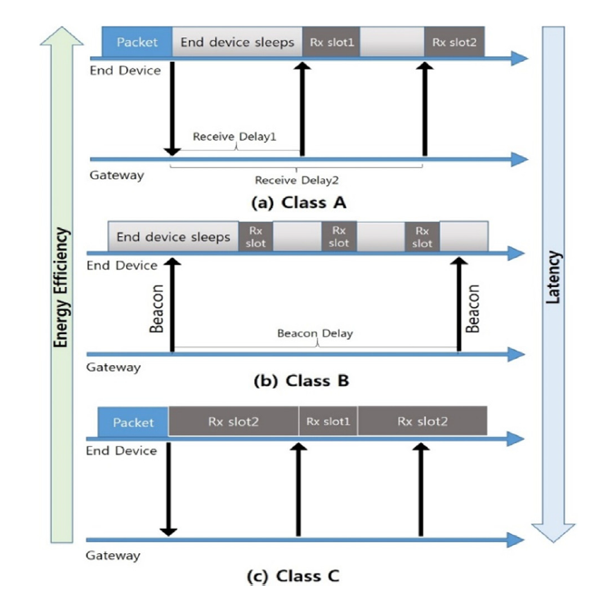
LORA
MAC layer

Slide 98
References
[1] Want, Roy. "An introduction to RFID technology." IEEE Pervasive Computing5, no. 1 (2006): 25-33.
[2] In The RF in RFID (Second Edition), edited by Daniel M. Dobkin,, Newnes, 2013, ISBN 9780123945839
[3] Townsend, Kevin, Carles Cufí, and Robert Davidson. Getting started with Bluetooth low energy: tools and techniques for low-power networking. " O'Reilly Media, Inc.", 2014.
[4] Das, Aveek K., Parth H. Pathak, Chen-Nee Chuah, and Prasant Mohapatra. "Uncovering Privacy Leakage in BLE Network Traffic of Wearable Fitness Trackers." In Proceedings of the 17th International Workshop on Mobile Computing Systems and Applications, pp. 99-104. ACM, 2016.
[5] http://www.cypress.com/documentation/development-kitsboards/cyalkit-e02-solar-powered-ble-sensor-beacon-reference-design

Slide 99
References
[6] https://www.ericsson.com/en/mobility-report/internet-of-things-forecast
[7] https://cdn.rohde-schwarz.com/pws/dl_downloads/dl_application/application_notes/1c108/1C108_0e_Bluetooth_BR_EDR_AFH.pdf
[8] http://www.element14.com/community/groups/wireless/blog/2013/08/23/bluetooth-low-energy
[9] https://people.eecs.berkeley.edu/~prabal/teaching/cs294-11-f05/slides/day21.pdf

