Slide 1
Welcome to
CS 655
Wireless and Mobile Computing
Parth H. Pathak
Assistant Professor
Computer Science Department
George Mason University

Slide 2
Welcome to CS 655
Today’s agenda
  General information
  Course objectives and topics
  Course structure and grading
  Policies
  Course project

Slide 3
CS 655: Wireless & Mobile Computing
Time and location
  Mondays, 4:30 – 7:10 pm
  Innovation Hall 134
Office hours
  Tuesdays 4-6pm
  Office: ENGR 5318

Slide 4
CS 655: Wireless & Mobile Computing
Course Communications
  Use your George Mason email address
  Announcements, assignments, slides, reading list, etc. on Blackboard
  Course schedule regularly updated on Blackboard

Slide 5
[~]$ whoami > _
Instructor
  Parth H. Pathak
  Assistant professor, Computer Science Department
  Post-doc from UC Davis, PhD in CS from NC State
  Webpage: www.cs.gmu.edu/~phpathak
  Email: phpathak@gmu.edu
Research interests
  Wireless networking and mobile computing

Slide 6
Welcome to CS 655
Today’s agenda
  General information
  Course objectives and topics
  Course structure and grading
  Policies
  Project

Slide 7
Course Objectives
Learn about the state-of-the-art topics in
wireless networking and mobile computing
What’s the difference?
High-speed wireless connectivity
Smartphone and
wearables sensing
Wireless networking
Mobile
computing
Reliable connection and coverage
Activity tracking and healthcare applications
Energy consumption due to wireless networking on smartphones
Smartphone indoor localization

Slide 8
Why Wireless and Mobile Computing?
Wireless/mobile traffic continues to grow globally
  Need to design, manage and sustain high-quality wireless networks
Cisco VNI report [1]
  We live in a world surrounded by mobile devices, generating tremendous amount of network traffic
[1] Cisco Visual Networking index (VNI) 2017 predictions https://www.cisco.com/c/en/us/solutions/collateral/service-provider/visual-networking-index-vni/mobile-white-paper-c11-520862.pdf

Slide 9
Mobile traffic
Smartphones dominate the mobile traffic
  Better understand networking/computing issues on smartphones
Cisco VNI report [1]

Slide 10
(Many) more “smart” devices
Number of smart mobile devices is continuously growing
Cisco VNI report [1]

Slide 11
The rise of wearables
Smartwatches
Fitness trackers
AR/VR, smart glasses
Health monitors
Life logging devices etc.
Cisco VNI report [1]

Slide 12
Virtual Reality
  5 fold growth expected in number of VR headsets!!
Cisco VNI report [1]

Slide 13
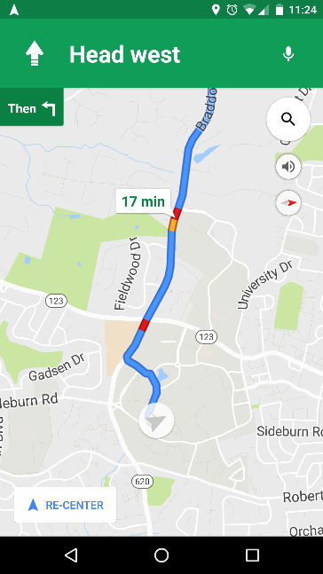
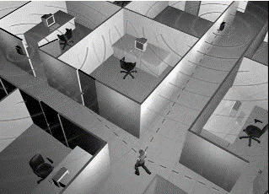



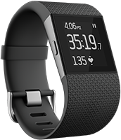
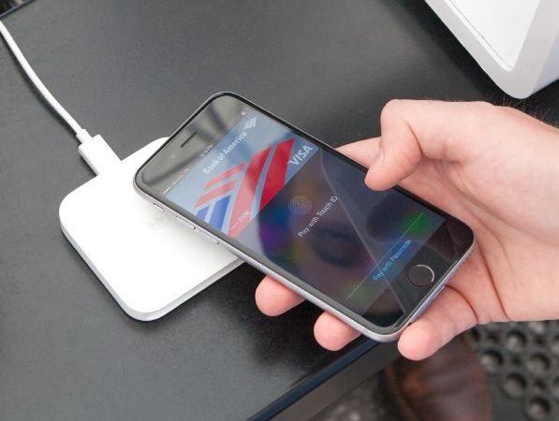
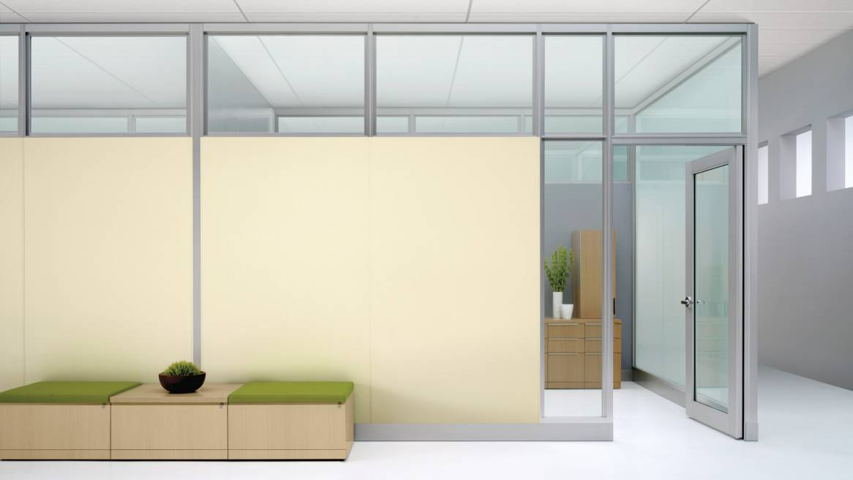

Mobile sensing and applications
Indoor localization
Scan and retrieve
Outdoor navigation
Fitness tracking
Mobile pay
Augmented reality

Slide 14
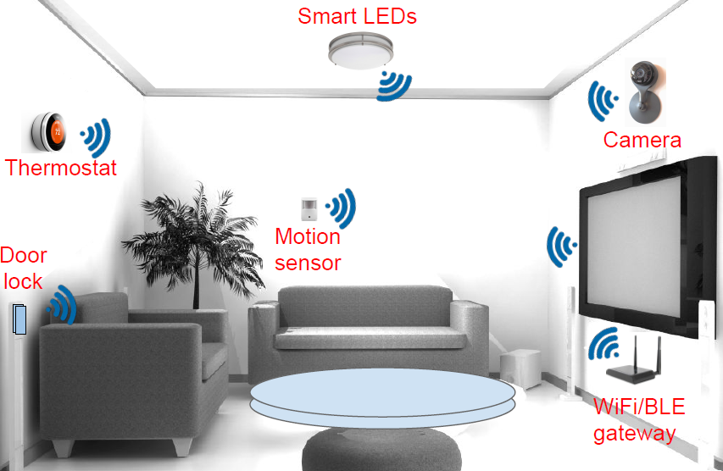
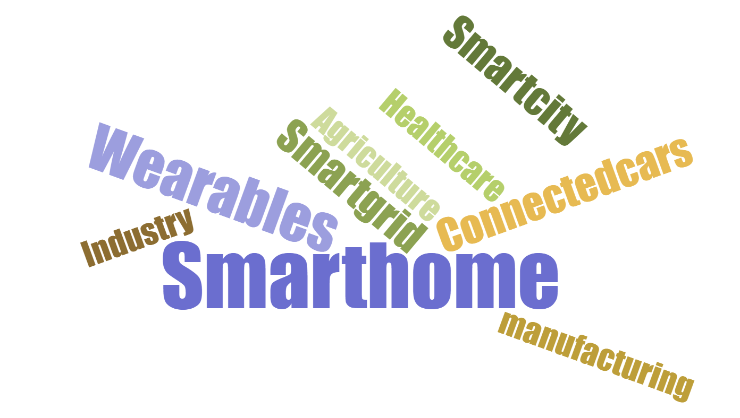
and the Internet-of-Things (IoTs)..
Internet-of-Things and Machine-to-machine communications
  Objects around us are becoming more and more intelligent
  Computing, communication and sensing capabilities
What is Internet-of-Things?
Popular IoT application domains
Smart homes

Slide 15
WiFi leading the way
Cisco VNI report [1]

Slide 16
Why WiFi (802.11) is the focus?
  Why WiFi (802.11) is the primary focus in this course?
  There are many types of wireless networks, but not all are easy to understand and tinker
  WiFi specifications are well understood
  WiFi hardware is relatively cheaper
  Most importantly: WiFi operates in free spectrum
  Some similarity to what Unix/Linux is for Operating Systems..

Slide 17
Topic 1
Wireless networking
  MAC layer
  What are the important MAC layer design problems in wireless networks?
    CSMA/CA and WiFi MAC overview
    Wide bandwidth channel access techniques – 802.11ac MAC layer overview
    Energy efficiency for battery operated devices
    Rate control
 | Topics
1. | Wireless networking: PHY and MAC
2. | Wireless networking: Network, transport and application
3. | Emerging wireless networks
4. | Mobile and wearable sensing
5. | Indoor localization and RF sensing
6. | Low-power networking

Slide 18
Topic 1
Wireless networking
  PHY layer
  What type of physical layer techniques are used to increase data rates?
    Understand wireless channel, interference and capacity
    OFDM and overview of 802.11 WiFi PHY layer
    Multi-antenna systems, MIMO and beamforming techniques
    Overview of 802.11n/ac PHY
 | Topics
1. | Wireless networking: PHY and MAC
2. | Wireless networking: Network, transport and application
3. | Emerging wireless networks
4. | Mobile and wearable sensing
5. | Indoor localization and RF sensing
6. | Low-power networking

Slide 19
Topic 2
Wireless networking
  Network layer
  Do we need to adapt the network layer when links are wireless?
    Wireless multi-hop networks
    Mesh and sensor networks
    Wireless routing protocols
 | Topics
1. | Wireless networking: PHY and MAC
2. | Wireless networking: Network, transport and application
3. | Emerging wireless networks
4. | Mobile and wearable sensing
5. | Indoor localization and RF sensing
6. | Low-power networking

Slide 20
Topic 2
Wireless networking
  Transport layer
  How do transport protocols such as TCP and UDP perform in wireless network?
    Last-hop transport layer problem
    TCP variants for wireless networks
    Reliable delivery over wireless networks
 | Topics
1. | Wireless networking: PHY and MAC
2. | Wireless networking: Network, transport and application
3. | Emerging wireless networks
4. | Mobile and wearable sensing
5. | Indoor localization and RF sensing
6. | Low-power networking

Slide 21
Topic 2
Wireless networking
  Application layer
  Cross-layer designs
    Applications made aware of unreliable wireless networks on which they are operating
    Video over wireless
 | Topics
1. | Wireless networking: PHY and MAC
2. | Wireless networking: Network, transport and application
3. | Emerging wireless networks
4. | Mobile and wearable sensing
5. | Indoor localization and RF sensing
6. | Low-power networking

Slide 22
Topic 3
Multi-gigabit wireless networks
5G wireless systems
  Millimeter wave networking
    Directionality and beamforming
    60 GHz wireless LANs for 5G wireless (7 Gbps per wireless link)
    IEEE 802.11ad MAC and PHY design
 | Topics
1. | Wireless networking: PHY and MAC
2. | Wireless networking: Network, transport and application
3. | Emerging wireless networks
4. | Mobile and wearable sensing
5. | Indoor localization and RF sensing
6. | Low-power networking

Slide 23
Topic 3
Multi-gigabit wireless networks
5G wireless systems
  Visible light communication
    High-speed networking using LEDs
    Camera and photosensor receivers
    IEEE 802.15.7 MAC and PHY overview
    Visible light positioning – localize your smartphone using indoor LEDs
 | Topics
1. | Wireless networking: PHY and MAC
2. | Wireless networking: Network, transport and application
3. | Emerging wireless networks
4. | Mobile and wearable sensing
5. | Indoor localization and RF sensing
6. | Low-power networking

Slide 24
Topic 4
 | Topics
1. | Wireless networking: PHY and MAC
2. | Wireless networking: Network, transport and application
3. | Emerging wireless networks
4. | Mobile and wearable sensing
5. | Indoor localization and RF sensing
6. | Low-power networking
Mobile and wearable sensing
  Mobile/wearable sensors
    Overview of mobile sensors - accelerometer, gyroscope, magnetometer etc.
    Smartphone orientation and heading detection
    Challenges in magnetometer-based heading detection

Slide 25
Topic 4
 | Topics
1. | Wireless networking: PHY and MAC
2. | Wireless networking: Network, transport and application
3. | Emerging wireless networks
4. | Mobile and wearable sensing
5. | Indoor localization and RF sensing
6. | Low-power networking
Mobile and wearable sensing
  Activity recognition and healthcare
    Identifying human activities through the use of sensors
    Health monitoring and fitness tracking - step counting
    Wrist-worn wearables – gesture and remote interaction

Slide 26
Topic 5
 | Topics
1. | Wireless networking: PHY and MAC
2. | Wireless networking: Network, transport and application
3. | Emerging wireless networks
4. | Mobile and wearable sensing
5. | Indoor localization and RF sensing
6. | Low-power networking
Indoor localization and RF sensing
  Smartphone localization
    WiFi fingerprinting for localization of mobile devices like smartphones
    Non-WiFi localization – sound, ambiance etc.

Slide 27
Topic 5
 | Topics
1. | Wireless networking: PHY and MAC
2. | Wireless networking: Network, transport and application
3. | Emerging wireless networks
4. | Mobile and wearable sensing
5. | Indoor localization and RF sensing
6. | Low-power networking
Indoor localization and RF sensing
  Device-free sensing with radio frequency
    Mining PHY channel state information for sensing
    Device-free localization and human activity recognition

Slide 28
Topic 6
 | Topics
1. | Wireless networking: PHY and MAC
2. | Wireless networking: Network, transport and application
3. | Emerging wireless networks
4. | Mobile and wearable sensing
5. | Indoor localization and RF sensing
6. | Low-power networking
Low-power networking
  Bluetooth and ZigBee
    Low power sensor networks
    PHY and MAC overview

Slide 29
Topic 6
 | Topics
1. | Wireless networking: PHY and MAC
2. | Wireless networking: Network, transport and application
3. | Emerging wireless networks
4. | Mobile and wearable sensing
5. | Indoor localization and RF sensing
6. | Low-power networking
Low-power networking
  Backscatter communication
    RFID technology overview
    Energy harvesting RFID tags
    Near Field Communication (NFC)

Slide 30
Topic 6
 | Topics
1. | Wireless networking: PHY and MAC
2. | Wireless networking: Network, transport and application
3. | Emerging wireless networks
4. | Mobile and wearable sensing
5. | Indoor localization and RF sensing
6. | Low-power networking
Low-power networking
  Internet-of-Things (IoT)
    IoT protocols – MQTT and CoAP
    IPv6 networking in low-power IoTs – 6LoWPAN

Slide 31
If time permits..
Future mobile networks
  Drone networking
    Multi-UAV networks, architectures and civilian applications
    Communication challenges and protocols for micro UAVs

Slide 32
If time permits..
Future mobile networks
  Connected autonomous cars
    Wireless technologies for Vehicle-to-Infrastructure (V2I) and Vehicle-to-Vehicle (V2V) communications
    Surrounding sensing with terahertz and gigahertz wireless signals

Slide 33
Summary of outcomes
After the completion of this course, you will
  Become familiar with the state-of-the-art technologies in wireless networking and mobile computing
  Better understand the techniques used in wireless networks to increase the data rates, support mobility and increase energy efficiency
  Become familiar with various sensors on smartphone and wearables, and their use in sensing applications and networking
  Get a hands-on experience to work with wireless devices and smartphones
  Deeper understanding of important research problems in the field

Slide 34
How will that be useful?
Job search in industry
  Improved knowledge about current topics
  Mobile and wireless are thriving markets
  For example, WiFi and localization startups
Research
  Most topics discussed in class are today’s important research problems
  Help you decide your thesis research topic
  Course project can result in a paper

Slide 35
Welcome to CS 655
Today’s agenda
  General information
  Course objectives and topics
  Course structure and grading
  Policies
  Project

Slide 36
Course structure
No required textbook
  I will provide slides/notes for all topics
  Additional reading material (i.e. papers, articles etc.) will also be provided
Reference textbooks (covers some course topics)
  802.11 Wireless Networks: The Definitive Guide, Book by Matthew Gast (available online through GMU library)
  802.11n: A Survival Guide, by Matthew Gast, O'Reilly Media.
  802.11ac: A Survival Guide, by Matthew Gast, O'Reilly Media.
  Wireless Networking Complete, by Pei Zheng et al., Morgan Kaufmann.
  Wireless Communications: Principles and Practice, by Theodore S. Rappaport, Prentice Hall.

Slide 37
Grading
Course component | Percentage
Paper reviews | 15%
Programming assignments | 25%
Class participation | 10%
Class presentation | 10%
Course project | 40%

Slide 38
Reviews (15%)
Reviews (15%)
  I will post 1-2 papers/articles every 1-2 weeks
  5-10 reviews in total for the course
  Read the articles, and write a short review (2-3 paragraphs)
Review format
  A general format (will be provided in advance) includes
    (i) Summarize the paper in 3 sentences, (ii) Describe 3 main contributions (pros) of the paper, (iii) Describe 1 limitation (cons) of the paper and (iv) Provide 1 way how you think the limitation can be fixed?
Example – localize your phone using building LED lamps
  Kuo, Ye-Sheng, et al. "Luxapose: Indoor positioning with mobile phones and visible light." ACM MobiCom 2014.
Objective
  Read papers and understand how to find and solve important problems
  Develop critical thinking

Slide 39
Presentation (10%)
Presentation (10%)
  One oral in-class presentation per student
  This is *not* the project presentation (which will happen towards the end)
  Student will present a paper/article/book chapter based on the content discussed in the *previous* week
  Example: We discussed wireless routing protocols in Week 4, a student will present a new protocol called (BATMAN :) in first half of Week 5
Student presentation
Week 1
Week 2
Week 3
Week N

Slide 40
Presentation (10%)
Who presents in which week?
  I will make entire semester’s schedule beforehand
  You can pick a week that works best for you
  The paper will be assigned the week before (depending on our progress)
Objective
  Better understand the material by presenting it and discussing it with the class
  Learning how to apply the basic concepts when learning slightly more advanced concepts *yourself*
Student presentation
Week 1
Week 2
Week 3
Week N

Slide 41
Programming assignments (25%)
3-4 mini programming assignments
  Analyze the provided traces/dataset, and answer the questions
  Perform experiments and measurements
Examples of traces/dataset/measurements
  WiFi packet traces in Wireshark to understand medium access
  TCP’s performance on mobile device vs. fixed wireless device
  Smartphone sensor data (e.g. accelerometer traces to count the number of steps a user walked)
Programming language
  Choose the language of your choice to analyze the data
  No mobile platform programming (e.g. iOS, Android) required
Objective
  Reinforce the concepts learned in the course through practical, real-world dataset and traces

Slide 42
Class participation (10%)
Engage
  Discuss, ask questions, agree, disagree
  Constructive discussions and debates are encouraged
  Interact with me – office hours, after class, online, etc.

Slide 43
Grading
Course component | Percentage
Paper reviews | 15%
Programming assignments | 25%
Class participation | 10%
Class presentation | 10%
Course project | 40%

Slide 44
Welcome to CS 655
Today’s agenda
  General information
  Course objectives and topics
  Course structure and grading
  Policies
  Project

Slide 45
Prerequisite
CS 555 – Computer communications and networking
  Good understanding of computer networking (i.e. layers, protocols) required
  Any students who do not meet the prerequisite?

Slide 46
Academic integrity
GMU honor code
  http://oai.gmu.edu/the-mason-honor-code-2/
Computer Science Department’s honor code policies
  https://cs.gmu.edu/wiki/pmwiki.php/HonorCode/CSHonorCodePolicies
Academic honesty in this course
  Students are required to complete reviews, presentation and programming assignments independently, on their own
  Any resources (online from Internet or offline) used in any component of the course should be clearly credited with proper citation
  Equal contribution expected from each member of the team in the course project
  Plagiarism detection tools can be used on all submissions
If there is a doubt, ask me
  Violation will result in a failing grade – no exceptions

Slide 47
Policies
Online or in-class communications
  Strive to create a friendly environment of constructive criticism
  Show respect when disagreeing with others
  Provide rational arguments in a polite manner
  Do not discuss material outside the scope of the course
  Do not use inappropriate language

Slide 48
Late submission policy
Late submissions of the following will be penalized at 15% each day, and will not be accepted after 3 days of the due date
  Programming assignments
  Final project report
No late submission allowed (0 grade after deadline)
  Reviews
  Project proposal
  Class presentation (no show)

Slide 49
Welcome to CS 655
Today’s agenda
  General information
  Course objectives and topics
  Course structure and grading
  Policies
  Project

Slide 50
Course project (40%)
Semester long project
  Can be done individually or with a partner (maximum 2 per group)
Maximum group size of 2
  Design and implement a novel mobile sensing or wireless networking technique
  Emphasis on hands-on, practical aspects of system design
Implementation of real devices or simulations
  Devices such as smartphones, IoT boards will be provided for the duration of the project
  Limited quantity available – so FCFS

Slide 51
Project deliverable
Deliverable
    Project proposal – 5%
    Project discussion with me – 5%
    Final report – 15%
    Final demo – 15%
Start early
  Discuss your ideas with me well before the project proposal
Choose your partner early!
  Contact me if you need help
In-person meeting with me to discuss your project (at least 2 during the semester)

Slide 52
Project ideas
Topics must be within the scope of the course
PhD and MS students already working on their thesis
  Can combine their research with the course project, given it is still within the scope of the course

Slide 53
Project ideas - I
Indoor localization
  Smartphone/laptop localization using WiFi access points
  Build WiFi fingerprint of a building
  Propose improvements to existing localization algorithms
  Additionally, can also focus on battery consumption aspects of localization
Indoor localization

Slide 54
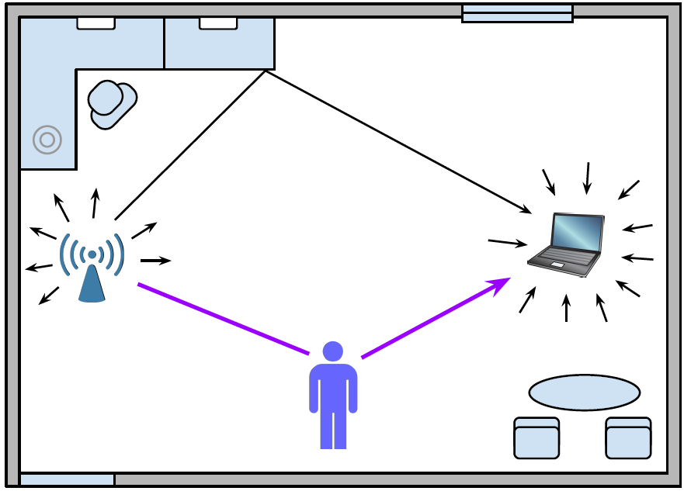
Project ideas - 2
RF based occupancy counting
  Detect if there is a human being in the room using a WiFi link
  Count the number of people in the room using wireless channel state change
  Collect and mine - RSSI or Channel State Information
Understand how absence and presence of a human changes WiFi signals

Slide 55
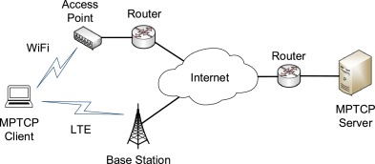
Project ideas - 3
Transport layer protocol for WiFi
  Implement split-TCP or multi-path TCP for wireless links
  Serve your laptop/phone with two TCP connections (MPTCP) – one on WiFi and other on cellular
https://www.sciencedirect.com/science/article/pii/S0140366417302426#fig0001

Slide 56
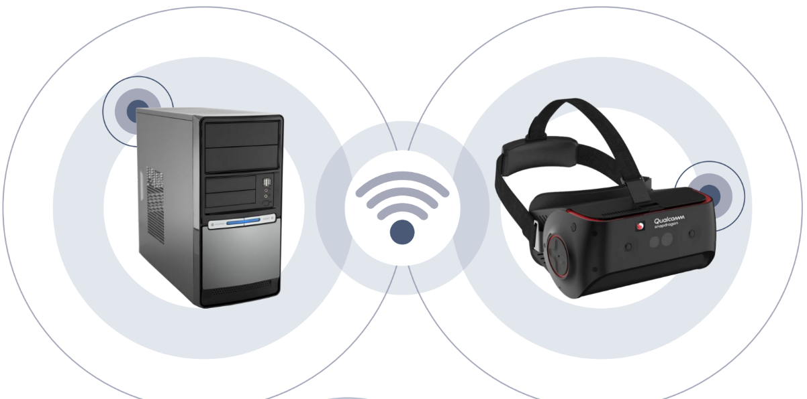
Project ideas - 4
Augmented reality (AR/VR) on multi-gigabit WiFi
  Test, evaluate and analyze the performance of multi-gigabit WiFi for delay sensitive applications like AR/VR
  360-degree camera connected to WiFi router
https://www.cnet.com/news/qualcomms-new-wireless-vr-headsets-work-with-pcs-too/

Slide 57
Project ideas - 5
Bluetooth beacons for context detection
  Detect user’s proximity
  Bluetooth low energy broadcast

Slide 58

Project ideas - 6
Wrist-worn wearable pedometer
  Use smartphone sensors for activity monitoring
  Interface with a wireless network for additional fidelity
Measure and process the accelerometer and gyroscope sensor data to count steps or recognize activities

Slide 59
Project ideas - 7
Gesture recognition using wearable sensors
  Design remote interaction applications
  American sign language recognition
  Use Bluetooth communication

Slide 60
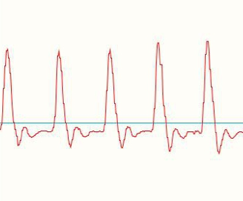
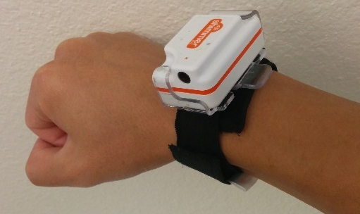
Project ideas - 8
Monitor heart rate using smartwatch
  Visible light signal reflection at different wavelengths
  Challenge – accuracy in presence of motion
Light
Reflection
Skin and tissues
[2] http://pulsesensor.com/products/pulse-sensor-amped
[3] Tamura, T.; Maeda, Y.; Sekine, M.; Yoshida, M. Wearable Photoplethysmographic Sensors—Past and Present. Electronics 2014,3, 282-302.

Slide 61


Project ideas - 9
Proximity based authentication
  Detect the distance between your personal devices (smartphone and laptop)
  Use the distance to authenticate
  Example – if users smartphone is closer to her laptop, infer user’s presence and unlock laptop
  Use audio waves - propagation time to determine distance
Measure distance

Slide 62
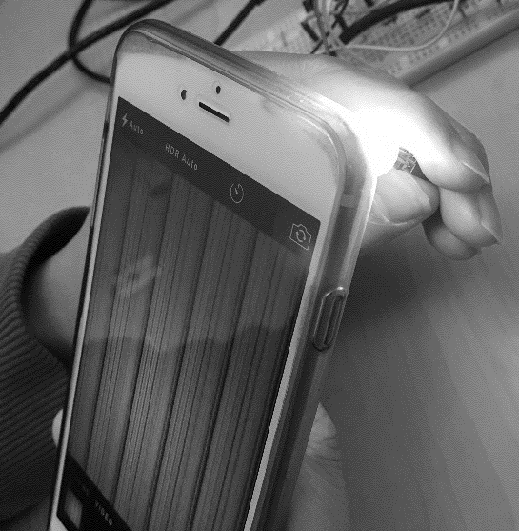
Project ideas – 10
Dynamic barcodes using LEDs
  Transmit information through LED, receive through smartphone camera
  Visible light communication
Characterize energy consumption of IoT protocols
  Smart homes, smart buildings applications
  Compare MQTT, CoAP etc. in terms of battery life

Slide 63
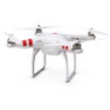
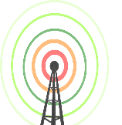
Project ideas – 11
Coverage for mobile clients in 60 GHz millimeter wave WLANs
  Beamwidth adaptation – directionality
  Simulations in NS-3
Routing protocols for multi-drone networks
  Design drone mobility models as per an application domain (i.e. precision farming)
  Evaluate routing protocols and provide improvements

Slide 64
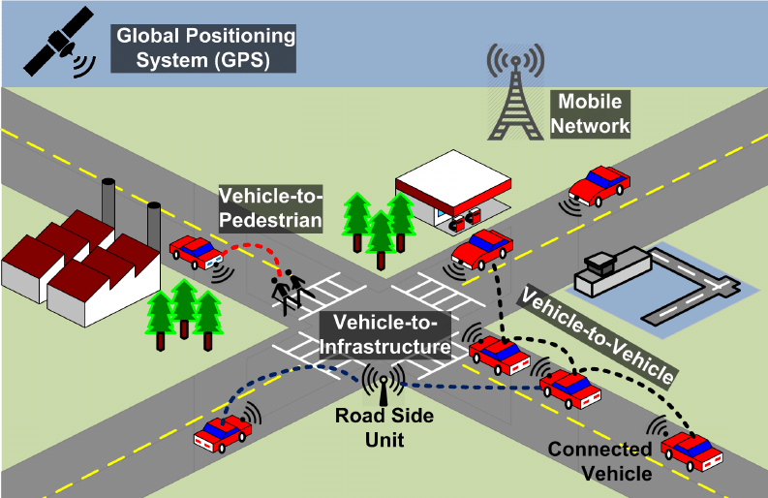
Project ideas – 12
Vehicle to vehicle communication
  Autonomous vehicles with high speed wireless links
  V2I and V2V communication with 802.11p/DSRC
  High density traffic, dynamic topologies
  NS-3 simulation

Slide 65
Project ideas
And more…
Develop other novel ideas
  Read related research and create new techniques/applications
  Can result in a research paper

Slide 66
Project platform
Real devices
  Smartphones, laptops, wearables, embedded platforms etc.
  Highly encouraged
  Limited hardware available – first come, first reserved
  Start thinking about your project now!
    What devices you will need? What you already have (smartphone, laptop)? What you need to borrow?
Simulators
  Network simulators (e.g. NS3) or others
  Develop own simulator using programming language of your choice (not recommended)

Slide 67
Next lecture
Wireless networking:
Medium Access Control (MAC) design

