Slide 1
Fair Division
CSE 516A: Multi-Agent Systems
Sujoy Sikdar

Slide 2
Resource Allocation Problem
A set of agents $N=\left\{1,2,…,n\right\}$
A set of resources $M$
Valuations
Valuation of agent $i$ is $v_{i}:2^{M}→ℝ$
Range is $ℝ_{+}$ when resources are goods, $ℝ_{−}$ when bads
Additive valuations: $∀X,Y$ with $X∩Y=∅,v_{i}\left(X∪Y\right)=v_{i}\left(X\right)+v_{i}(Y)$
Allocations
$A=\left(A_{1},…,A_{n}\right)∈Π_{n}(M)$, a partition of resources among the agents
$A_{i}∩A_{j}=∅, ∀i,j∈N; ∪_{i∈N}A_{i}=M$
$A$ is a partial allocation if $∪_{i∈N}A_{i}≠M$

Slide 3
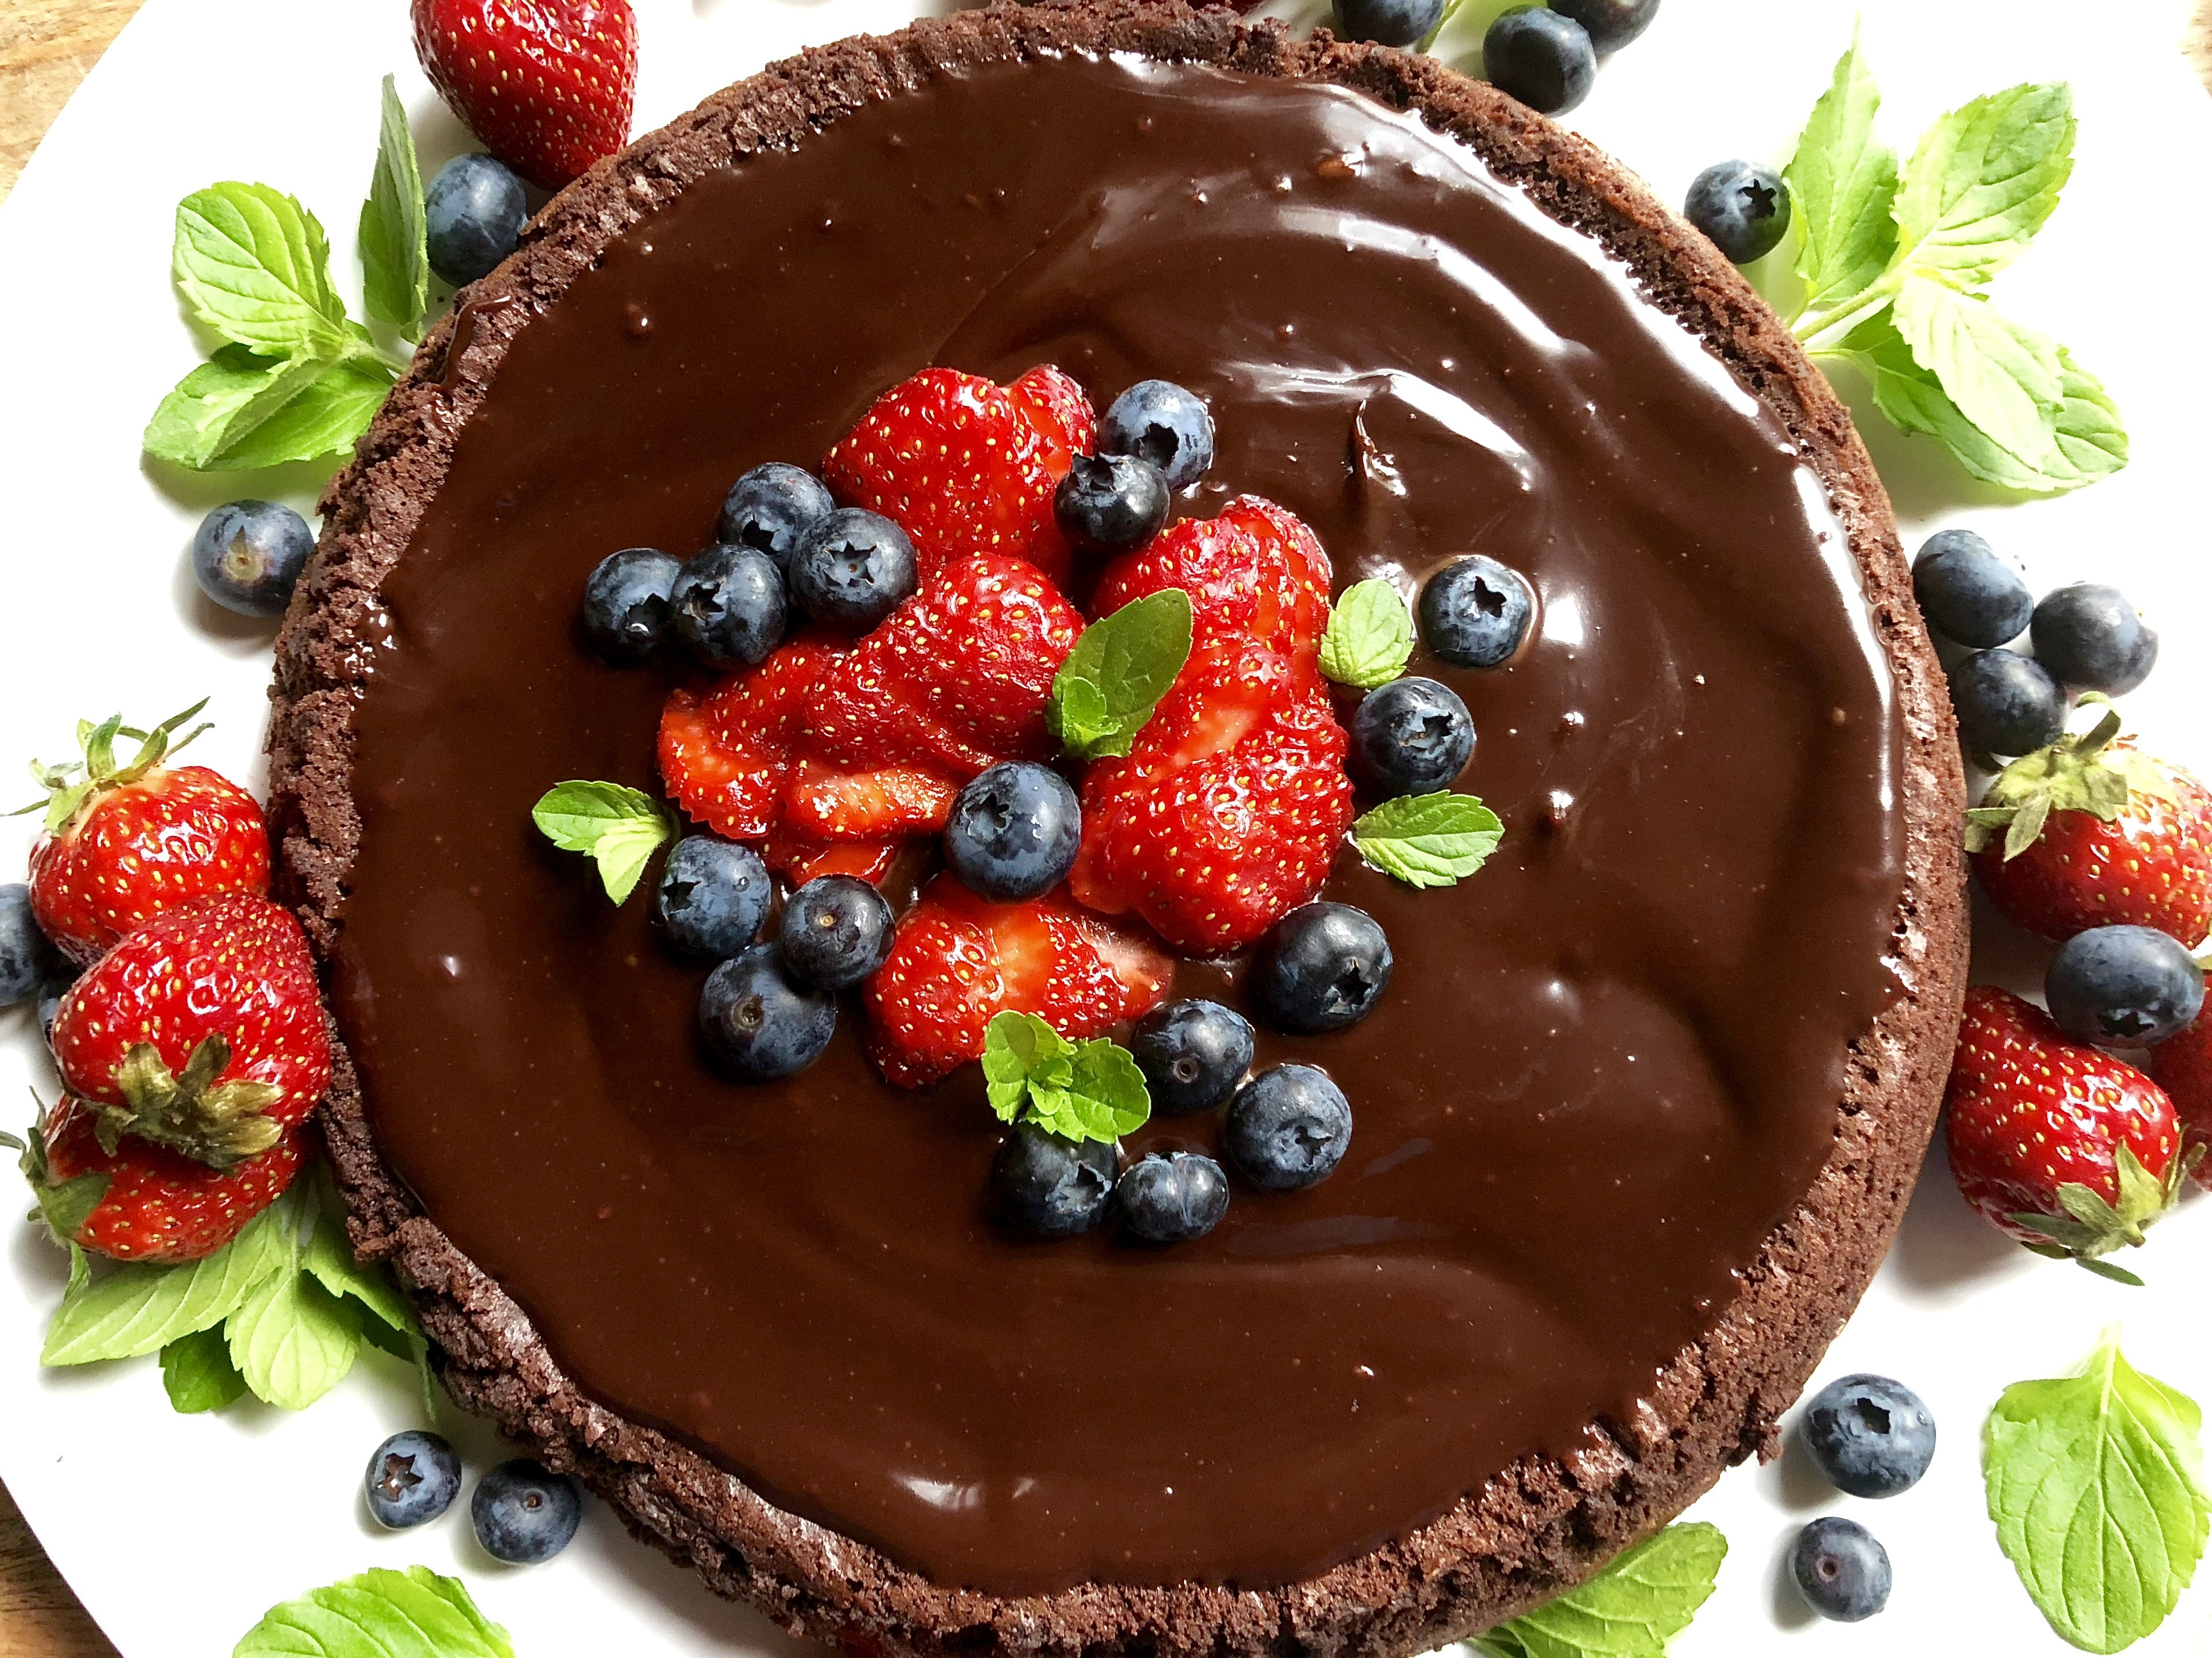
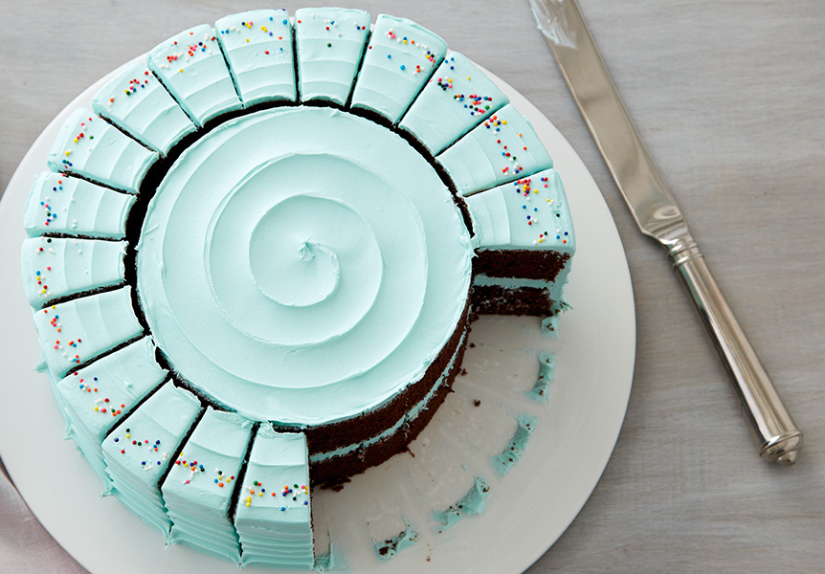
Cake Cutting
Resource: $M=\left[0,1\right]$
Heterogenous
Divisible
Constraints:
Full allocation (no waste)
Each $A_{i}∈𝒜$, where $𝒜$ is the set of finite union of disjoint intervals
Simple allocations
Each agent is allocated a single interval
Cuts cake at $n−1$ points

Slide 4
Fairness Desiderata
Proportionality (Prop)
$∀i∈N:v_{i}\left(A_{i}\right)≥\frac{1}{n}$
Every agent gets their fair share
Envy-Freeness (EF)
$∀i,j∈N:v_{i}\left(A_{i}\right)≥v_{i}(A_{j})$
No agent wishes she had another agents’ allocation
Equitability (EQ)
$∀i,j∈N:v_{i}\left(A_{i}\right)≥v_{j}(A_{j})$
All agent value their allocations equally
No agent is “jealous” of another agents’ allocation

Slide 5
Relationship between Fairness Criteria
EF $⇒$ Prop
$∀i, v_{i}\left(A_{i}\right)≥v_{i}\left(A_{j}\right), ∀j≠i$, Sum over all other agents
EQ incomparable to EF, Prop
Eg. When every agent values her allocation at 0 (EQ), but values every other agents’ allocation at 1 (not EF or Prop)

Slide 6
Prop: Cut and Choose
1 divides cake in two pieces X, Y
2 chooses the piece she prefers
1 divides the cake so that $v_{1}\left(X\right)=v_{1}\left(Y\right)=\frac{1}{2}$
The allocation is EF (therefore Prop)
Discrete
Continuous pieces
Minimum number of cuts

Slide 7
Computational Aspects: What is the input?
Time complexity for $n$ agents?
Valuations part of the input: how to encode them?
$v_{i}$’s are functions
May be infinite binary representation
Want: Running time as function of $n$

Slide 8
Robertson-Webb Model – Query Complexity
Access to $v_{i}$ restricted to two queries
$Eval_{i}(x,y)$ returns $v_{i}([x,y])$
$Cut_{i}(x,α)$ returns $y$ s.t. $v_{i}\left(\left[x,y\right]\right)=α$
How many queries for $n=2$?
2

Slide 9
Dubins-Spanier: Moving Knife
Referee starts at 0 and moves knife to the right
In $n−1$ rounds:
When the piece to the left of the knife is worth $\frac{1}{n}$ to a player, player shouts stop, gets the piece, exits
Last player gets remaining piece
How to implement using the two queries?

Slide 10
Dubins-Spanier: Query complexity
What is the query complexity?
$Θ(n^{2})$
Satisfies Prop
EF?
Can we do better?
Even-Paz $Θ\left(n\log{n}\right)$
Asymptotically optimal: Any Prop protocol needs $Ω(n\log{n})$ queries [Edmonds & Pruhs]

Slide 11
Envy-Freeness?
$n=2$: Cut and Choose
$n=3$:
Selfridge-Conway procedure
Discrete, number of cuts is not minimum
Stromquist procedure
Continuous, four simultaneous moving knives
$n=4$:
No known procedure with continuous pieces
Up to 5 cuts [Barbanel & Brams, 2004]
$n≥5$:
[Aziz & Mackenzie, 2016]: $O(n^{n^{n^{n^{n^{n}}}}})$ protocol!

Slide 12
Price of Fairness
Social welfare (SW) of $A=\sum_{i}{v_{i}(A_{i})}$
Price of EF:
Worst case (over valuation functions) ratio between:
SW of best allocation
SW of EF allocation
[Caragiannis et al., 2009]:
Price of Prop is $Θ\left(\sqrt{n}\right)$
Price of EF is $Ω\left(\sqrt{n}\right)$, upper bound?
Price of EQ is $Θ(n)$

Slide 13
Other Desiderata
Pareto Optimality (PO)
Notion of efficiency
No “obviously better” allocation
Strategyproofness (SP) / Incentive Compatibility
No agent should be able to gain by misreporting their valuation

Slide 14
Pareto Optimality (+ EF)
Always Exists [Weller, 1985]
Nash-optimal allocation:
Nash Welware: $Π_{i∈N}v_{i}(A_{i})$
Nash optimal allocation (MNW): $A^{∗}∈$ $\arg{\max{Π_{i∈N}v_{i}(A_{i})}}$
PO is easy to see
EF is non-trivial to prove
Hard to compute in general
Polynomial time for piecewise constant valuations
PO + EF + EQ not guaranteed to exist [Barbanel and Brams, 2011]

Slide 15
Strategyproofness
Deterministic:
[Menon & Larson, 2017]: No deterministic SP mechanism is (even approximately) proportional
Randomized:
[Chen et al., 2013, Mosel & Tamuz, 2010]: There is a randomized SP mechanisms that always returns an EF allocation

Slide 16
Perfect Partition
Perfect partition [Lyapunov, 1940] $(B_{1},…,B_{n})$ of the cake such that
$v_{i}\left(B_{j}\right)=\frac{1}{n}, ∀i,j∈N$
That only cuts the cake at $poly(n)$ points [Alon, 1987]
Black box to design SP-in-expectation + EF mechanism
Assign the $n$ bundles to $n$
EF:
Every agent values every bundle at $\frac{1}{n}$
SP-in-expectation:
Agent is assigned a random bundle, expected utility is $\frac{1}{n}$, irrespective of report

Slide 17
Fair Division of Indivisible Goods
Resources: Set of indivisible goods $M=\{g_{1},…,g_{n}\}$
Allocation: $A=\left(A_{1},…,A_{n}\right)∈Π_{n}\left(M^{′}\right)$, a partition of some $M^{′}⊆M$
Valuations: $v_{i}:2^{M}→ℝ_{+}$
EF allocation may not exist
No Equal treatment of equals

Slide 18
Approximate Envy-Freeness
Envy-free up to any (one) good (EFX): [Caragiannis et al. 2016]
$v_{i}\left(A_{i}\right)≥v_{i}\left(A_{j}∖\left\{g\right\}\right), ∀g∈A_{j}$
Envy is eliminated by removing any one good allocated to the envied agent
Envy is eliminated by removing the least valued good allocated to the envied agent
Existence unknown (See [Plaut & Roughgarden, 2018])
Envy-freeness up to one good (EF1):
For every pair of agents $i,j∈N$, there exists a good $g∈A_{j}$ such that
$v_{i}\left(A_{i}\right)≥v_{i}\left(A_{j}∖\{g\}\right)$
$i$ may envy $j$, but the envy can be eliminated by removing a single good from $j$’s bundle
(or $A_{j}=∅$)

Slide 19
Round Robin Algorithm
Fix order of agents
Proceed in $m$ rounds:
In each round $k$, agent $k$ mod $n$ picks her favorite remaining item
Envy-free up to the items selected in round 1
Not PO

Slide 20
Greedy Algorithm
[Lipton et al., 2004]
One by one:
Allocate a good to an agent no one envies
While there is an envy cycle:
Pick a cycle
Pass allocations along the cycle
Ends in polynomial number of steps
No change in edges involving agents outside cycle
Possibly fewer outward edges from agents in the cycle
Strictly fewer edges between agents in the cycle

Slide 21
Greedy algorithm is EF1
EF1: By remove the most recently added good from envied agent
Bounded (by maximum marginal value) envy:
$α=\arg{\max_{i∈N,S⊂M}{v_{i}\left(S∪\left\{g\right\}\right)−v_{i}(S)}}$
Let $A^{k}$ denote (partial) allocation at round $k$
At any round $k$,
Suppose envy graph was acyclic in rounds $1,…,k−1$
Allocate $g_{k}$ to a source agent in the envy graph
For every $j∈N, v_{j}\left(A_{i}^{k}\right)≤v_{j}\left(A_{i}^{k−1}\right)+α$
Eliminate any cycles at round $k$
Not PO

Slide 22
Maximum Nash Welfare: EF1 + PO
[Caragiannis et al., 2016]
PO is easy to see
EF1: By removing the most valued good from every agents’ bundle
Up to which good? (Sketch)
Any $g^{∗}∈\arg{\max_{g∈A_{j}}{v_{j}(A_{j})}}$ [Conitzer et al., 2019]
A is MNW $⇒∀g∈A_{j}, v_{i}\left(A_{i}\right)v_{j}\left(A_{j}\right)≤v_{i}\left(A_{i}+g\right)v_{j}\left(A_{j}−g\right)$
Some algebra later: $\frac{v_{i}\left(g\right)}{v_{i}(A_{i})}≤\frac{v_{j}\left(g\right)}{v_{j}(A_{j}−g)}$
Let $g^{∗}∈\arg{\max_{g∈A_{j}}{v_{j}\left(g\right)}},$
$\frac{v_{i}\left(g\right)}{v_{i}(A_{i})}≤\frac{v_{j}\left(g\right)}{v_{j}\left(A_{j}−g^{∗}\right)}$
Sum over all $g∈A_{j}−g^{∗}$, $v_{i}\left(A_{j}−g^{∗}\right)≤v_{i}(A_{i})$

Slide 23
More EF1 + PO
[Barman et al., EC 2018]: Pseudo-polynomial time algorithm using Fisher markets
[Barman et al., AAMAS 2018]: Polynomial time algorithm for MNW allocation for binary valuations

Slide 24
Envy Freeness through Information Withholding
[Hosseini et al., 2019]
Envy-freeness with hidden goods (HEF-$k$):
$A$ is envy-free up to $k$ hidden goods (HEF-$k$) if there exists a set $S⊆M$ of at most $k$ goods such that for every pair of agents $i,j∈N$:
$v_{i}\left(A_{i}\right)≥v_{j}(A_{j}∖S)$
Envy-free up to $k$ uniformly hidden goods (uHEF-$k$) if for every agent $i∈N$: $|A_{i}∩S|≤1$
Satisfied by Round Robin, Envy Graph, MNW
What is the smallest number of goods which must be hidden?
HEF-$k$-Verification: Given an allocation, can we eliminate envy by hiding at most $k$ goods?
HEF-$k$-Existence: Does an HEF-$k$ allocation exist?

Slide 25
HEF in practice: Non-EF instances
Binary valuations generate using a biased ($p=0.7$) coin
See [Dickerson et al., 2014, Manurangsi & Suksompong, 2018]

Slide 26
HEF in practice: # hidden goods; worst-case
Binary valuations generate using a biased ($p=0.7$) coin

Slide 27
HEF: Computatability
HEF-$k$-Existence NP-complete even for identical valuations
Reduction from Partition problem
EF-Existence is NP-complete even for binary valuations
Therefore HEF-$k$-Existence is NP-complete for $k=0$
NP-hard to check if instance admits HEF-$k$ + PO allocation
HEF-$k$-Verification NP-hard to approximate to within $\left(1−ε\right)\log{E}$, even for binary valuations, where $E$ is aggregate envy
Reduction from Hitting Set
Standard greedy submodular maximization algorithm

Slide 28
Various EF1 Algorithms in Practice
On data from Spliddit [Goldman & Procaccia, 2014]

Slide 29
(Approximately) Equitable Allocations
Equitability up to one good (EQ1): For every pair $i,j∈N,$ there exists a good $g∈A_{j}$ such that:
$v_{i}\left(A_{i}\right)≥v_{j}(A_{j}∖\{g\})$
Equitability up to any good (EQX): For every pair $i,j∈N, ∀g∈A_{j}, v_{i}\left(A_{i}\right)≥v_{j}(A_{j}∖\{g\})$
Always exists [Gourves et al., 2014]
[Freeman et al., 2019]:
EQ1+PO NP-hard to determine existence
EQ1+EF1+PO in polynomial time for binary valuations whenever it exists

Slide 30
Proportionality up to One Good
Proportionality up to one good (Prop1): for every $i∈N$, there exists a good $g∈M∖A_{i}$, such that $v_{i}\left(A_{i}∪\left\{g\right\}\right)≥\frac{1}{n}v_{i}(M)$ [Conitzer et al. 2017]
Any algorithm which is EF1+PO is also Prop1+PO
Can be computed in polynomial time [Barman & Krishnamoorthy, 2019]

Slide 31
Randomized Algorithms
$m=n$ (for now)
Random Priority (RP)
Order agents uniformly at random
Each agent picks favorite remaining item in turn
Probability share of item is probability with which it is consumed
Probabilistic Serial (PS) [Bogomolnaia & Moulin, 2001]
In $n$ rounds,
Every agent “eats” their favorite remaining item simultaneously at a constant, uniform rate
Probability shares equal to the fraction of item eaten
Equal treatment of equals

Slide 32
Fair, Efficient, and Strategyproof Assignments?
Assignment $P$ is a doubly stochastic matrix
Row $i$ is $n$-vector of agents’ allocation
Stochastic dominance (sd)
$p$stochastically dominates $q$ if at every good $g$, $\sum_{h≽g}{p_{h}}≥\sum_{h≽g}{q_{h}}$
RSD is weak-sd-EF + sd-SP + ex-post PO
PS is sd-efficient, sd-EF, weak sd-SP

Slide 33
Acknowledgements
These slides borrow heavily from:
Tutorial on fair division by Nisarg Shah and Rupert Freeman, EC-19
http://www.cs.toronto.edu/~nisarg/papers/Fair-Division-Tutorial.pdf
Lectures by Nisarg Shah
http://www.cs.toronto.edu/~nisarg/teaching/2556s19/slides/2556s19-L6.pdf
Lectures by Ariel Procaccia and Alex Psomas
http://www.cs.cmu.edu/~15896/slides/896f18-1.pdf
http://www.cs.cmu.edu/~15896/slides/896f18-2.pdf
http://www.cs.cmu.edu/~15896/slides/896f18-5.pdf
Lectures by Lirong Xia
No public link
Lecture series on Fair Division
https://www.youtube.com/watch?v=NQf_RqmJ9p8
and more…

