Slide 1
Aura: An Architectural Framework for User Mobility in Ubiquitous Computing Environments
Presented by:
Ashirvad Naik
April 20, 2010

Slide 2
Outline
Introduction
Aura’s Architecture
Aura at Work
Limitations and Future Work

Slide 3
Introduction

Slide 4
Ubiquitous Computing
The environment has lots of computing, storage, and communication capabilities
Leverage Moore’s law
The environment is device rich
Displays, cameras, touch screens, microphones, etc.
Multi-modal interaction between users and the system
The goal is to help the user with a broad set of tasks in an efficient way
Access to information, preparing documents, etc.

Slide 5
Approaches to user mobility
Support as much of a user’s computing needs as possible on a mobile machine.
To compute via remote access to a computing server that stores a users personal state and preferences
provide standard applications that are ported to and installed in all environments
provide standard virtual platforms (such as the Java Virtual Machine) that enable mobile code to follow the user as needed

Slide 6
Problems with these approaches
To some degree they assume a homogenous computing baseline, they cannot take full advantage of the diverse capabilities of each environment
Lack the ability to handle dynamic variations of capabilities and resources in the environment without overburdening the user with manual tuning and reconfiguration

Slide 7
Aura – An alternative solution
An architectural framework for ubiquitous computing applications
Key features:
User tasks become first class entities that are represented explicitly and autonomously from a specific environment
User tasks are represented as coalitions of abstract services
Environments are equipped to self-monitor and renegotiate task support in the presence of run time variation of capabilities and resources

Slide 8
Benefits
Representing user tasks explicitly
Provides a placeholder to capture user intent
Guides the search for suitable configurations in each new environment
Representing tasks as service coalitions
Infrastructure can recognize when all the essential services in a task can be supported, instantiating them jointly when possible
Provide early warning to the user that that is not possible

Slide 9
Aura’s Architecture

Slide 10
Goals
Maximize the use of available resources – that is, effectively exploiting the increasingly pervasive computing and communication resources in our environments
Minimize user distraction and drains on user attention by forcing him to manual tune and reconfigure with respect to change in environment.

Slide 11
Concept of personal Aura
Aura acts as a proxy for the mobile user it represents
When a user enters a new environment, his or her Aura marshals the appropriate resources to support the user’s task.
Aura captures constraints that the physical context around the user imposes on tasks

Slide 12
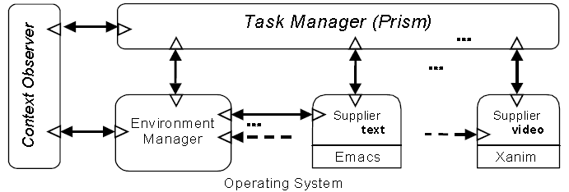
Aura architectural framework

Slide 13
Task Manager (Prism)
Prism embodies the concept of a personal Aura
The key idea behind Prism is a platform-independent description of user tasks
It strives to minimize user distractions in the face of the following four kinds of change:
The user moves to another environment
The environment changes
The task changes
The context changes

Slide 14
Service Suppliers
Suppliers provide the abstract services that tasks are composed of
These abstract services are implemented by wrapping existing applications and services to conform to Aura APIs
Such wrappers play a fundamental role while instantiating a task based on its platform-independent description

Slide 15
Context Observer
Provide information about the physical context. Example: location, recognition (authentication), activity
Report events in the physical context back to Prism and the Environment Manager
The more sophisticated a Context Observer, the less Prism has to rely on explicit indications from a user concerning his intentions

Slide 16
Environment Manager
Aware of which Suppliers are available to supply which services, and where they can be deployed
When Suppliers are installed in an environment, they become registered with the local Environment Manager
Registry is the base for matching requests for services
Registry also keeps track of the available capacity of suppliers
Evaluates each alternative configuration of service suppliers to select the one that presents a better match to the user’s preferences

Slide 17
Self adaptation in Aura
Addressed at two levels:
At the higher level, the infrastructure monitors the availability and performance of whole components and of the communications infra­structure, evaluating possible alternatives for supporting a user task when the requirements for such a task are not met by the current configuration
At the lower level, system components themselves are endowed with the ability to adjust their operation following the variation of available resources using user defined utility functions

Slide 18
Aura at Work

Slide 19
Fred goes from home to the office

Slide 20
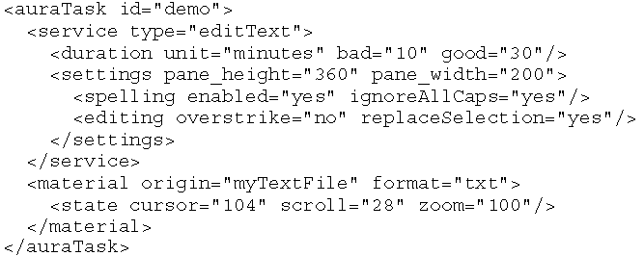
Example of service description

Slide 21
Limitations and Future Work

Slide 22
Limitations
Supports the migration of simple user tasks interchangeably between personal computers running Windows or Linux
Limited supplier of services
Environment Manager has basic service registry abilities, and relies on distributed file systems like Coda for file access across environments
Not yet integrated research on context observation.

Slide 23
Limitations
While the current implementation shows the feasibility of automated task migration it is limited by
Granularity of the task components (full applications working separately from each other)
Inability to anticipate or infer what the user wants to do next

Slide 24
Future Work
To address these problems, we have begun to develop support for finer-grained tasks and richer models of user intent.
To support a spectrum of task models ranging from simple invocation of applications to sophisticated models that can anticipate immediate needs of users, or even assist them in accomplishing some complex multi-step activity (like financial planning, travel assistance, or health management.)

Slide 25
Future Work
Aura must strike a balance between user involvement and automatic inference of user intent.
Our assumption is that an Aura should prove useful even with no deeper knowledge of the task beyond the coalition of services currently being used.
Approach should prove useful only with rudimentary context awareness, specifically recognizing a user entering and leaving a given environment

