Slide 1
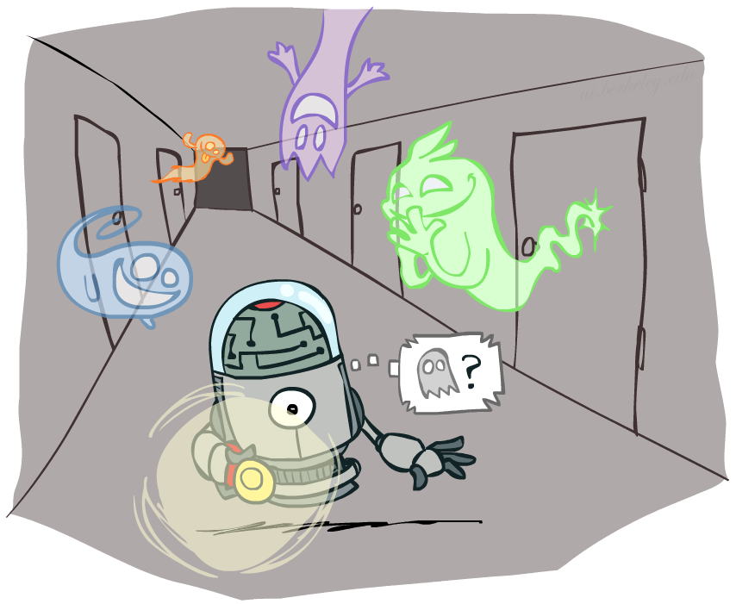
CS 580: Introduction to Artificial Intelligence
Hidden Markov Models
Prof. Xuesu Xiao
George Mason University
[Based on slides created by Dan Klein and Pieter Abbeel for CS188 Intro to AI at UC Berkeley. All original materials available at http://ai.berkeley.edu.]
Notes:
Please retain proper attribution, including the reference to ai.berkeley.edu. Thanks!

Slide 2


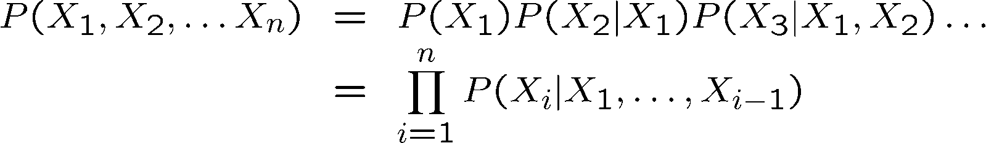

Probability Recap
Conditional probability
Product rule
Chain rule
X, Y independent if and only if:
X and Y are conditionally independent given Z if and only if:

Slide 3

Reasoning over Time or Space
Often, we want to reason about a sequence of observations
  Speech recognition
  Robot localization
  User attention
  Medical monitoring
Need to introduce time (or space) into our models

Slide 4


Markov Models
  Value of X at a given time is called the state
  Parameters: called transition probabilities or dynamics, specify how the state evolves over time (also, initial state probabilities)
  Stationarity assumption: transition probabilities the same at all times
  Same as MDP transition model, but no choice of action
  A (growable) BN: We can always use generic BN reasoning on it if we truncate the chain at a fixed length
X₁
X₂
X₃
X₄

Slide 5

Markov Assumption: Conditional Independence
Basic conditional independence:
  Past and future independent given the present
  Each time step only depends on the previous
  This is called the (first order) Markov property

Slide 6
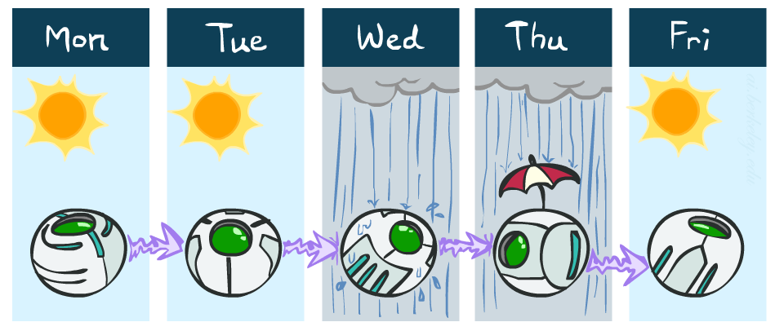
Example Markov Chain: Weather
States: X = {rain, sun}
Initial distribution: 1.0 sun
CPT P(X_{t} | X_{t-1}):
Two new ways of representing the same CPT
X_{t-1} | X_{t} | P(X_{t}|X_{t-1})
sun | sun | 0.9
sun | rain | 0.1
rain | sun | 0.3
rain | rain | 0.7
0.9
0.3
0.9
rain
sun
sun
sun
0.1
0.3
rain
rain
0.7
0.7
0.1

Slide 7
Example Markov Chain: Weather
0.9
0.3
Initial distribution: 1.0 sun
What is the probability distribution after one step?
rain
sun
0.7
0.1

Slide 8
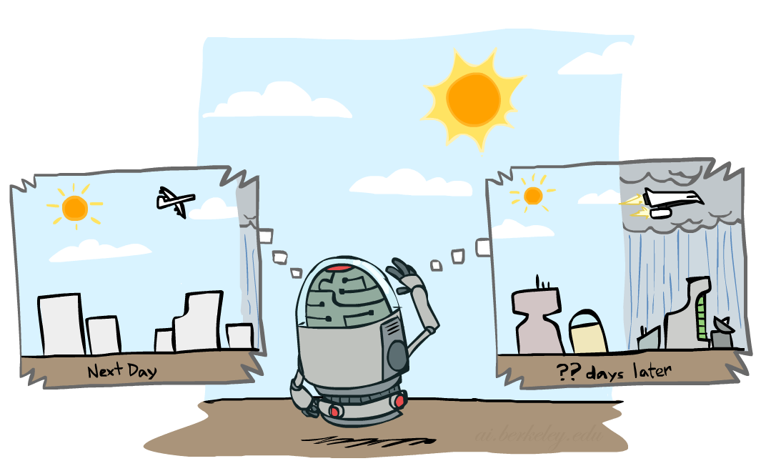

Mini-Forward Algorithm
Question: What’s P(X) on some day t?
X₁
X₂
X₃
X₄
Forward simulation

Slide 9
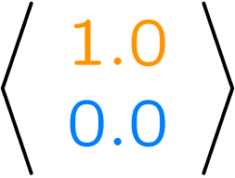
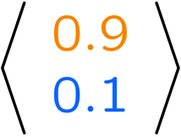
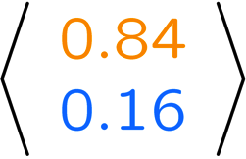
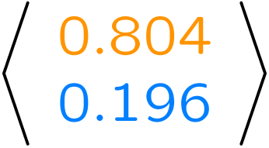
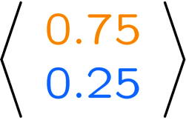
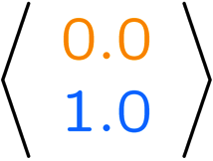
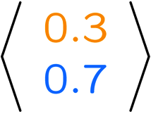
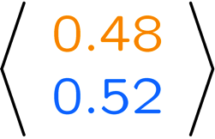
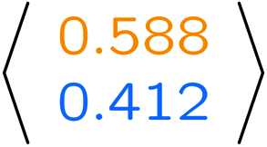
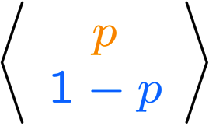
Example Run of Mini-Forward Algorithm
From initial observation of sun
From initial observation of rain
From yet another initial distribution P(X₁):
P(X₁)
P(X₂)
P(X₃)
P(X₄)
P(X∞)
P(X₁)
P(X₂)
P(X₃)
P(X₄)
P(X∞)
…
P(X₁)
P(X∞)

Slide 10

Video of Demo Ghostbusters Basic Dynamics

Slide 11
Video of Demo Ghostbusters Circular Dynamics

Slide 12
Video of Demo Ghostbusters Whirlpool Dynamics

Slide 13

Stationary Distributions
For most chains:
  Influence of the initial distribution gets less and less over time.
  The distribution we end up in is independent of the initial distribution
Stationary distribution:
  The distribution we end up with is called the stationary distribution of the chain
  It satisfies

Slide 14
Example: Stationary Distributions
Question: What’s P(X) at time t = infinity?
X₁
X₂
X₃
X₄
X_{t-1} | X_{t} | P(X_{t}|X_{t-1})
sun | sun | 0.9
sun | rain | 0.1
rain | sun | 0.3
rain | rain | 0.7
Also:

Slide 15
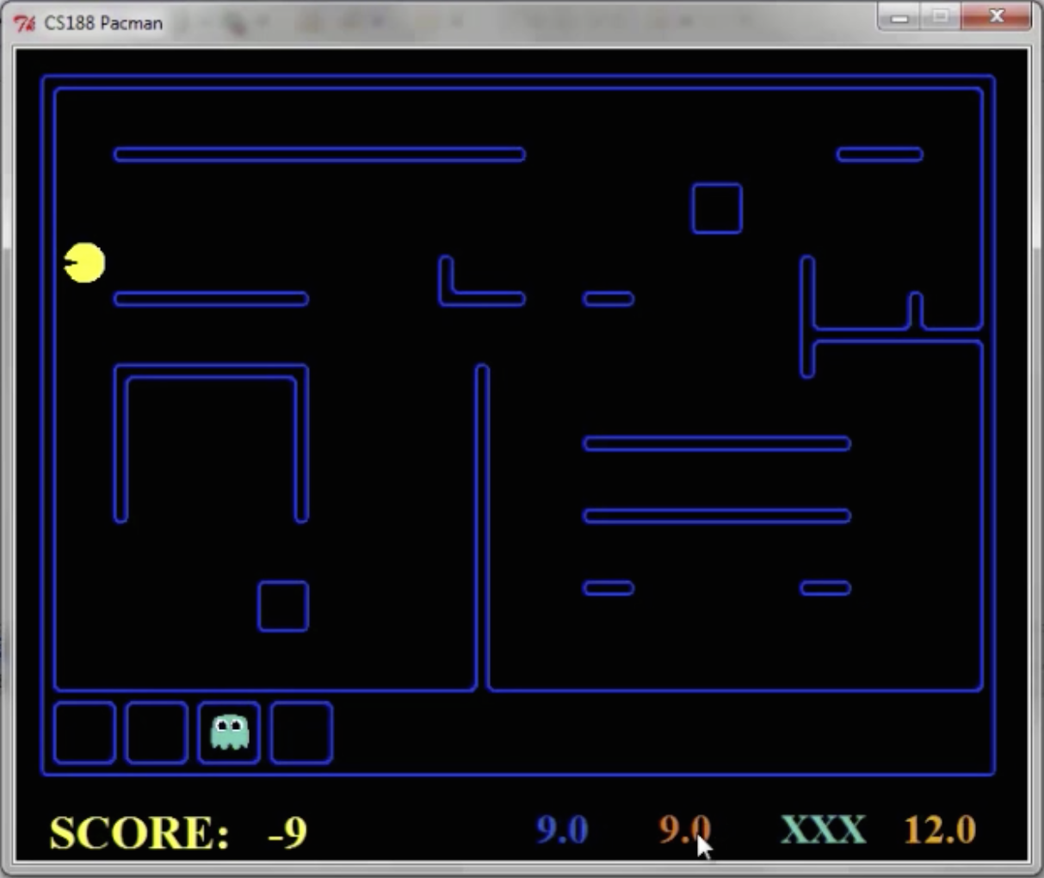
Pacman – Sonar (P4)

Slide 16
Video of Demo Pacman – Sonar (no beliefs)

Slide 17

Hidden Markov Models

Slide 18
Hidden Markov Models
Markov chains not so useful for most agents
  Need observations to update your beliefs
Hidden Markov models (HMMs)
  Underlying Markov chain over states X
  You observe outputs (effects) at each time step
X₁
X₂
X₃
X₄
X₅
E₁
E₂
E₃
E₄
E₅

Slide 19


Example: Weather HMM
Rain_{t-1}
Rain_{t}
Rain_{t+1}
Umbrella_{t-1}
Umbrella_{t}
Umbrella_{t+1}
An HMM is defined by:
  Initial distribution:
  Transitions:
  Emissions:
R_{t} | R_{t+1} | P(R_{t+1}|R_{t})
+r | +r | 0.7
+r | -r | 0.3
-r | +r | 0.3
-r | -r | 0.7
R_{t} | U_{t} | P(U_{t}|R_{t})
+r | +u | 0.9
+r | -u | 0.1
-r | +u | 0.2
-r | -u | 0.8
Notes:
demo

Slide 20

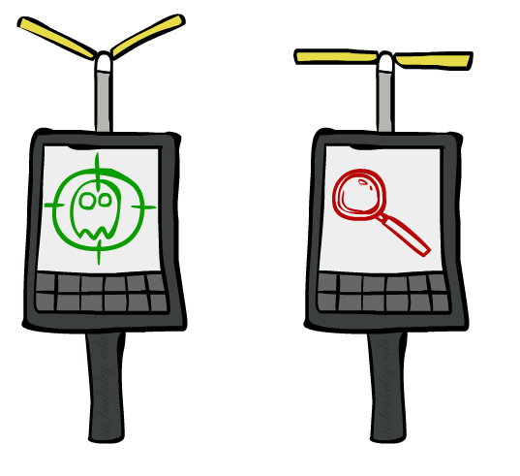
Example: Ghostbusters HMM
P(X₁) = uniform
P(X|X’) = usually move clockwise, but sometimes move in a random direction or stay in place
P(R_{ij}|X) = same sensor model as before:
red means close, green means far away.
1/9
1/9
1/9
1/9
1/9
1/9
1/9
1/9
1/9
P(X₁)
1/6
1/6
1/2
0
1/6
0
X₁
X₂
X₃
X₄
0
0
0
X₅
P(X|X’=<1,2>)
R_{i,j}
R_{i,j}
R_{i,j}
R_{i,j}
Notes:
Dan has some demo for this.

Slide 21
Video of Demo Ghostbusters – Circular Dynamics -- HMM

Slide 22
Joint Distribution of an HMM
X₁
X₂
X₃
X₅
E₁
E₂
E₃
E₅
  Joint distribution:
  More generally:

Slide 23
Chain Rule and HMMs
X₁
X₂
X₃
E₁
E₂
E₃
From the chain rule, every joint distribution over can be written as:
Assuming that
gives us the expression posited on the previous slide:

Slide 24
Chain Rule and HMMs
X₁
X₂
X₃
E₁
E₂
E₃
From the chain rule, every joint distribution over can be written as:
Assuming that for all t:
  State independent of all past states and all past evidence given the previous state, i.e.:
  Evidence is independent of all past states and all past evidence given the current state, i.e.:
gives us the expression posited on the earlier slide:

Slide 25
Implied Conditional Independencies
X₁
X₂
X₃
E₁
E₂
E₃
Many implied conditional independencies, e.g.,

Slide 26
Real HMM Examples
Speech recognition HMMs:
  Observations are acoustic signals (continuous valued)
  States are specific positions in specific words (so, tens of thousands)
Machine translation HMMs:
  Observations are words (tens of thousands)
  States are translation options
Robot tracking:
  Observations are range readings (continuous)
  States are positions on a map (continuous)

Slide 27
Filtering / Monitoring
Filtering, or monitoring, is the task of tracking the distribution B_{t}(X) = P_{t}(X_{t} | e₁, …, e_{t}) (the belief state) over time
We start with B₁(X) in an initial setting, usually uniform
As time passes, or we get observations, we update B(X)
The Kalman filter was invented in the 60’s and first implemented as a method of trajectory estimation for the Apollo program
Notes:
Dan has some demo for this

Slide 28
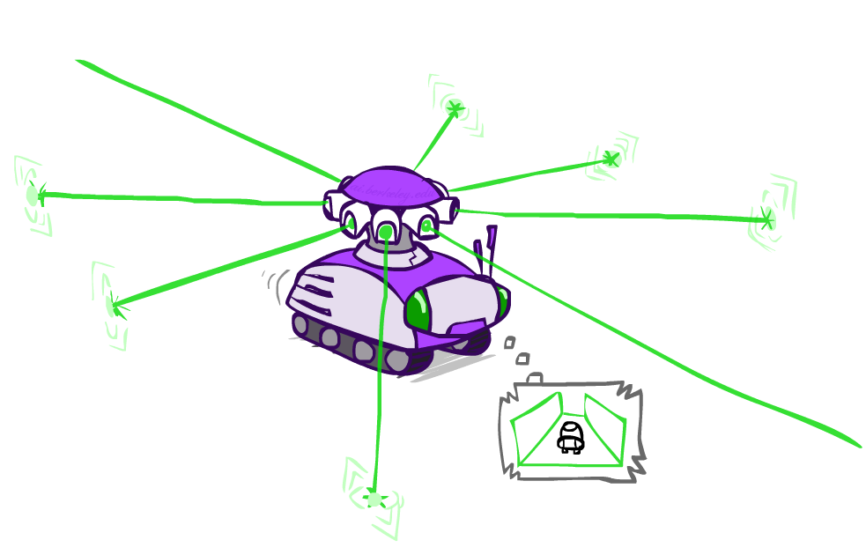
Example: Robot Localization
Example from Michael Pfeiffer
Prob
0
1
t=0
Sensor model: can read in which directions there is a wall, never more than 1 mistake
Motion model: may not execute action with small prob.

Slide 29
Example: Robot Localization
Prob
0
1
t=2

Slide 30
Example: Robot Localization
Prob
0
1
t=2

Slide 31
Example: Robot Localization
Prob
0
1
t=3

Slide 32
Example: Robot Localization
Prob
0
1
t=4

Slide 33
Example: Robot Localization
Prob
0
1
t=5

Slide 34


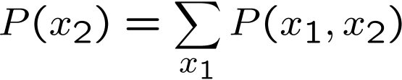

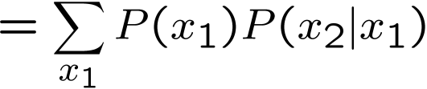

Inference: Base Cases
X₁
X₁
X₂
E₁

Slide 35

Passage of Time
Assume we have current belief P(X | evidence to date)
Then, after one time step passes:
Basic idea: beliefs get “pushed” through the transitions
  With the “B” notation, we have to be careful about what time step t the belief is about, and what evidence it includes
X₁
X₂
Or compactly:
Notes:
TODO: intermediate step in derivation!

Slide 36

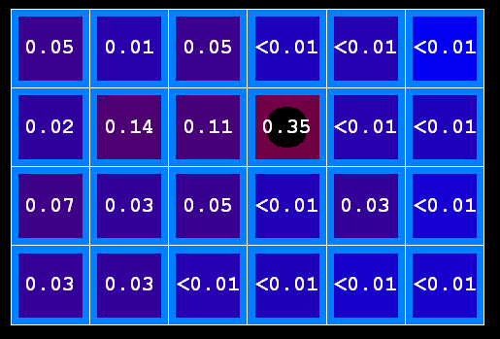

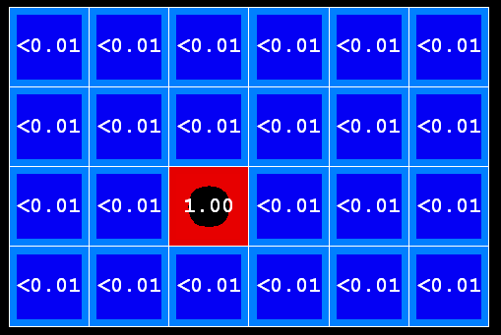
Example: Passage of Time
As time passes, uncertainty “accumulates”
(Transition model: ghosts usually go clockwise)
T = 1
T = 2
T = 5

Slide 37
Observation
X₁
Assume we have current belief P(X | previous evidence):
Then, after evidence comes in:
Or, compactly:
E₁
Basic idea: beliefs “reweighted” by likelihood of evidence
Unlike passage of time, we have to renormalize
Notes:
Basic idea: beliefs “reweighted” by likelihood of evidence
Unlike passage of time, we have to renormalize

Slide 38



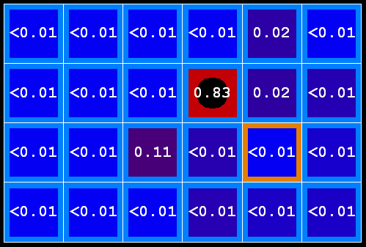
Example: Observation
As we get observations, beliefs get reweighted, uncertainty “decreases”
Before observation
After observation

Slide 39

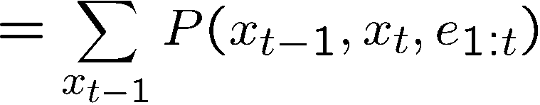
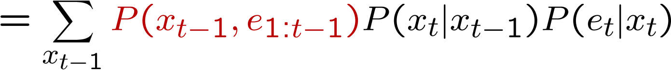
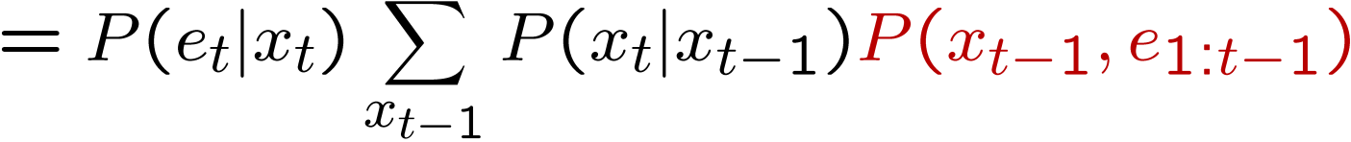
Putting it All Together: The Forward Algorithm
We are given evidence at each time and want to know
We can derive the following updates
We can normalize as we go if we want to have P(x|e) at each time step, or just once at the end…
Notes:
TODO: explain propto and it’s X_t, not X

Slide 40
Online Belief Updates
Every time step, we start with current P(X | evidence)
We update for time:
We update for evidence:
The forward algorithm does both at once (and doesn’t normalize)
X₁
X₂
X₂
E₂

Slide 41
Example: Weather HMM
B’(+r) = 0.5
B’(-r) = 0.5
B’(+r) = 0.627
B’(-r) = 0.373
B(+r) = 0.5
B(-r) = 0.5
B(+r) = 0.818
B(-r) = 0.182
B(+r) = 0.883
B(-r) = 0.117
Rain₀
Rain₁
Rain₂
R_{t} | R_{t+1} | P(R_{t+1}|R_{t})
+r | +r | 0.7
+r | -r | 0.3
-r | +r | 0.3
-r | -r | 0.7
R_{t} | U_{t} | P(U_{t}|R_{t})
+r | +u | 0.9
+r | -u | 0.1
-r | +u | 0.2
-r | -u | 0.8
Umbrella₁
Umbrella₂
Notes:
demo

Slide 42
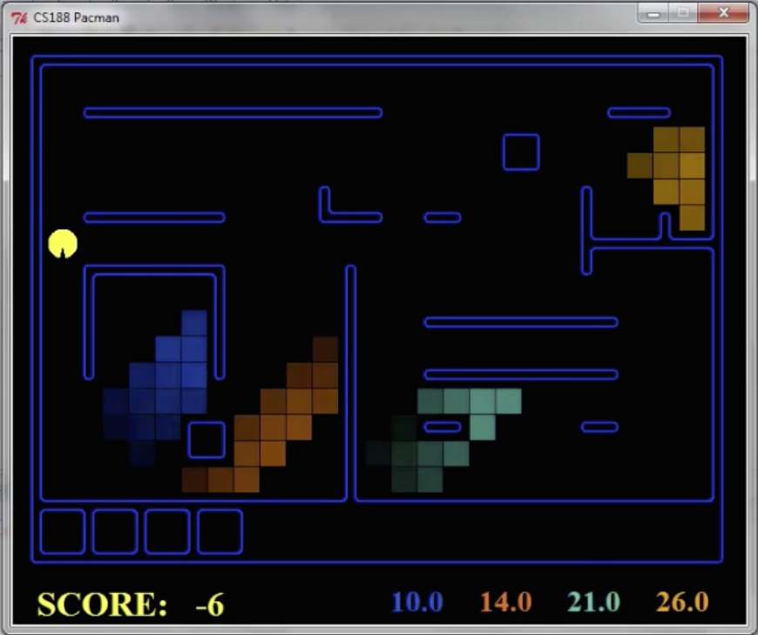
Pacman – Sonar (P4)

Slide 43
Video of Demo Pacman – Sonar (with beliefs)

Slide 44
Next Time: Particle Filtering and Applications of HMMs

