Slide 1
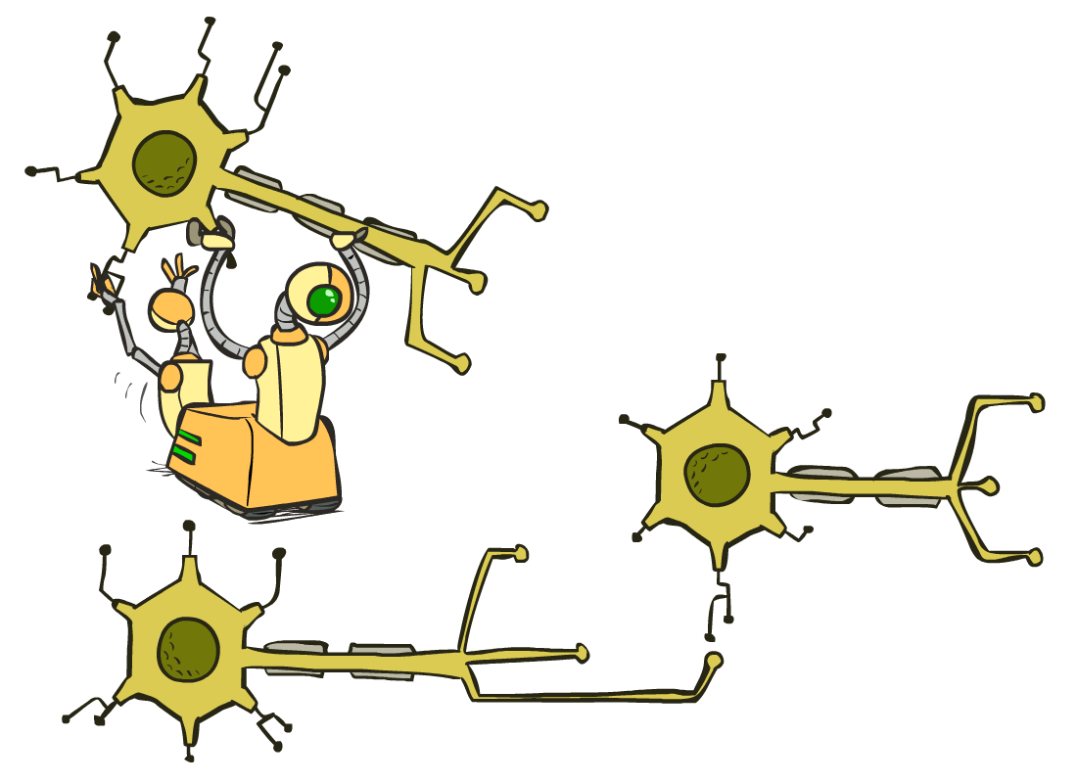
CS 580: Introduction to Artificial Intelligence
Neural Nets
Prof. Xuesu Xiao
George Mason University
[Based on slides created by Dan Klein and Pieter Abbeel for CS188 Intro to AI at UC Berkeley. All original materials available at http://ai.berkeley.edu.]
Notes:
Please retain proper attribution, including the reference to ai.berkeley.edu. Thanks!

Slide 2
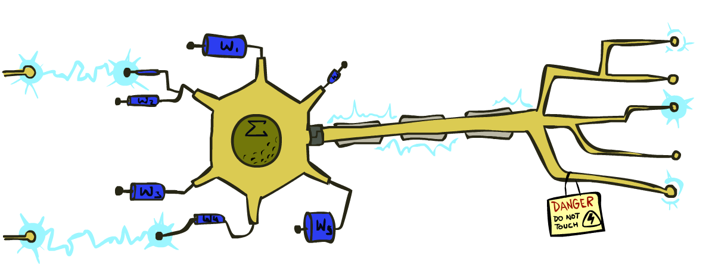
Reminder: Linear Classifiers
Inputs are feature values
Each feature has a weight
Sum is the activation
If the activation is:
Positive, output +1
Negative, output -1
w₁
f₁
Σ
w₂
>0?
f₂
w₃
f₃

Slide 3
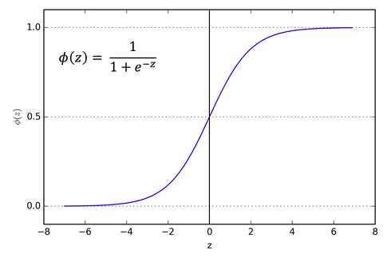
How to get probabilistic decisions?
Activation:
If very positive -> want probability going to 1
If very negative -> want probability going to 0
Sigmoid function

Slide 4
Best w?
Maximum likelihood estimation:
with:
= Logistic Regression

Slide 5
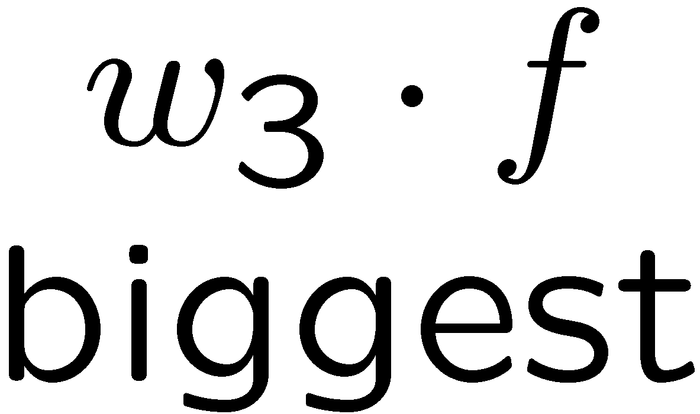
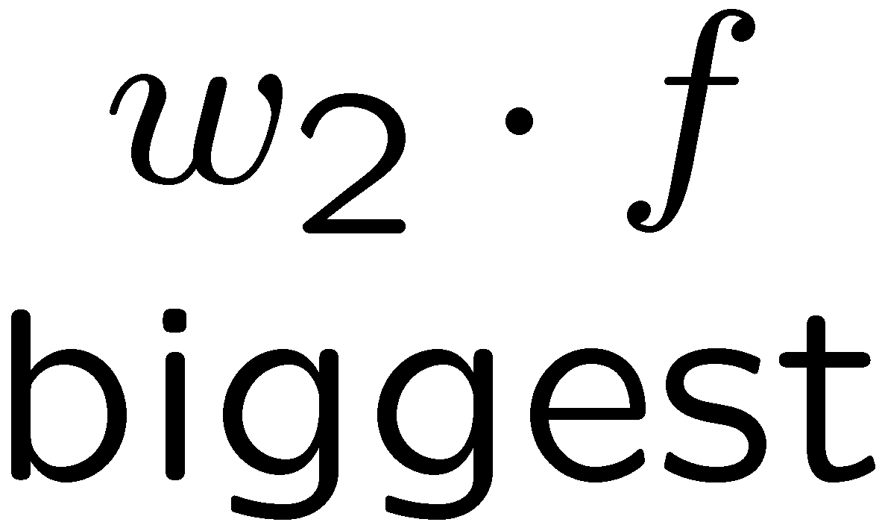
Multiclass Logistic Regression
Multi-class linear classification
A weight vector for each class:
Score (activation) of a class y:
Prediction w/highest score wins:
How to make the scores into probabilities?
original activations
softmax activations

Slide 6
Best w?
Maximum likelihood estimation:
with:
= Multi-Class Logistic Regression

Slide 7
This Lecture
Optimization
i.e., how do we solve:

Slide 8
Hill Climbing
Recall from CSPs lecture: simple, general idea
Start wherever
Repeat: move to the best neighboring state
If no neighbors better than current, quit
What’s particularly tricky when hill-climbing for multiclass logistic regression?
Optimization over a continuous space
Infinitely many neighbors!
How to do this efficiently?

Slide 9
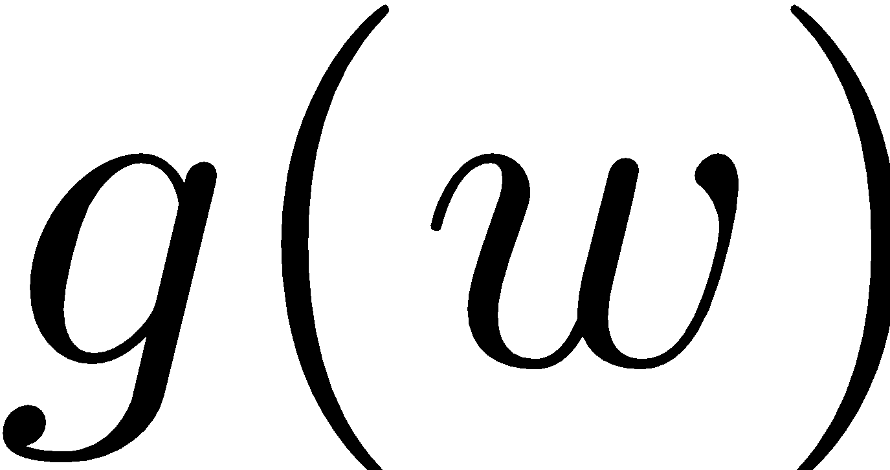
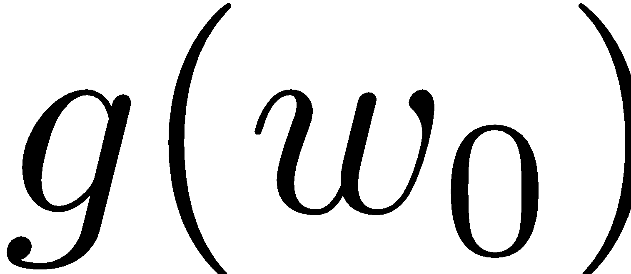
1-D Optimization
Could evaluate and
Then step in best direction
Or, evaluate derivative:
Tells which direction to step into

Slide 10
2-D Optimization
Source: offconvex.org

Slide 11
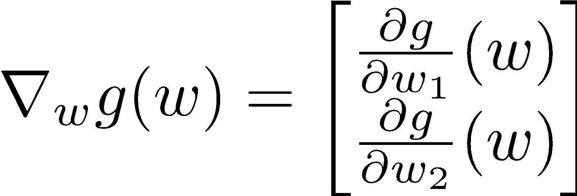
Gradient Ascent
Perform update in uphill direction for each coordinate
The steeper the slope (i.e. the higher the derivative) the bigger the step for that coordinate
E.g., consider:
Updates:
Updates in vector notation:
with:
= gradient

Slide 12
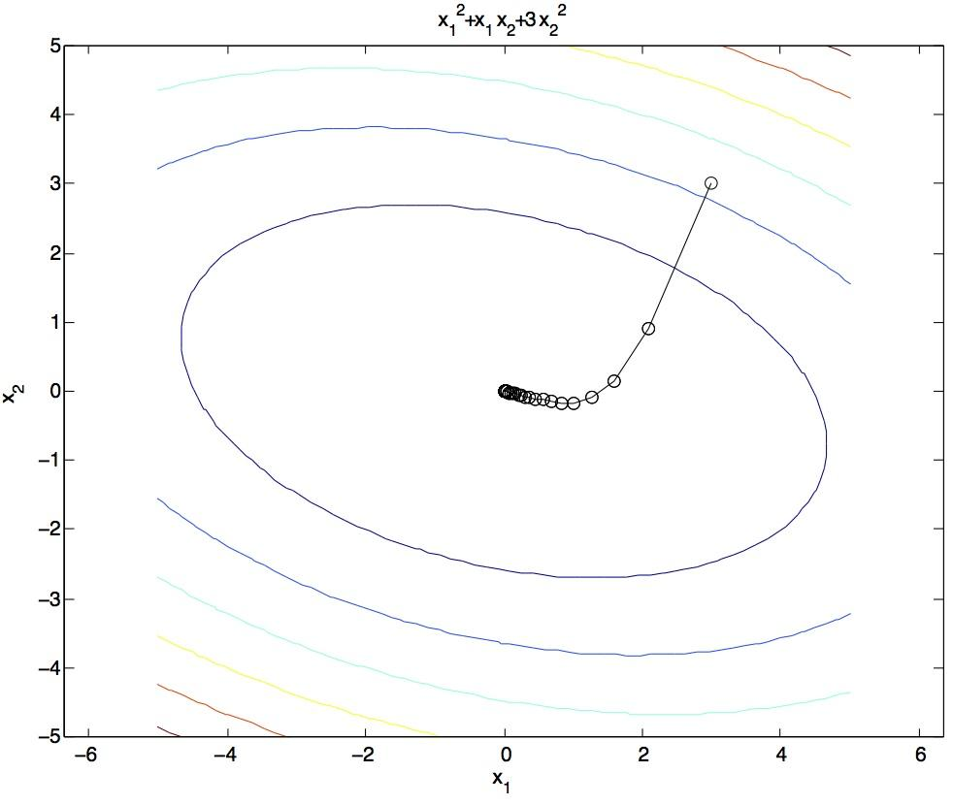
Gradient Ascent
Idea:
Start somewhere
Repeat: Take a step in the gradient direction
Figure source: Mathworks

Slide 13
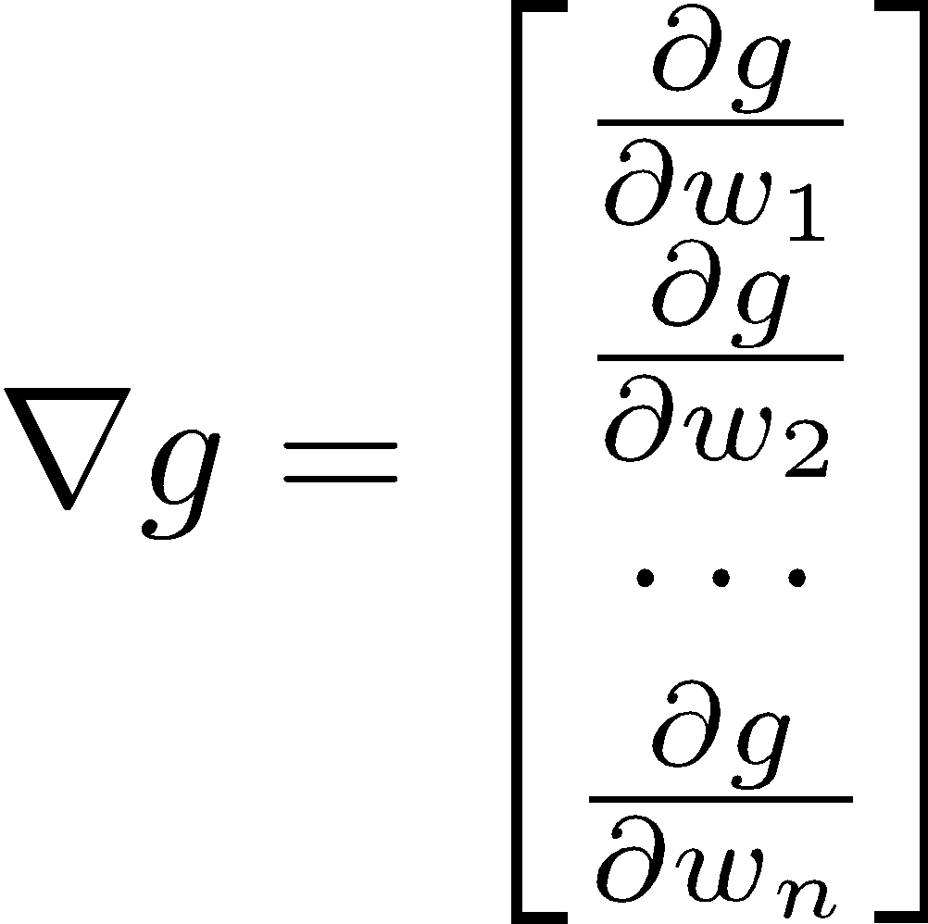
Gradient in n dimensions

Slide 14
Optimization Procedure: Gradient Ascent
init
for iter = 1, 2, …
: learning rate --- tweaking parameter that needs to be chosen carefully
How? Try multiple choices
Crude rule of thumb: update changes about 0.1 – 1 %

Slide 15
Batch Gradient Ascent on the Log Likelihood Objective
init
for iter = 1, 2, …

Slide 16
Stochastic Gradient Ascent on the Log Likelihood Objective
Observation: once gradient on one training example has been computed, might as well incorporate before computing next one
init
for iter = 1, 2, …
pick random j

Slide 17
Mini-Batch Gradient Ascent on the Log Likelihood Objective
Observation: gradient over small set of training examples (=mini-batch) can be computed in parallel, might as well do that instead of a single one
init
for iter = 1, 2, …
pick random subset of training examples J

Slide 18
Neural Networks

Slide 19
Multi-class Logistic Regression
= special case of neural network
f₁(x)
z₁
softmax
f₂(x)
z₂
f₃(x)
…
z₃
f_{K}(x)

Slide 20
Deep Neural Network = Also learn the features!
f₁(x)
z₁
softmax
f₂(x)
z₂
f₃(x)
…
z₃
f_{K}(x)

Slide 21
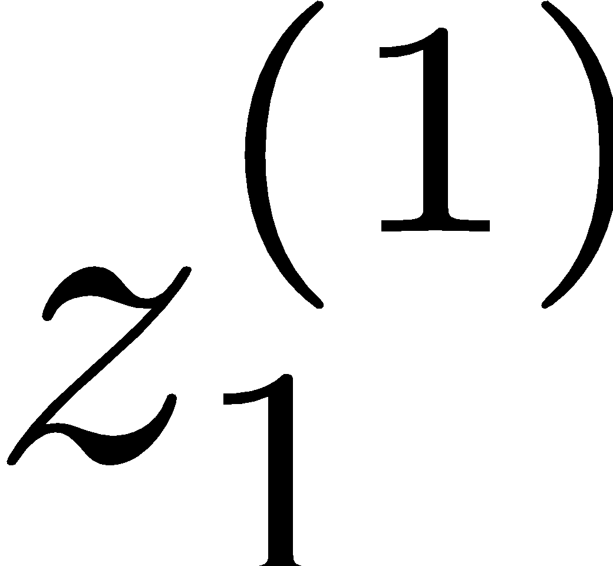
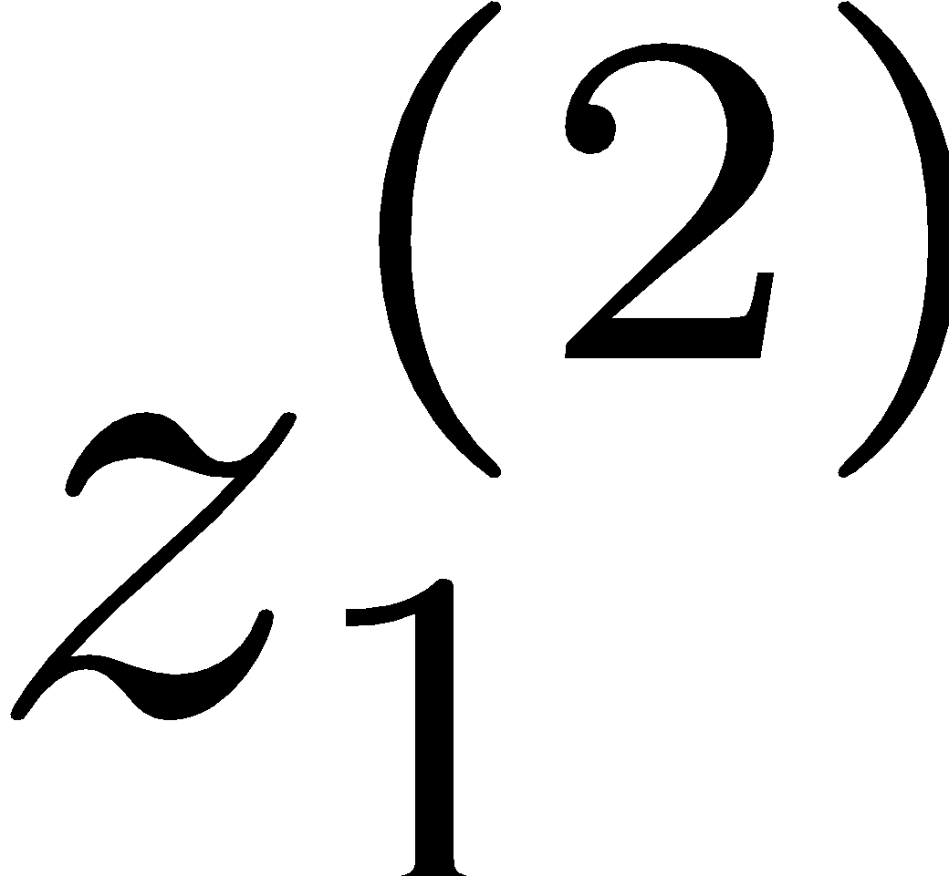
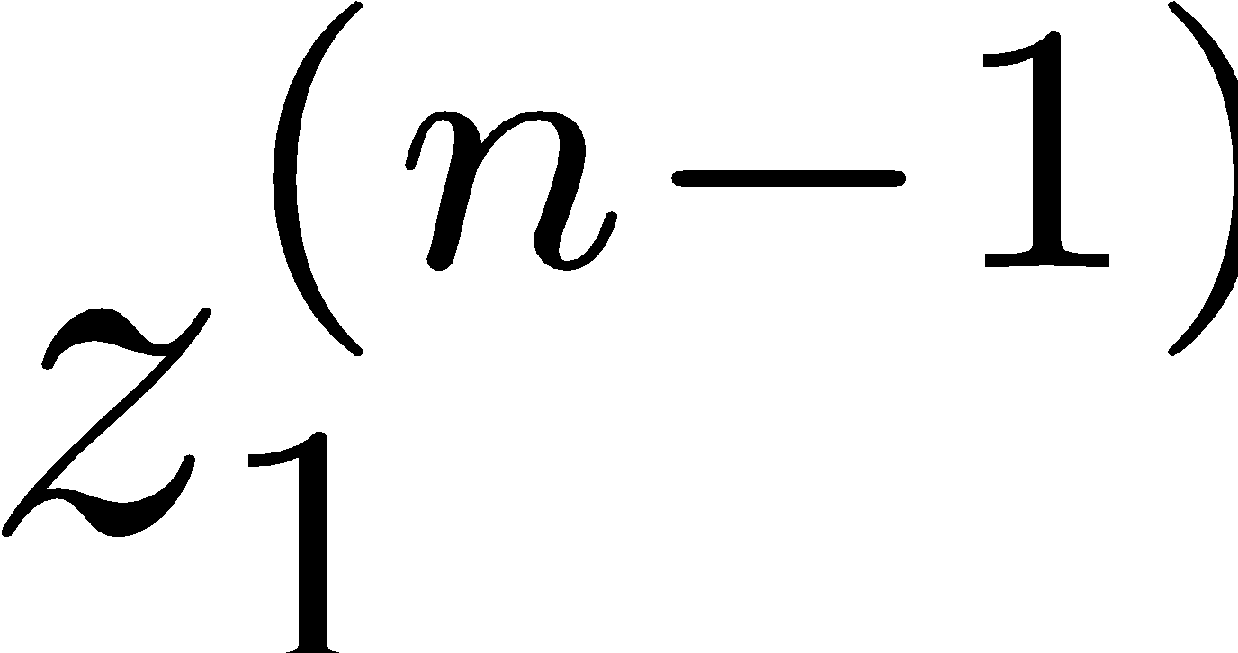
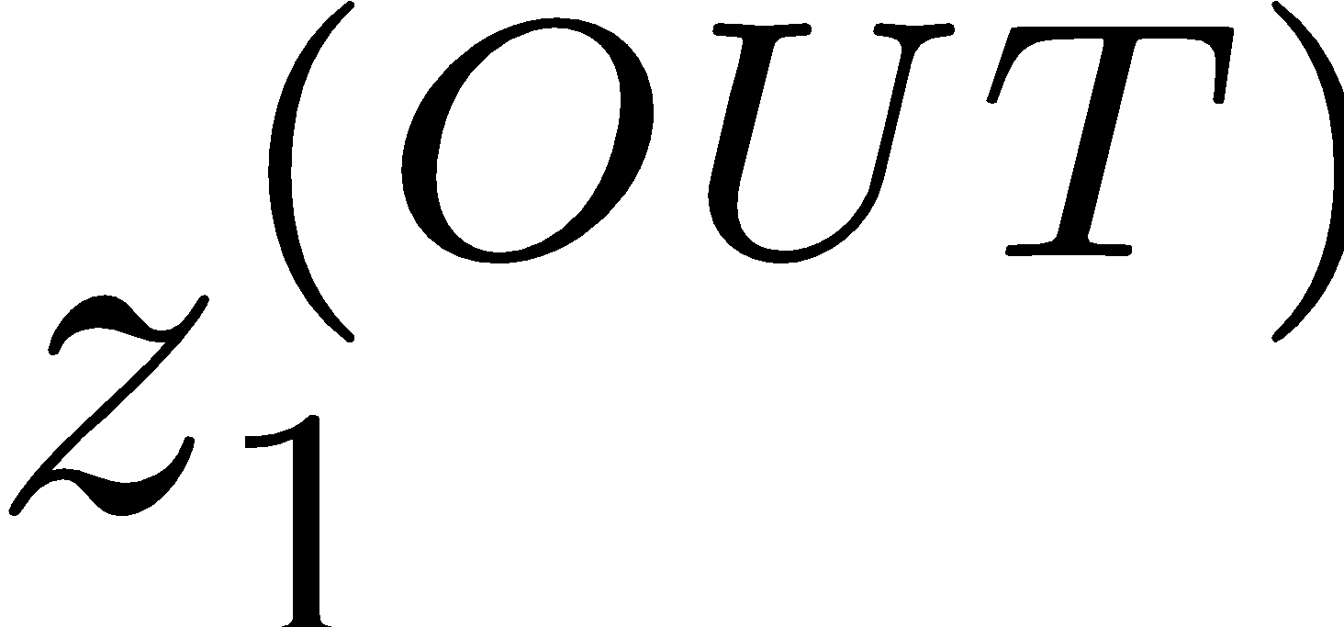
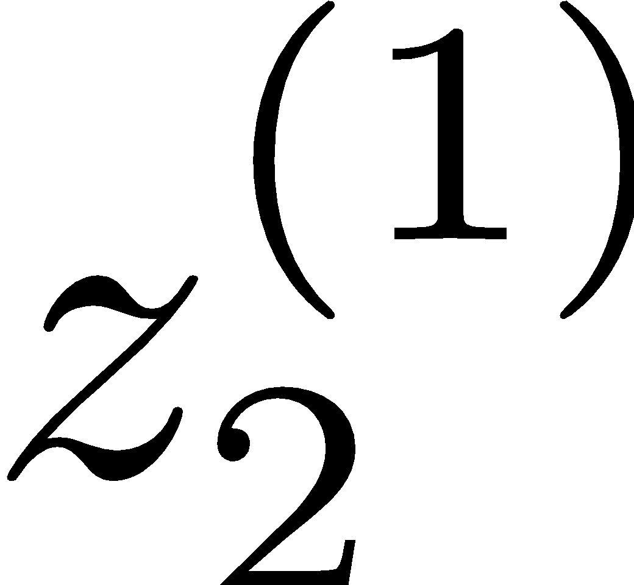
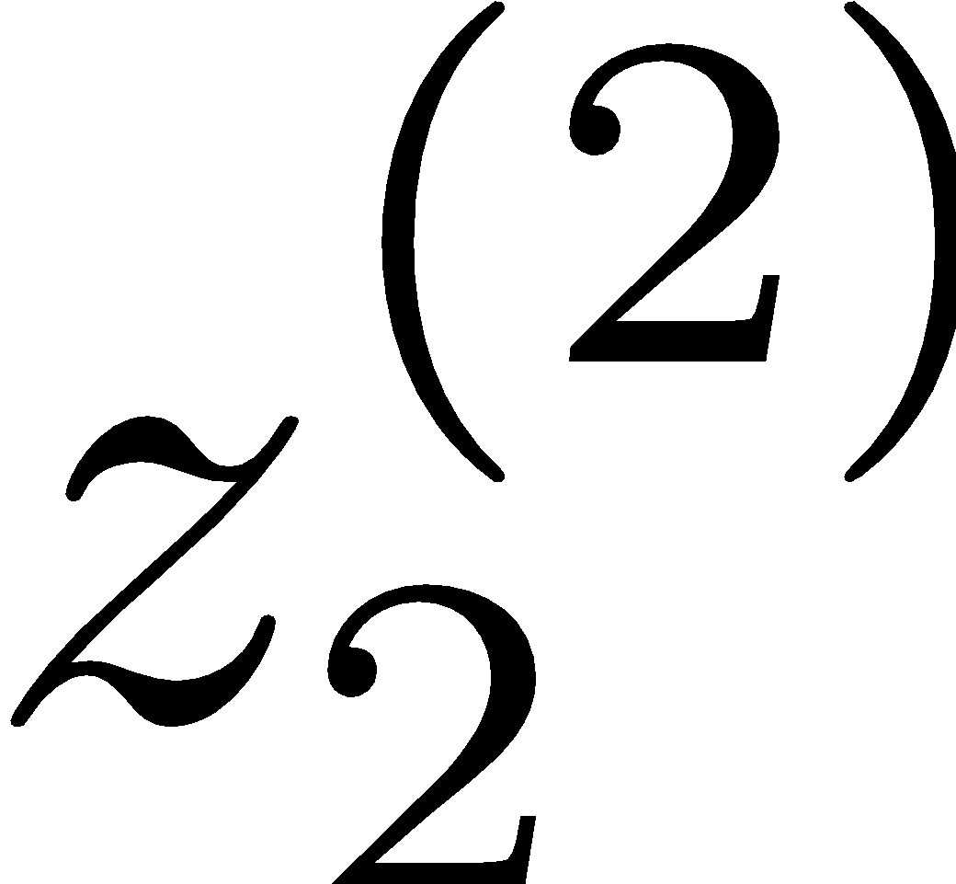
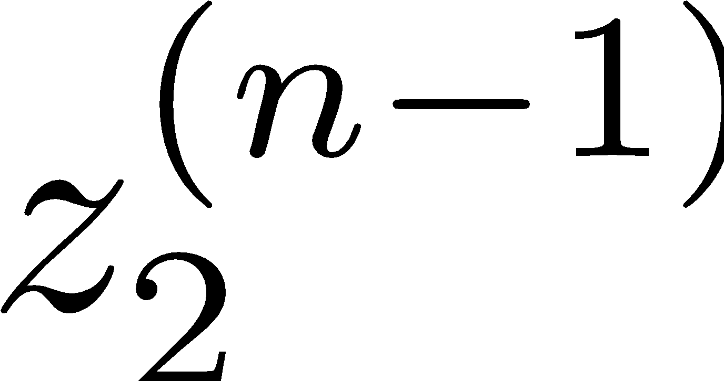
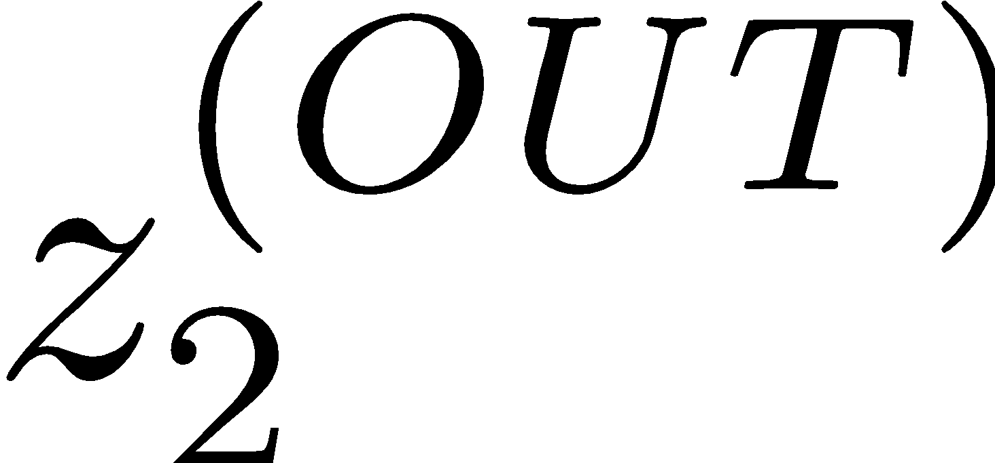
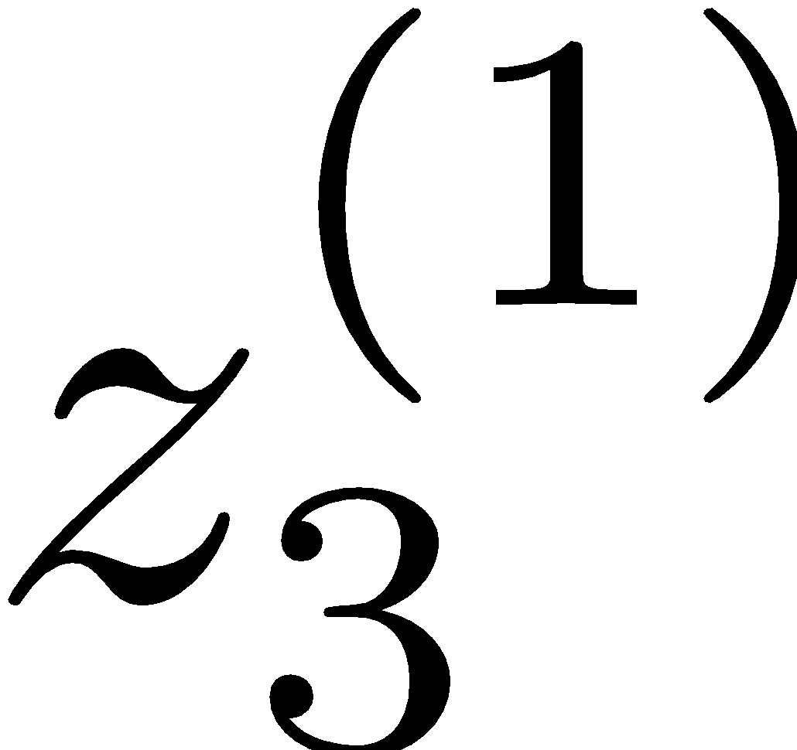
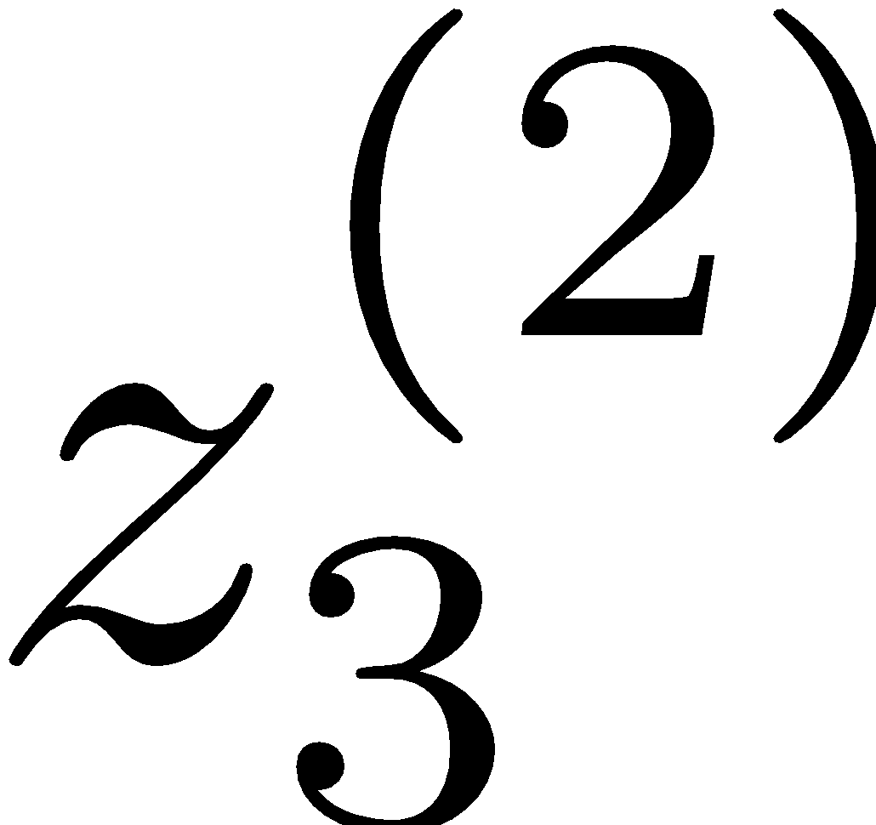
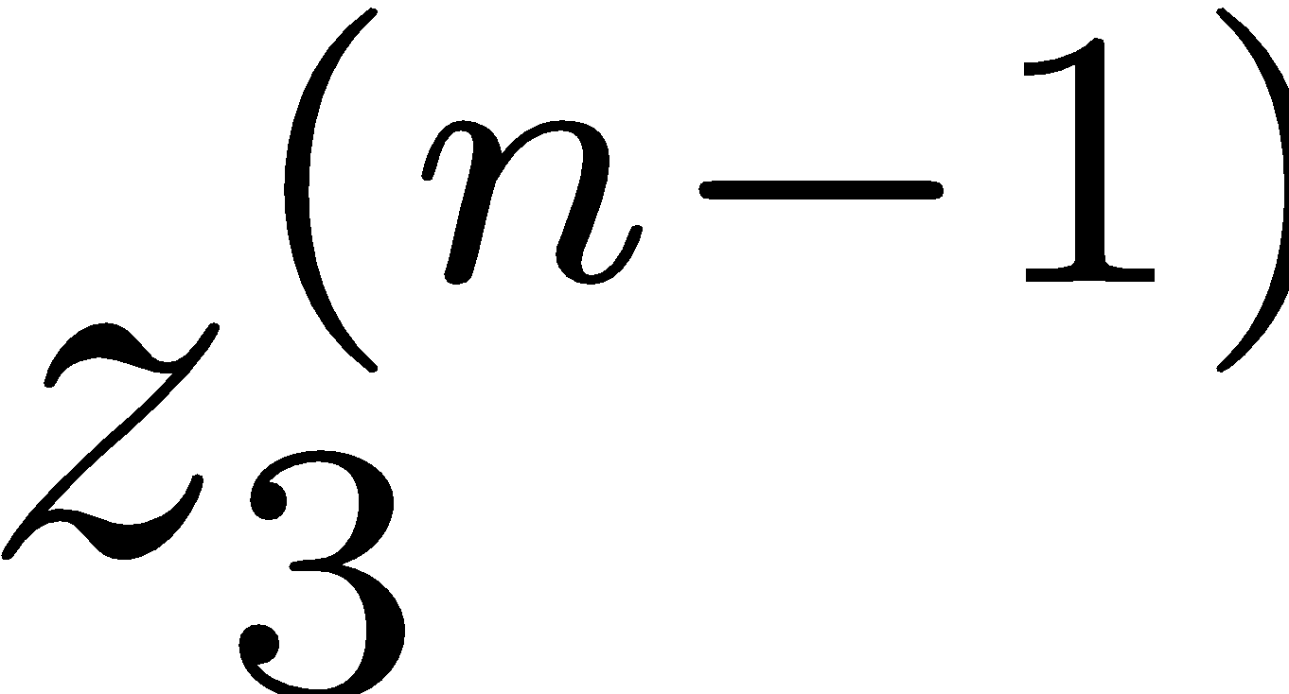
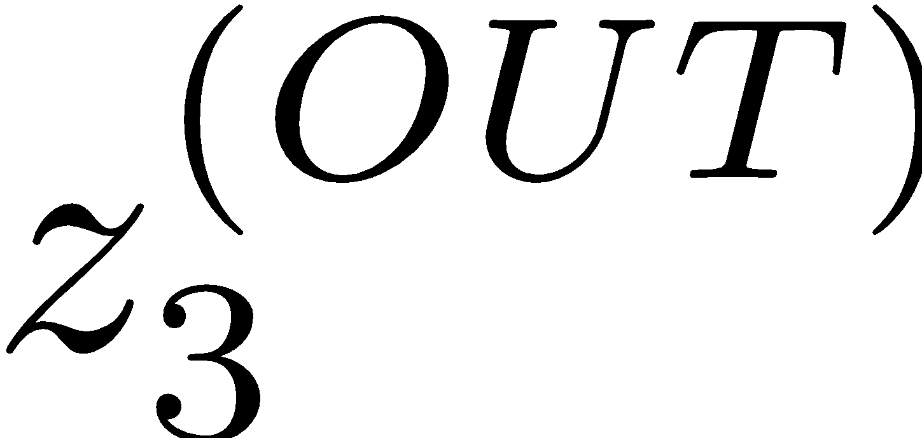
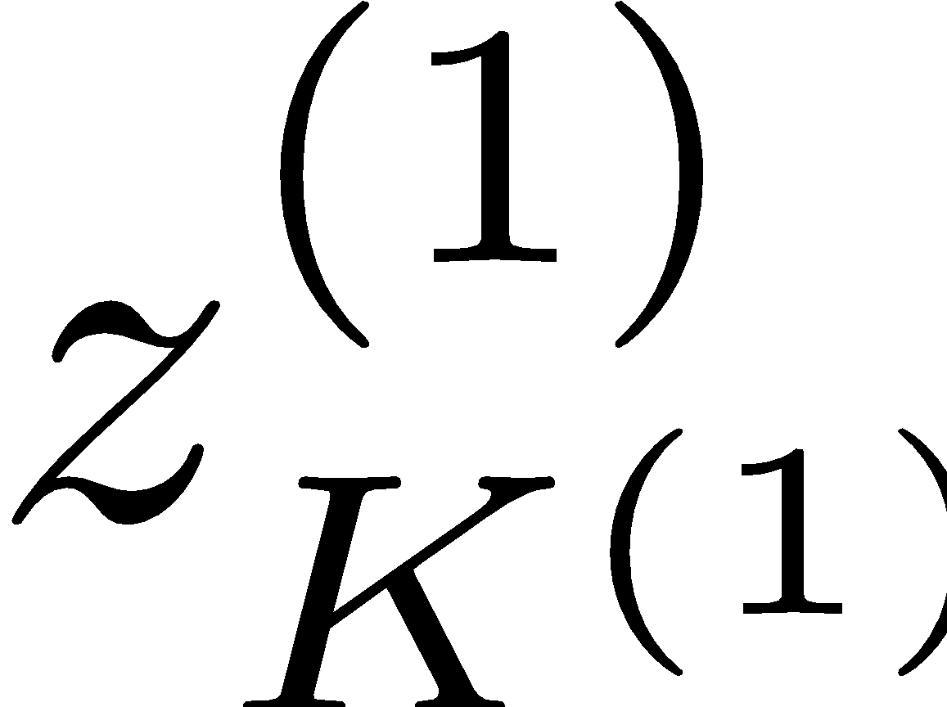
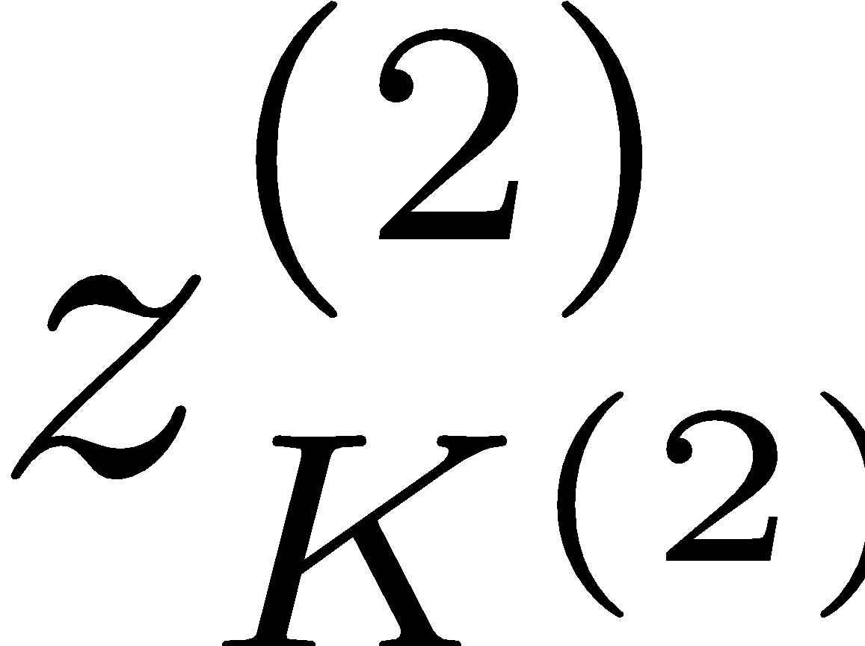
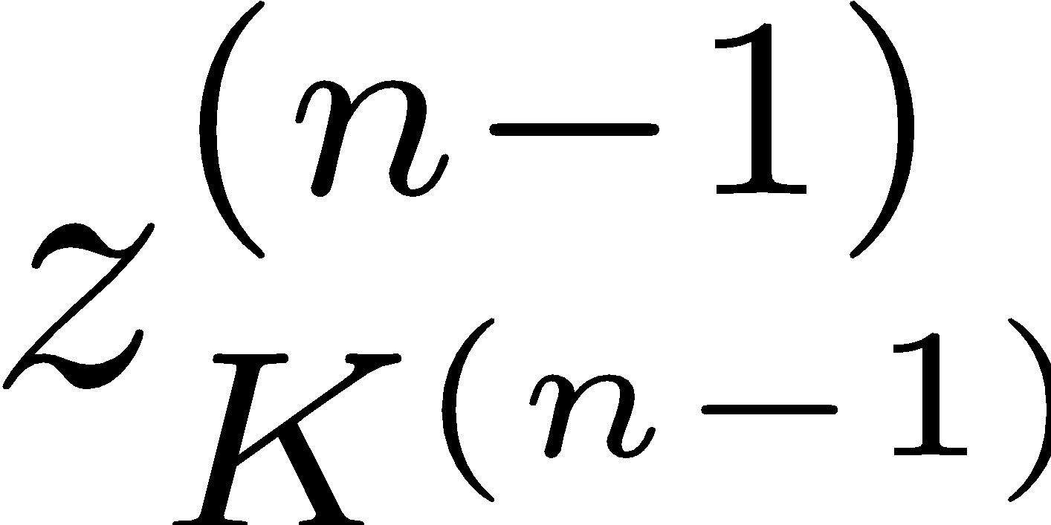
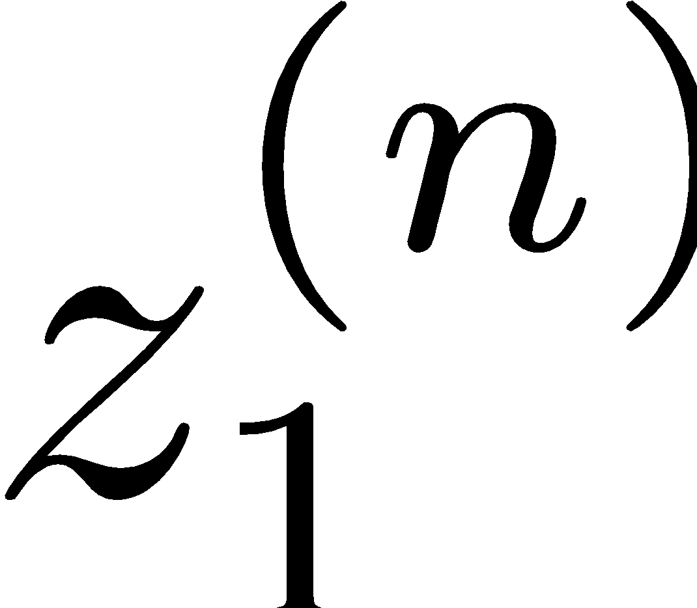
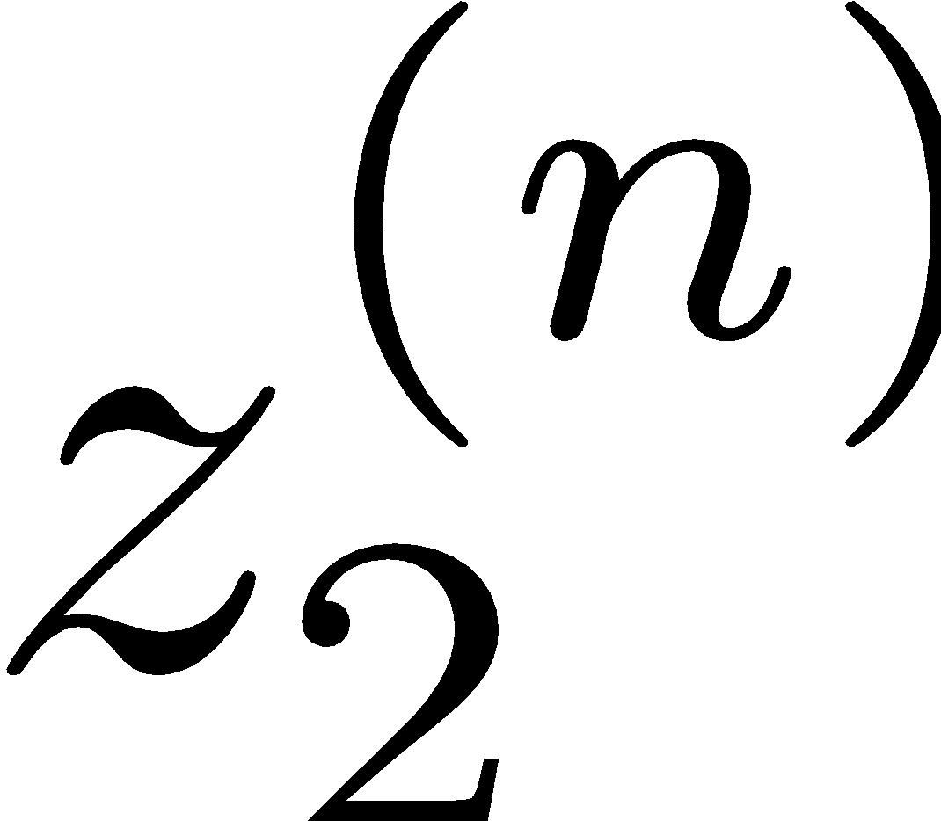
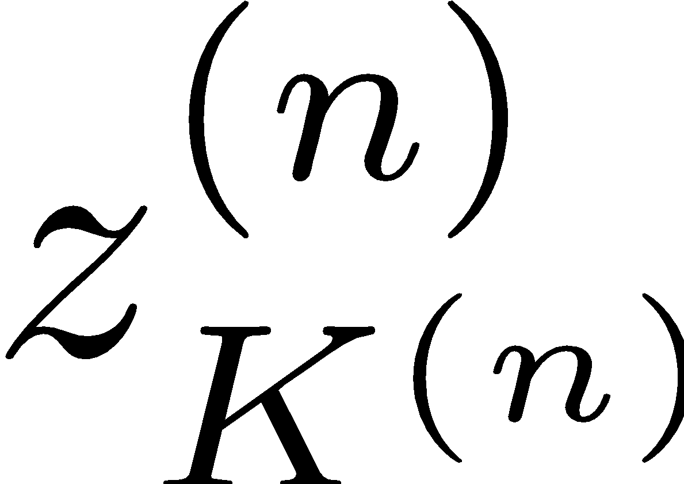
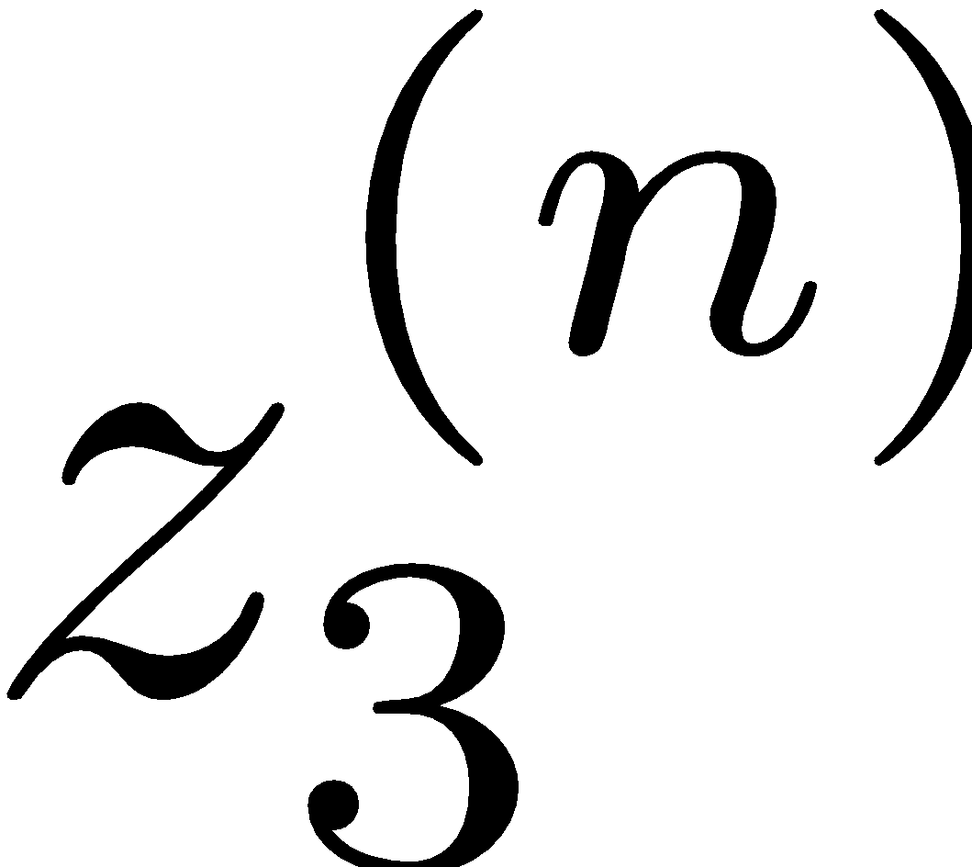
Deep Neural Network = Also learn the features!
x₁
f₁(x)
softmax
x₂
f₂(x)
…
x₃
f₃(x)
…
…
…
…
…
x_{L}
f_{K}(x)
g = nonlinear activation function

Slide 22
Deep Neural Network = Also learn the features!
x₁
softmax
x₂
…
x₃
…
…
…
…
…
x_{L}
g = nonlinear activation function

Slide 23
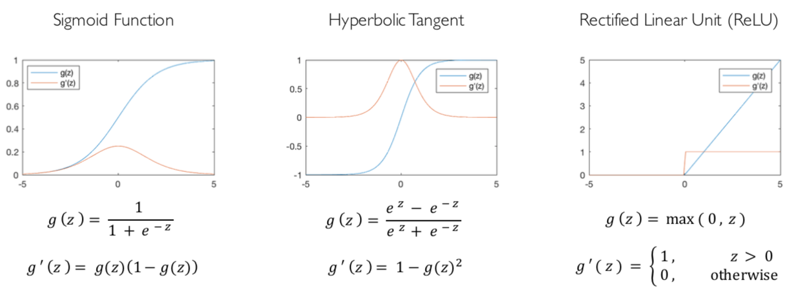
Common Activation Functions
[source: MIT 6.S191 introtodeeplearning.com]

Slide 24
Deep Neural Network: Also Learn the Features!
Training the deep neural network is just like logistic regression:
just w tends to be a much, much larger vector ☺
just run gradient ascent
+ stop when log likelihood of hold-out data starts to decrease

Slide 25
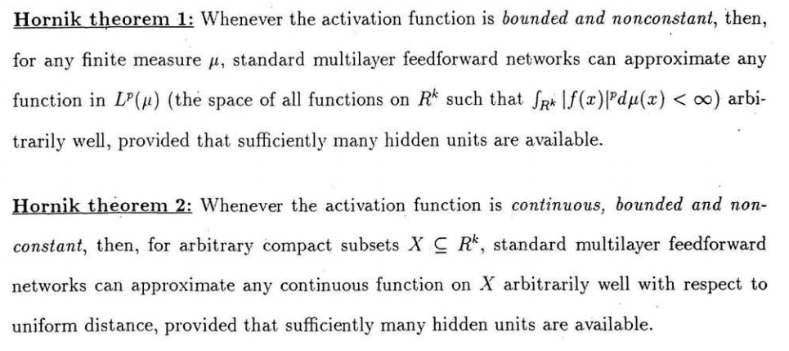
Universal Function Approximation Theorem*
In words: Given any continuous function f(x), if a 2-layer neural network has enough hidden units, then there is a choice of weights that allow it to closely approximate f(x).
Cybenko (1989) “Approximations by superpositions of sigmoidal functions”
Hornik (1991) “Approximation Capabilities of Multilayer Feedforward Networks”
Leshno and Schocken (1991) ”Multilayer Feedforward Networks with Non-Polynomial Activation Functions Can Approximate Any Function”

Slide 26
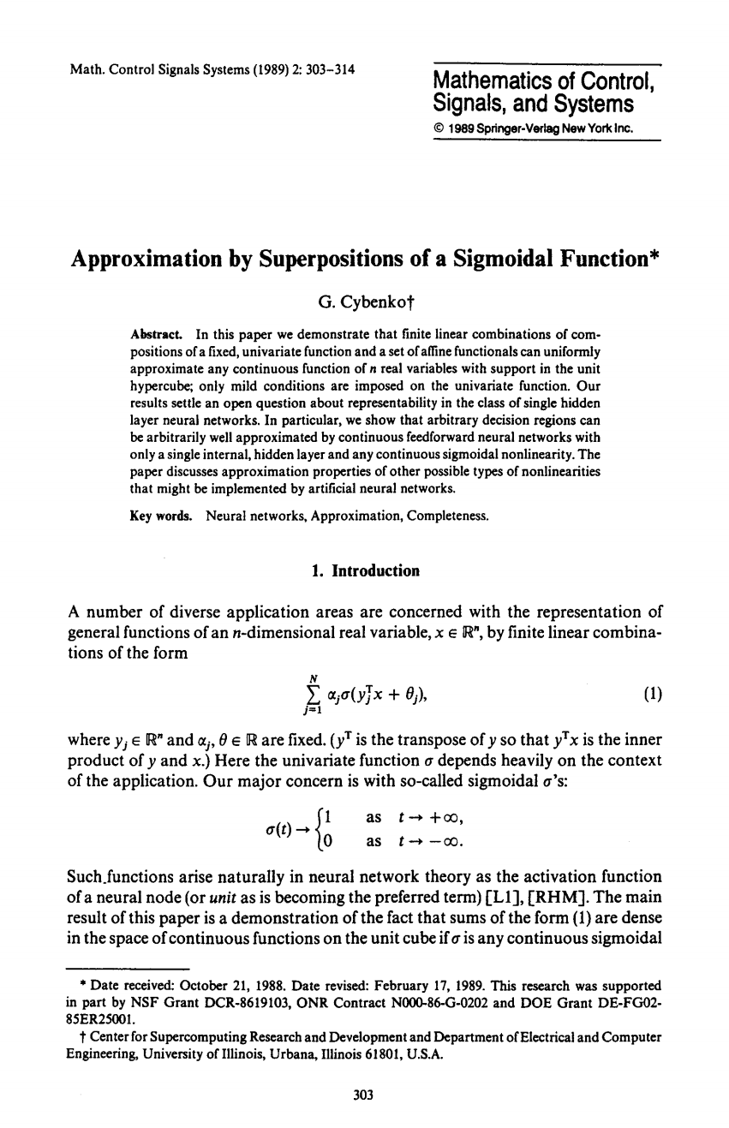
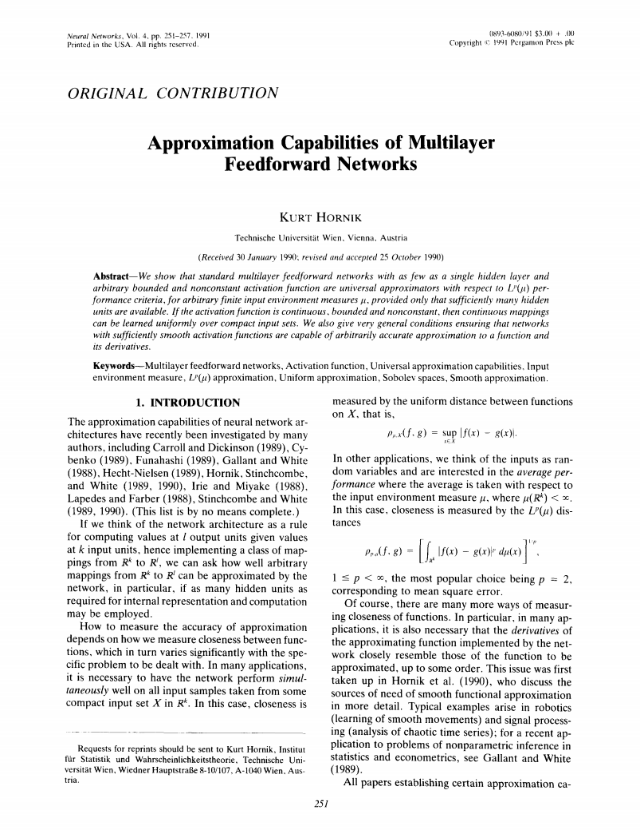
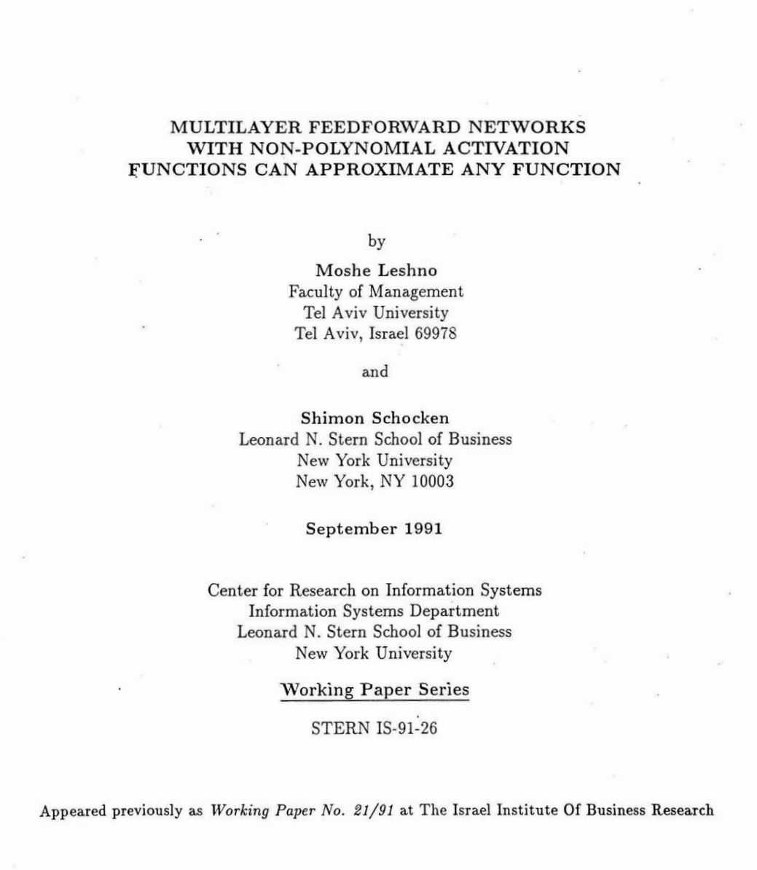
Universal Function Approximation Theorem*
Cybenko (1989) “Approximations by superpositions of sigmoidal functions”
Hornik (1991) “Approximation Capabilities of Multilayer Feedforward Networks”
Leshno and Schocken (1991) ”Multilayer Feedforward Networks with Non-Polynomial Activation Functions Can Approximate Any Function”

Slide 27
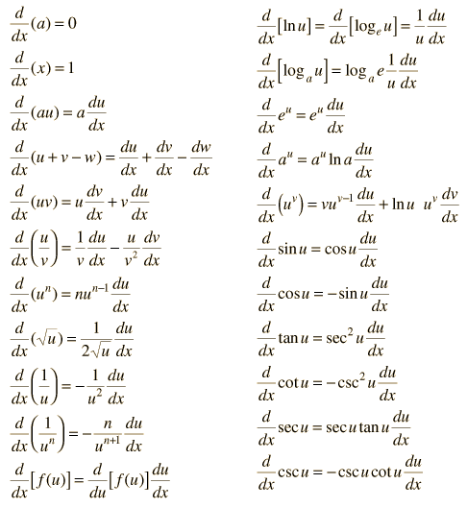
How about computing all the derivatives?
Derivatives tables:
[source: http://hyperphysics.phy-astr.gsu.edu/hbase/Math/derfunc.html

Slide 28
Next lecture: differentiation for neural nets!

