Slide 1
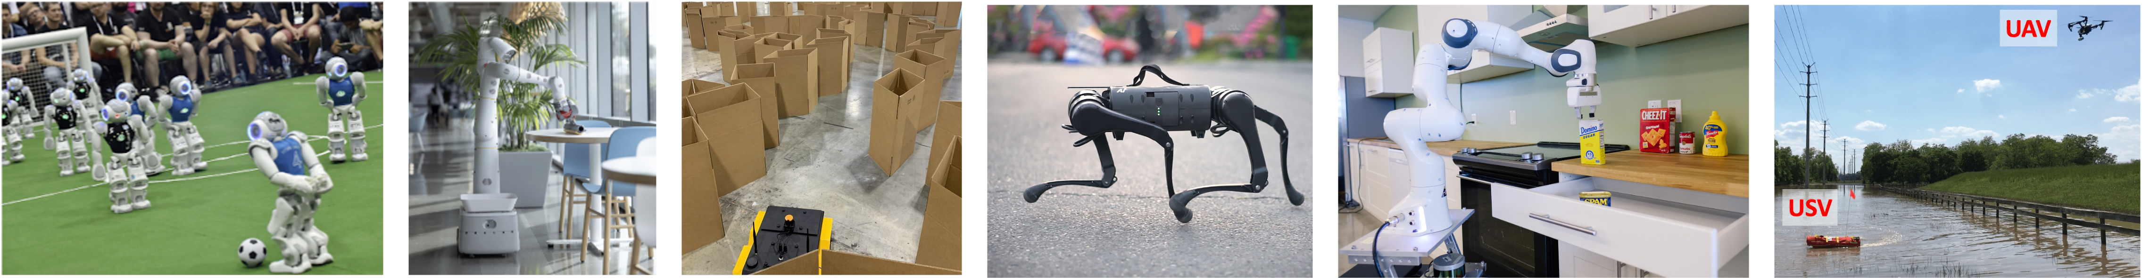
CS 685 Autonomous Robotics
Human Robot Interaction
Prof. Xuesu Xiao
George Mason University
Slides Credits: Justin Hart

Slide 2
There has been some form of interacting with machinery since the very first robots, including simple electro-mechanical devices that arguably may count from the turn of the 20th century
-Shultz & Goodrich, 2007

Slide 3
Current Hot Topics
  Measuring human emotion & engagement
  Human-robot autonomous collaboration
  Physical human-robot interaction
  HRI as design
  Legibility of motion
Long-Standing Topics
  Generating and interpreting gaze attention
  Language & HRI
  Gesturing
  Back-channel communication
  Proxemics

Slide 4
Kismet from MIT
https://www.youtube.com/watch?v=8KRZX5KL4fA

Slide 5
Humanoids
Designed to function in a human-like way
Roughly human form

Slide 6
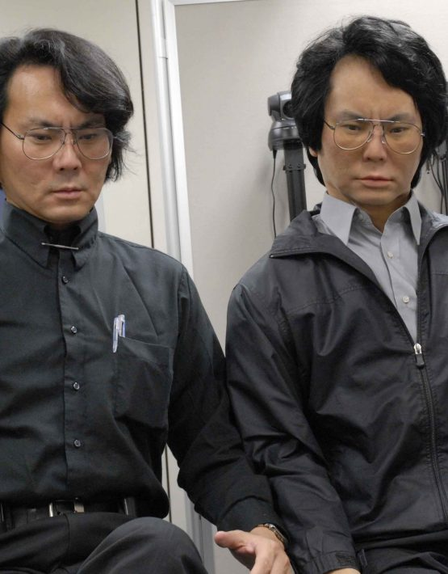

Androids
Designed to look very human
Often (partially) tele-operated
  Geminoid
  Erica (https://www.youtube.com/watch?v=TyJ-xLj9SEE)

Slide 7
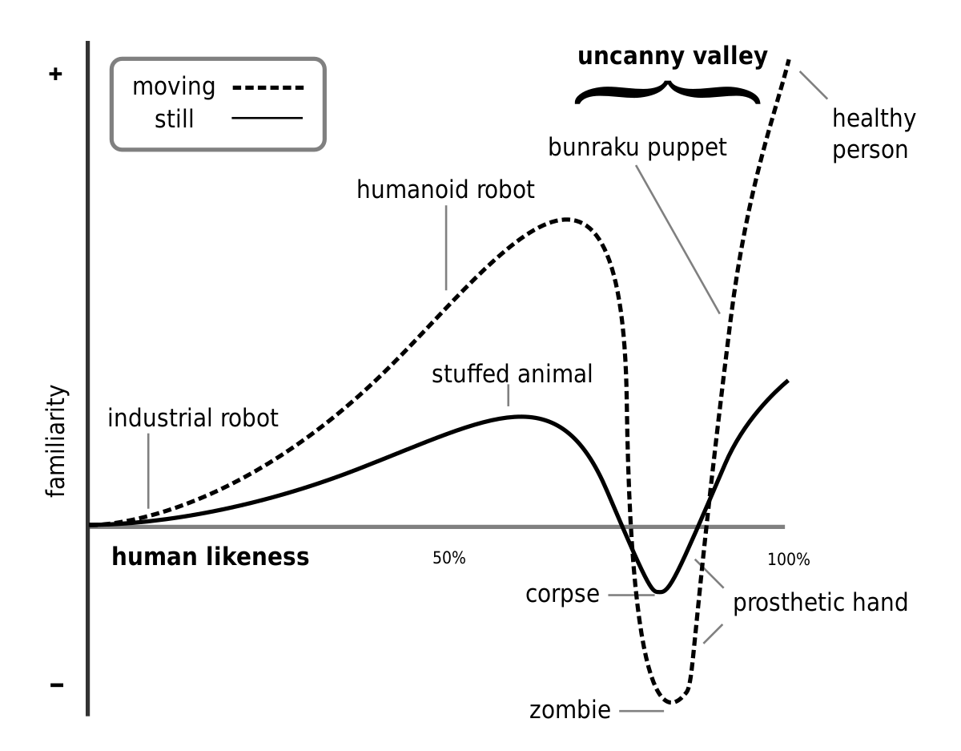
The Uncanny Valley

Slide 8
Physical HRI (pHRI)
Handovers
Shared Carrying
Exoskeletons
Collaborative assembly and manufacturing

Slide 9
Often human interpretation of the stimulus is the important factor
Robots as evocative devices
Use of psychological methods to interpret results

Slide 10
Experimental HRI & Psychology
User studies are a major driver of Human-Robot Interaction
Human-Robot Interaction is as much about understanding people well enough to write algorithms for robots as it is about the algorithms themselves

Slide 11
Survey Metrics
Likert scale
  The robot was lifelike 1 – 2 – 3 – 4 – 5
Cognitive differences scale
  The robot was <not at all lifelike> – – <neither lifelike nor unlifelike> – – <very lifelike>

Slide 12
Inter vs Intra Participant Design
Study conditions
  Group A – Control
  Group B – Experimental
  Group A – The robot plays a game with a participant
  Group B – The robot makes eye contact when it wants to influence the participant’s decisions in the game
Inter-participant
  Each participant sees exactly one experimental condition
Intra-participant
  Each participant sees every experimental condition
Why the difference?
  If the participant sees every condition, will it change the outcome?
  Can you get enough data?

Slide 13
Statistical Tests
Null hypothesis
  The hypothesis that nothing significant is happening. The default. There is no difference between your conditions in terms of their effect on the variable that you are measuring.
t-tests & ANOVA (and its variants)
  Establish that two conditions are different from each other
    People like robots that smile more than ones that frown
    A robot in the same room as a person has more influence over that person’s behavior than a telepresent agent
Correlation tests (Pearson, Spearman)
  Establish that two values correlate to each other
    More automation is associated with higher employment
Statistical significance
  p – Probability value. The probability of obtaining test results at least as extreme as the observed results, assuming that the null hypothesis is correct.
    This is to say, how probable is it that your statistical test demonstrates nothing
  α – How small should p be to be considered “significant.”

Slide 14
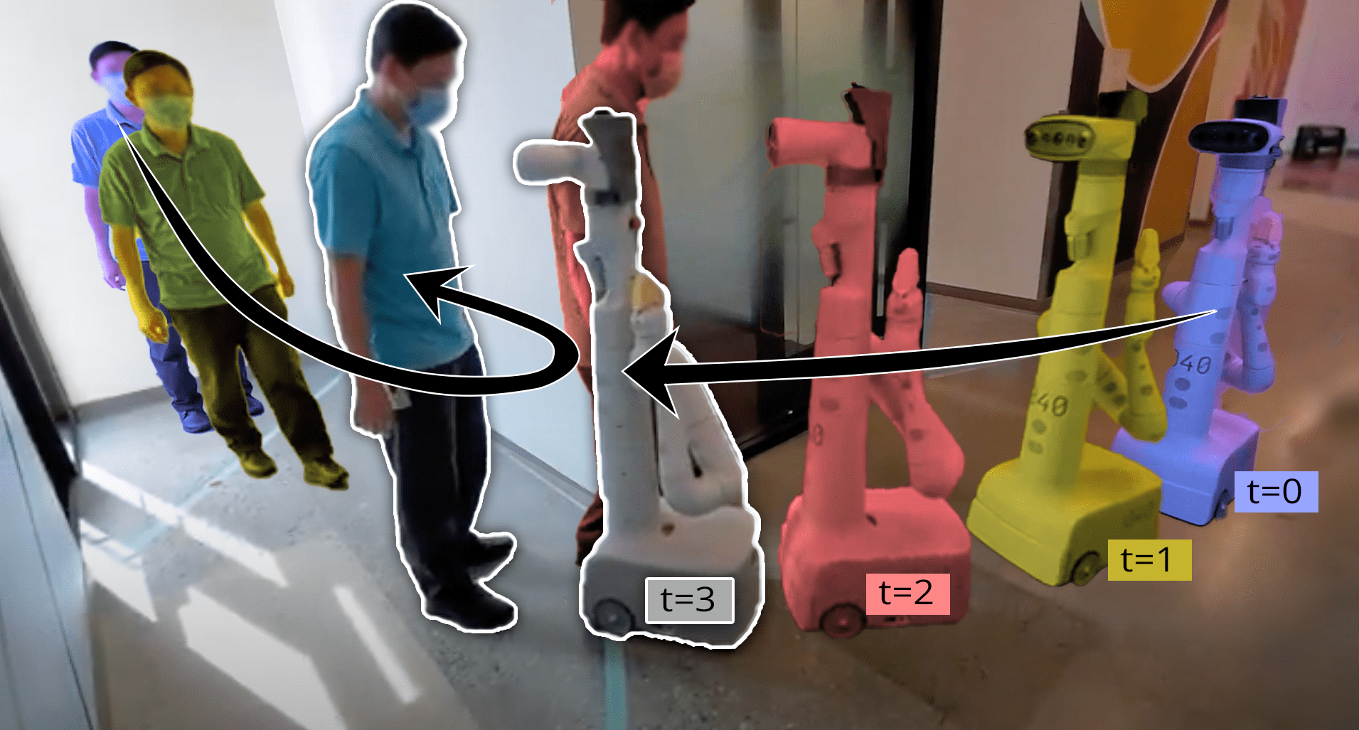
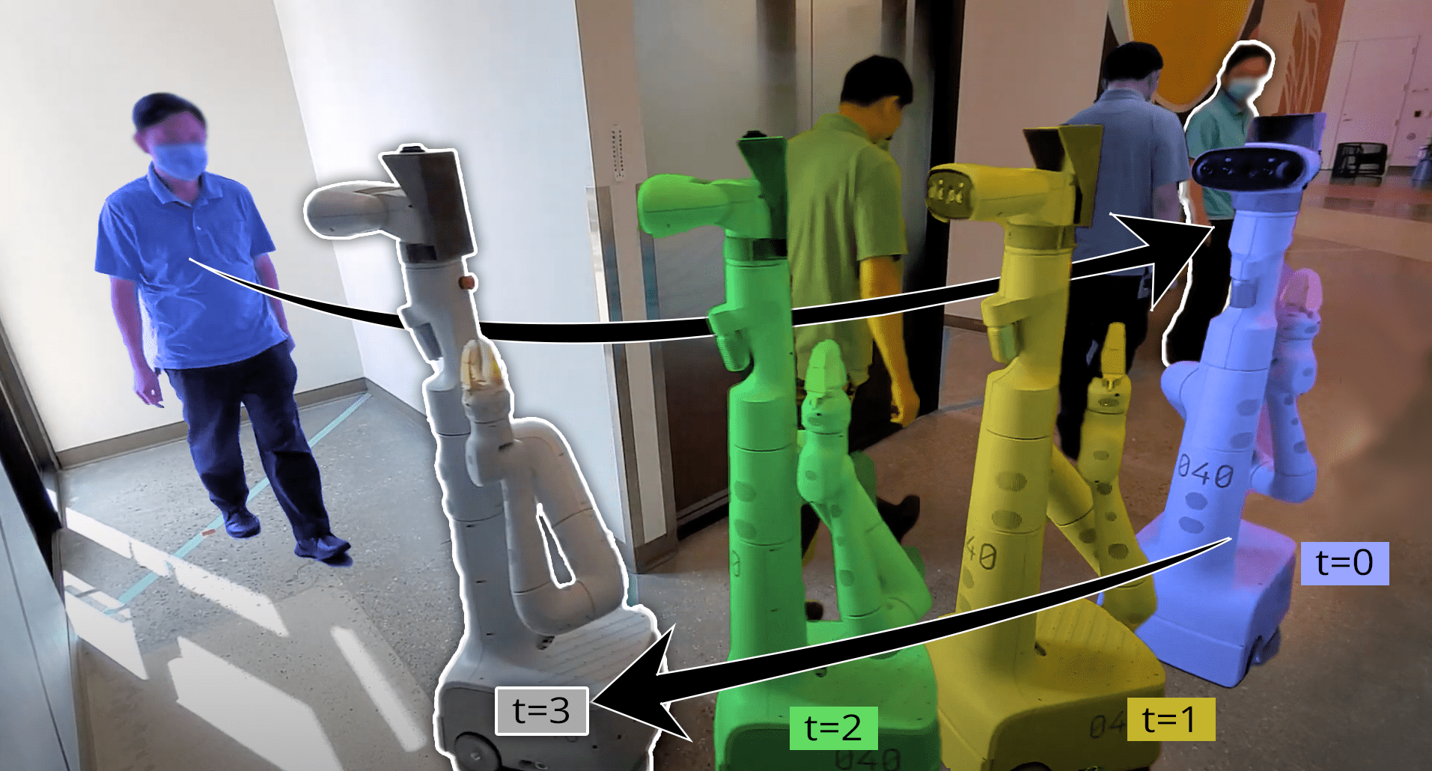
A Case Study: Evaluating Social Robot Navigation
Planning the most efficient, shortest length, minimal time plan?
Social compliance improves motion planning performance!
Performer-MPC
[XX et al., CoRL22]
14

Slide 15
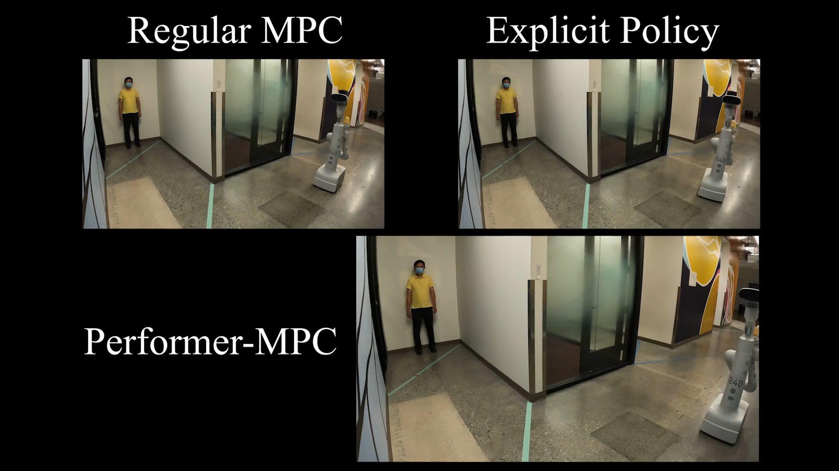
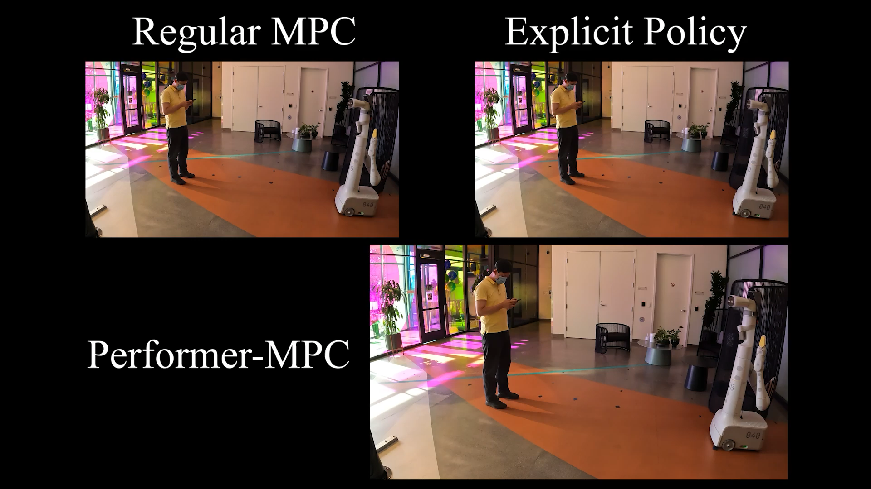
A Case Study: Evaluating Social Robot Navigation
Blind Corner
Learning to anticipate Pedestrians
Pedestrian Obstruction
Learning to respect comfort distance
Performer-MPC
[XX et al., CoRL22]
15

Slide 16
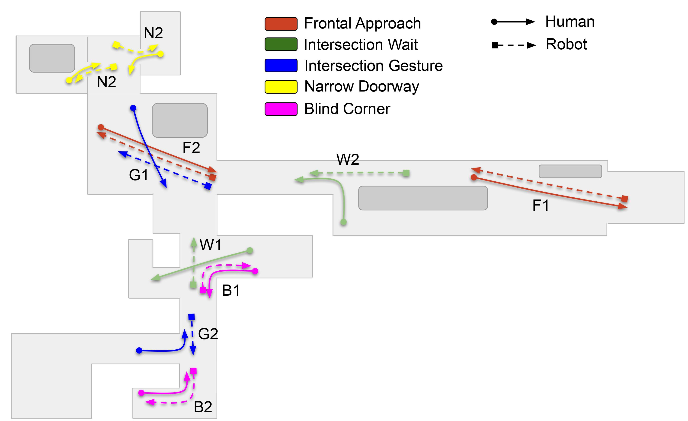
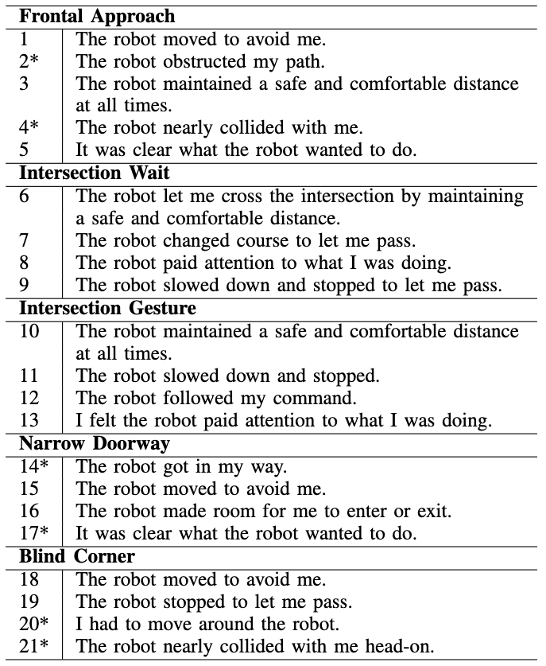
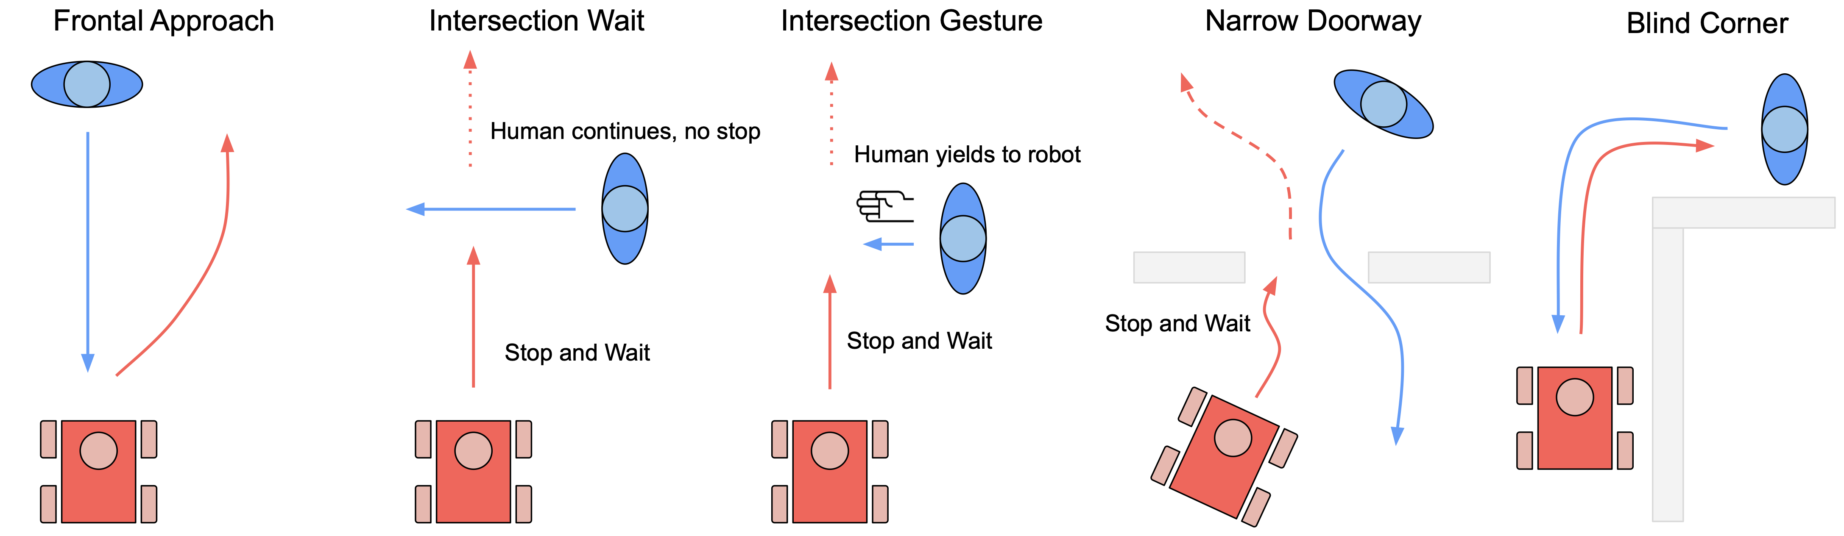
A Case Study: Evaluating Social Robot Navigation
[P. L. XX et al., ICRA22WS]
16

Slide 17
A Case Study: Adaptive Planner Parameter Learning from Non-Expert Human Interactions
Adaptive Planner Parameter Learning from Demonstration (APPLD)
  [XX et al., RA-L20]
Adaptive Planner Parameter Learning from Interventions (APPLI)
  [Wang et al., ICRA21]
Adaptive Planner Parameter Learning from Evaluative Feedback (APPLE)
  [Wang et al., RA-L21]
Adaptive Planner Parameter Learning from Reinforcement (APPLR)
  [Xu et al., ICRA21]
Cycle-of-Learning from APPL
  [Xiao et al., RAS22]

Slide 18
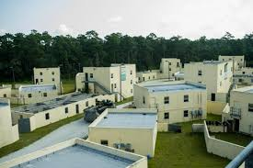

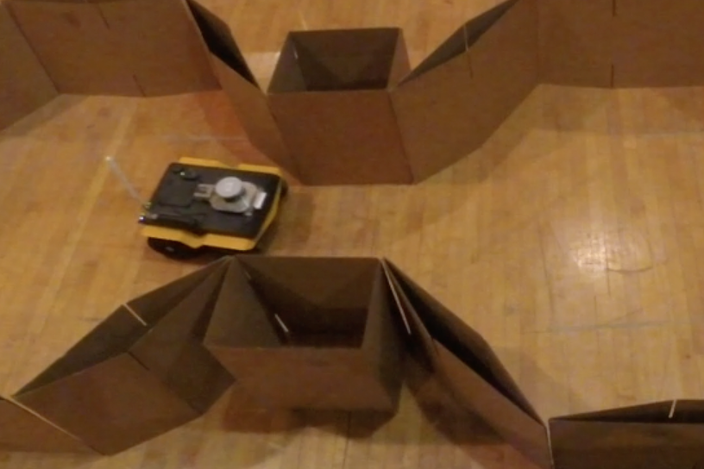
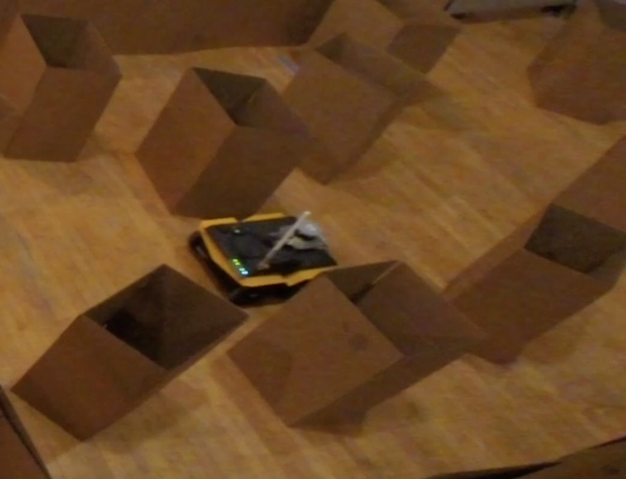
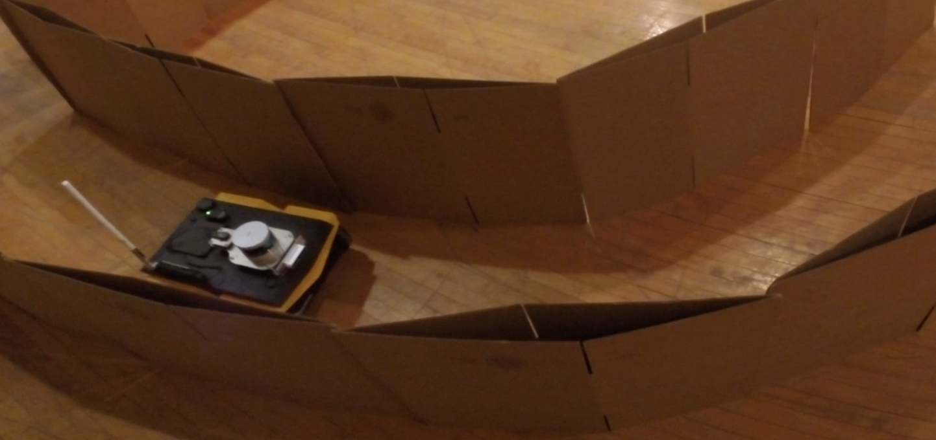
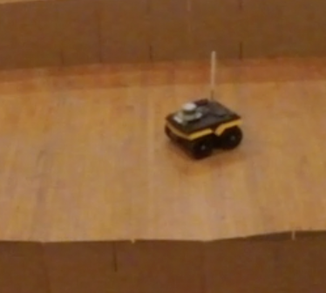
Adaptive Planner Parameter Learning (APPL)
Robots need to face entirely different obstacle configurations.
Classical navigation systems require expert roboticists to fine-tune planner parameters.
max_vel_x: 0.5
min_vel_x: 0.1
max_vel_theta: 1.57
min_vel_theta: -1.57
vx_samples: 6
vtheta_samples: 20
occdist_scale: 0.1
pdist_scale: 0.75
gdist_scale: 1.0
Inflation_radius: 0.30
......

Slide 19
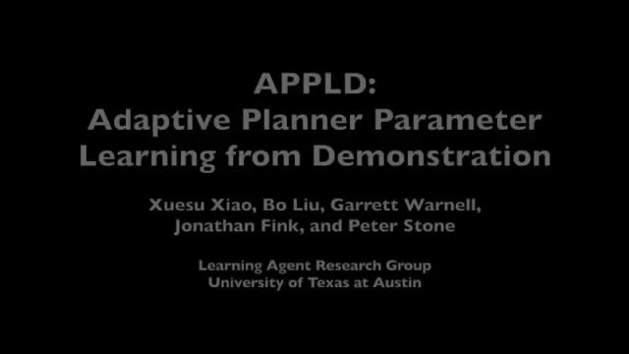
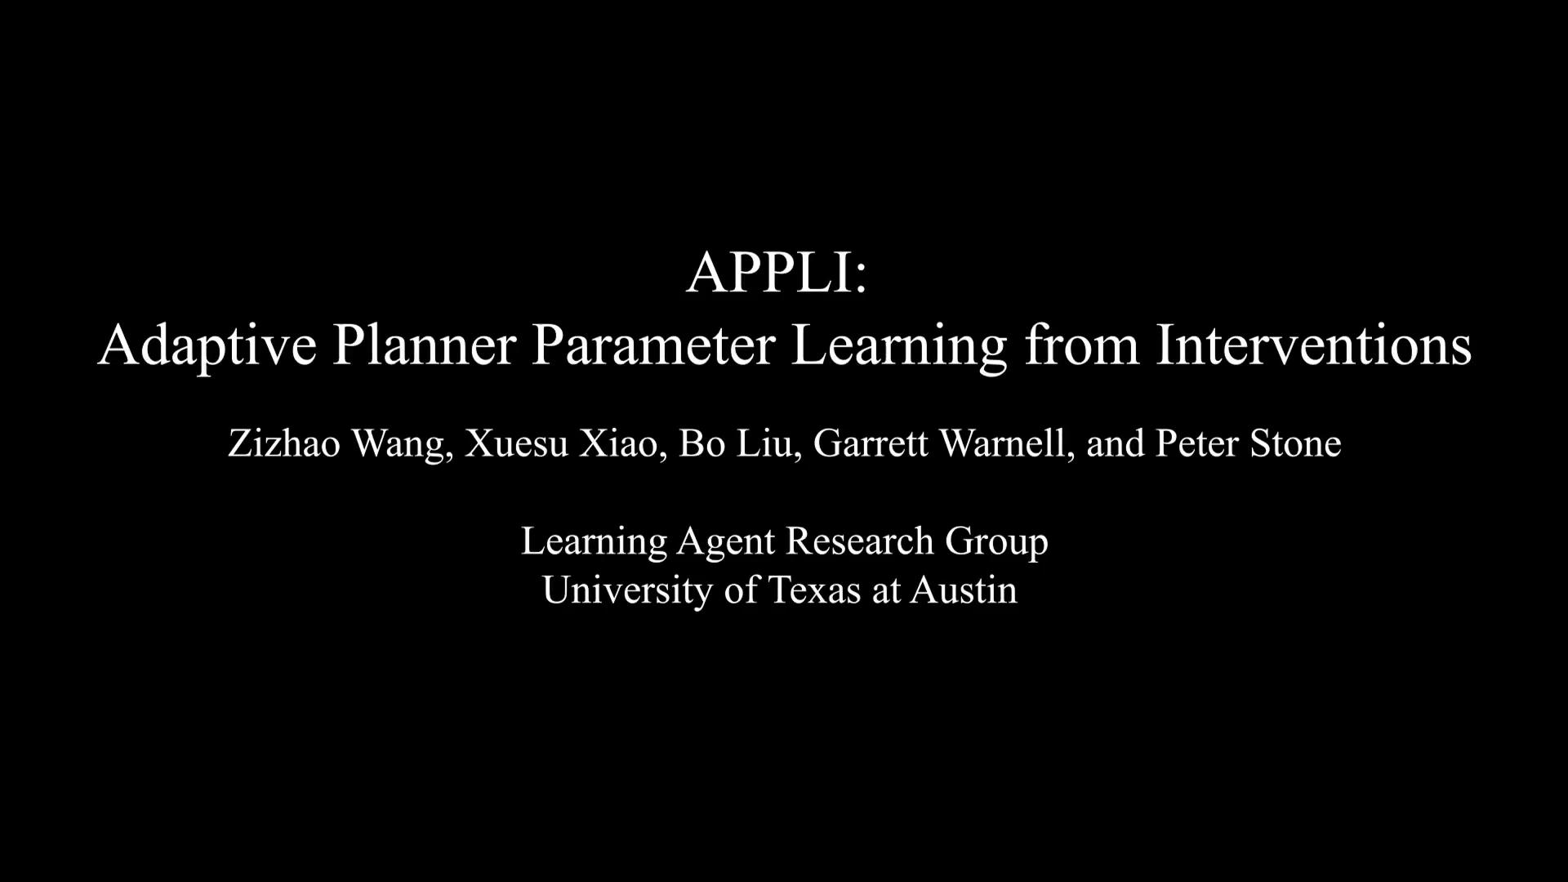

Adaptive Planner Parameter Learning (APPL)
Inspiration: Most humans are not robotics experts, but they are navigation experts.
Teleoperated Demonstration
Corrective Interventions
Evaluative Feedback
Reinforcement Learning

Slide 20
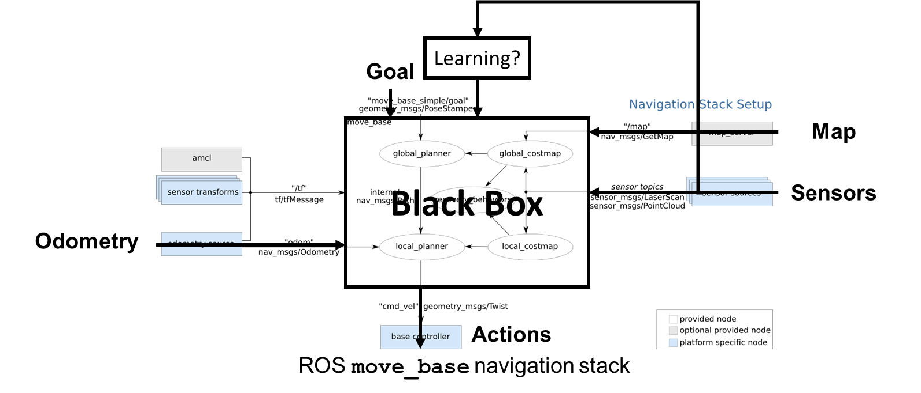
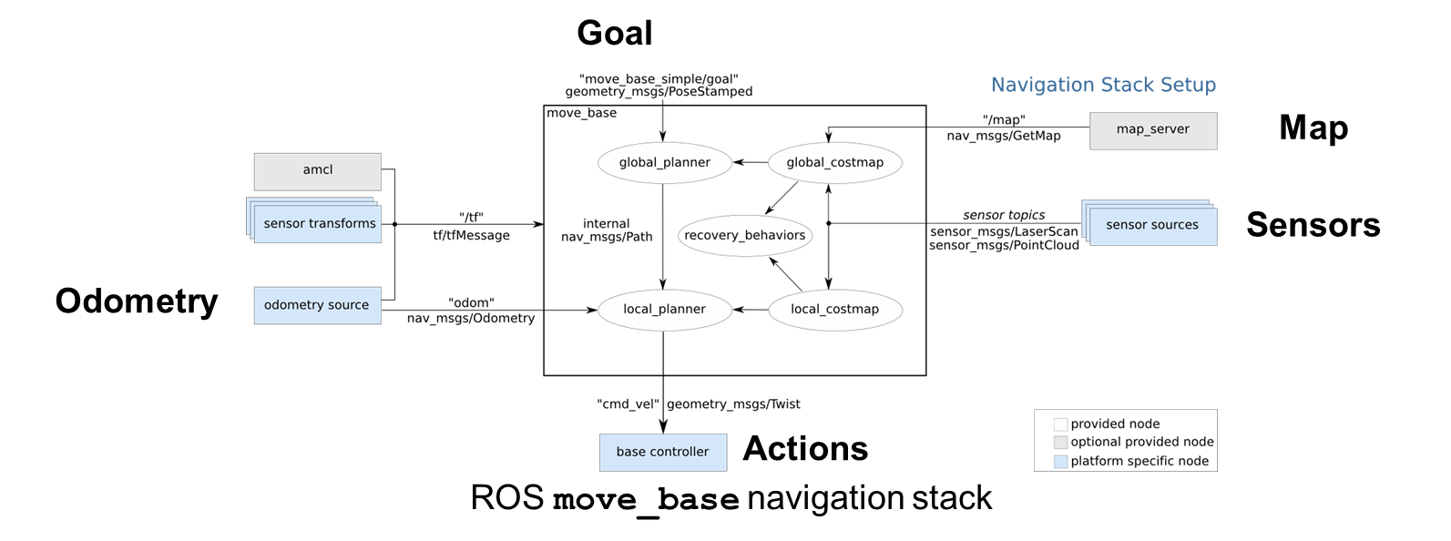
In Navigation Language…
[ROS move_base]

Slide 21
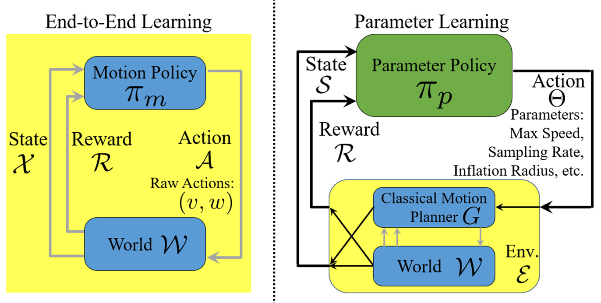
In Learning Language…
[Gao et al., CoRL17, Pfeiffer et al., ICRA17, Chiang et al., RA-L19, Xiao et al., RA-L21]
[Xiao et al., RA-L20, Wang et al., ICRA21, Wang et al., RA-L21, Xu et al., ICRA21]

Slide 22
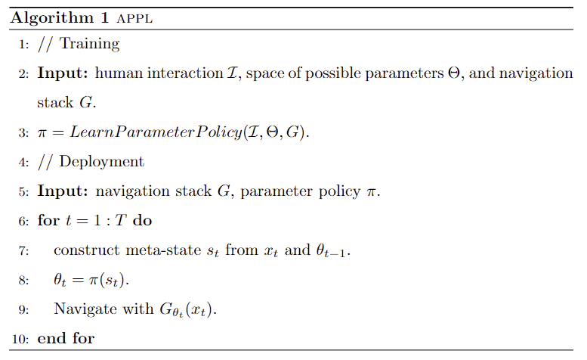
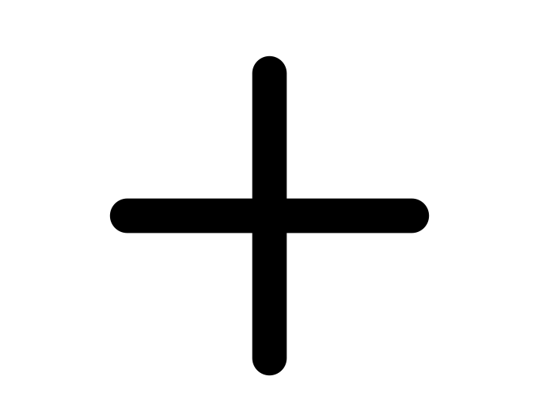


APPL from Human Interactions [Xiao et al., RAS22]

Slide 23




Adaptive Planner Parameter Learning from Demonstration (APPLD) [Xiao et al., RA-L20]
APPLD imposes an internal structure to the general parameter policy
State
Context Predictor
Context
Parameter Library
Param.

Slide 24
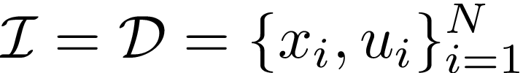
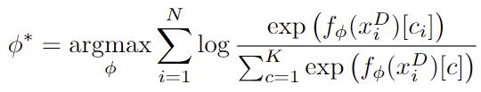


Adaptive Planner Parameter Learning from Demonstration (APPLD) [Xiao et al., RA-L20]
Context Predictor:
1. Collect demonstration
2. Perform automatic segmentation (e.g., using CHAMP [Niekum et al. ICRA15])
3. Train online context predictor

Slide 25
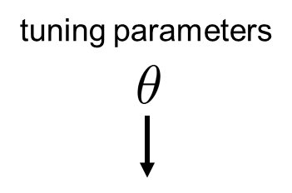
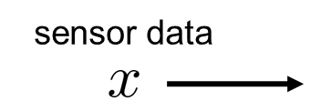
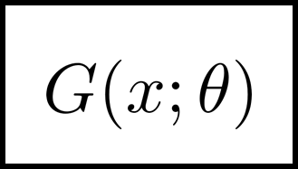
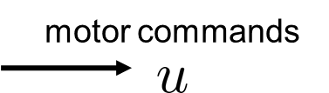
Adaptive Planner Parameter Learning from Demonstration (APPLD) [Xiao et al., RA-L20]
Parameter Library: For each context, use behavior cloning to construct each element of the parameter library
max_vel_x: 0.5
min_vel_x: 0.1
max_vel_theta: 1.57
min_vel_theta: -1.57
vx_samples: 6
vtheta_samples: 20
occdist_scale: 0.1
pdist_scale: 0.75
gdist_scale: 1.0
Inflation_radius: 0.30
......
Behavioral Cloning: Learn parameters from a demonstration using supervised learning.

Slide 26
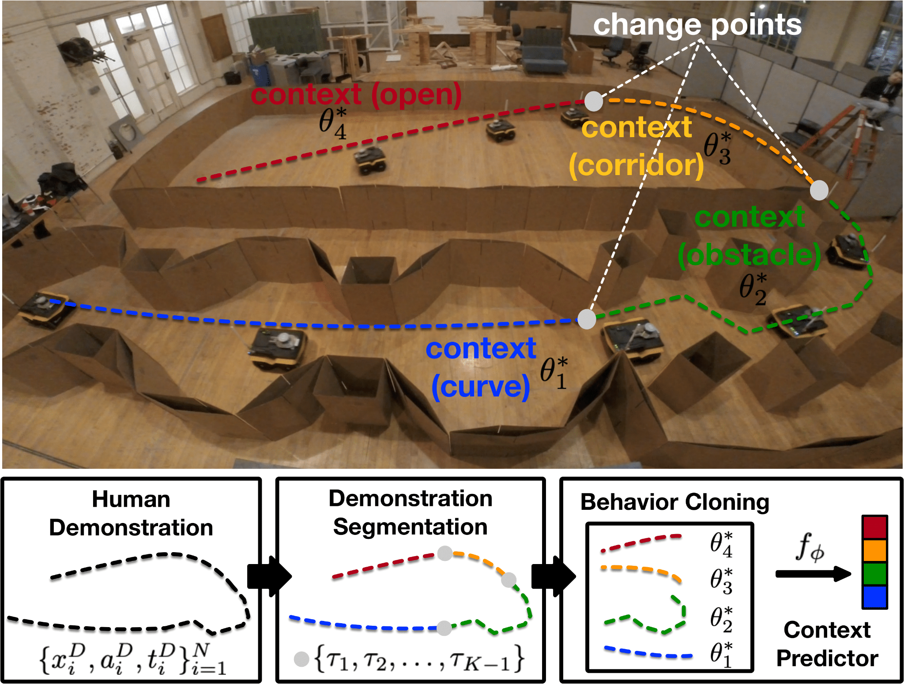
Adaptive Planner Parameter Learning from Demonstration (APPLD) [Xiao et al., RA-L20]

Slide 27
Adaptive Planner Parameter Learning from Demonstration (APPLD) [Xiao et al., RA-L20]

Slide 28
Adaptive Planner Parameter Learning from Demonstration (APPLD) [Xiao et al., RA-L20]

Slide 29
APPL from Human Interactions [Xiao et al., RAS22]

Slide 30
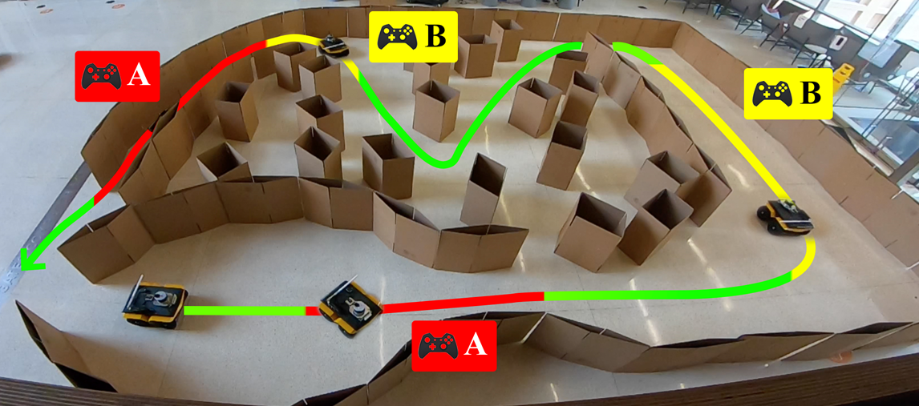


Adaptive Planner Parameter Learning from Interventions (APPLI) [Wang et al., ICRA21]
Robots do not behave suboptimally everywhere: Intervention when necessary
Context
Param.
State
Ctx. Pred.
Param. Library
Y
Confident?
N
Default Param.

Slide 31
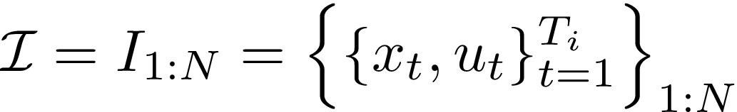


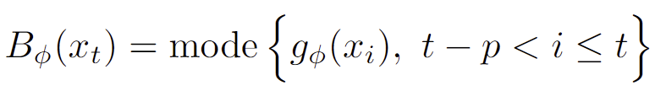
Adaptive Planner Parameter Learning from Interventions (APPLI) [Wang et al., ICRA21]
Context Predictor:
1. Collect (naturally segmented) interventions
2. Train context predictor with Evidential Deep Learning (EDL) [Sensoy et al. NeurIPS18]
Parameter Library
3. Behavior clone parameters for each intervention

Slide 32
APPL from Human Interactions [Xiao et al., RAS]

Slide 33
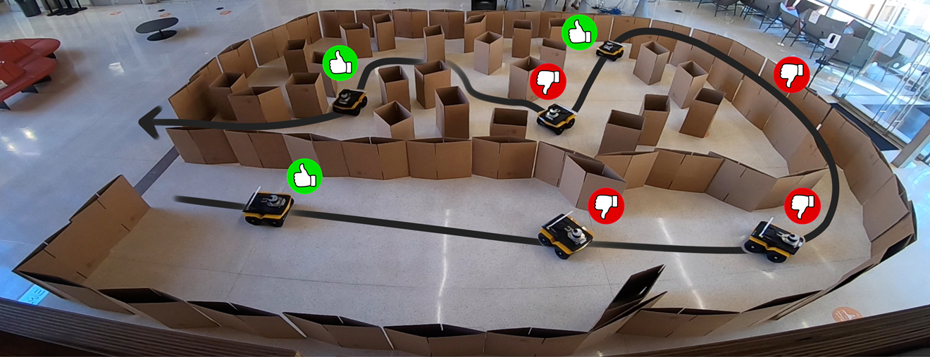


Adaptive Planner Parameter Learning from Evaluative Feedback (APPLE) [Wang et al., RA-L21]
Non-expert users may not be able to take control of the robot: Evaluative feedback
Discrete APPLE
Best Feedback
State
Feedback Predictor
Parameter Library
Param.

Slide 34



Discrete Adaptive Planner Parameter Learning from Evaluative Feedback (APPLE) [Wang et al., RA-L21]
Existing Parameter Library (from default, manually tuned, APPLD, APPLI, etc.)
Feedback Predictor:
1. Collect feedback set
2. Train feedback predictor
3. Deploy parameter policy

Slide 35
Adaptive Planner Parameter Learning from Evaluative Feedback (APPLE) [Wang et al., RA-L21]
Non-expert users may not be able to take control of the robot: Evaluative feedback
Continuous APPLE
State
Policy Network
Parameters

Slide 36
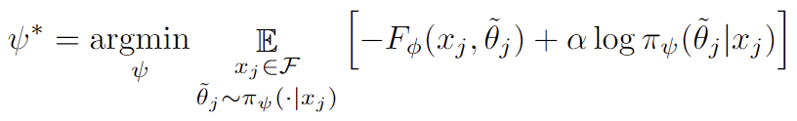
Continuous Adaptive Planner Parameter Learning from Evaluative Feedback (APPLE) [Wang et al., RA-L21]
Parameter Space instead of Parameter Library
Policy Network:
Train in actor-critic style
Critic
Actor

Slide 37
APPL from Human Interactions [Xiao et al., RAS22]

Slide 38
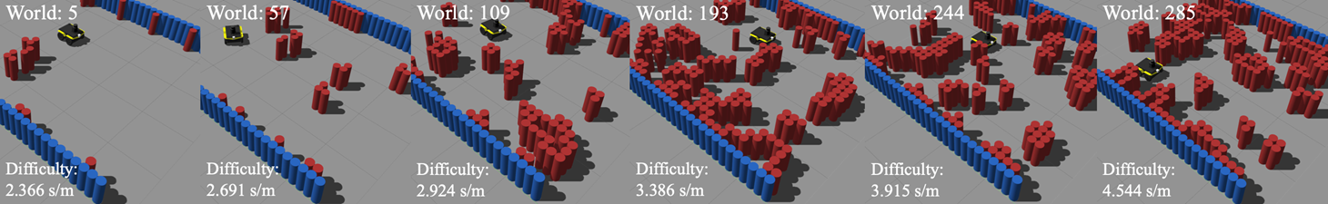
Adaptive Planner Parameter Learning from Reinforcement (APPLR) [Xu et al., ICRA21]
What about no humans at all?
Reinforcement Learning
APPLR
State
Policy Network
Parameters
Benchmark Autonomous Robot Navigation (BARN) Dataset [Perille et al., SSRR21]

Slide 39
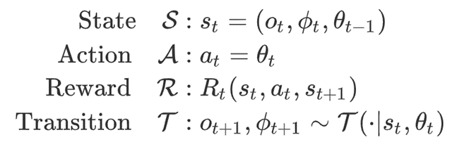
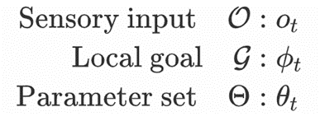
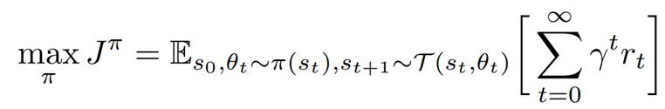
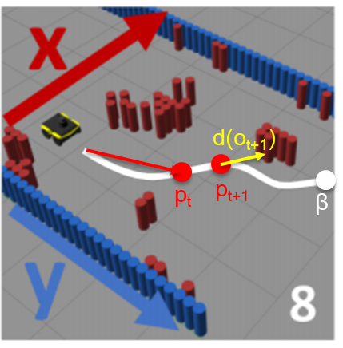
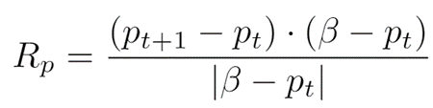

Adaptive Planner Parameter Learning from Reinforcement (APPLR) [Xu et al., ICRA21]
Optimization Objective:
Reward Design:

Slide 40
APPL from Human Interactions [Xiao et al., RAS22]

Slide 41
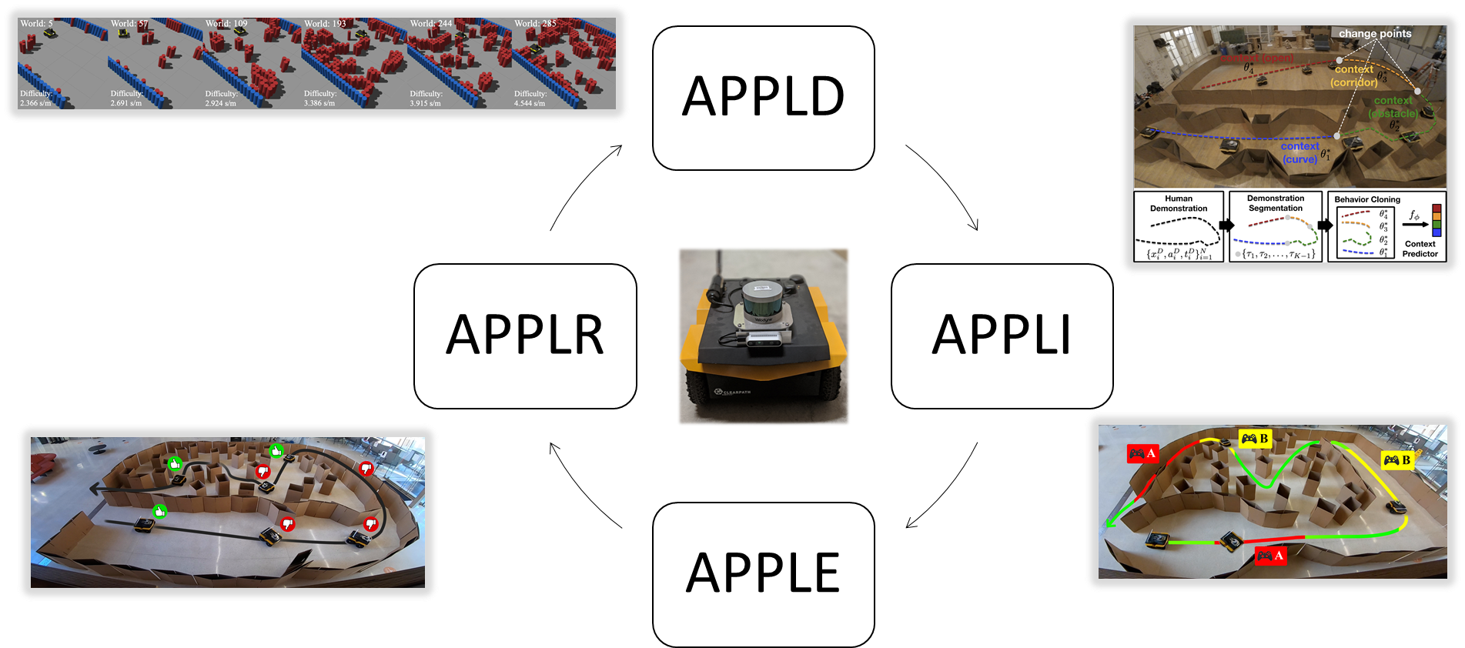
Cycle-of-Learning from APPL [Xiao et al., RAS22]
[Xu et al., ICRA21]
[Xiao et al., RA-L20]
[Wang et al., RA-L21]
[Wang et al., ICRA21]

Slide 42
References
Xiao, Xuesu, Bo Liu, Garrett Warnell, and Peter Stone. "Motion planning and control for mobile robot navigation using machine learning: a survey." Autonomous Robots (2022): 1-29.
Gao, Wei, David Hsu, Wee Sun Lee, Shengmei Shen, and Karthikk Subramanian. "Intention-net: Integrating planning and deep learning for goal-directed autonomous navigation." In Conference on Robot Learning, pp. 185-194. PMLR, 2017.
Pfeiffer, Mark, Michael Schaeuble, Juan Nieto, Roland Siegwart, and Cesar Cadena. "From perception to decision: A data-driven approach to end-to-end motion planning for autonomous ground robots." In 2017 ieee international conference on robotics and automation (icra), pp. 1527-1533. IEEE, 2017.
Chiang, Hao-Tien Lewis, Aleksandra Faust, Marek Fiser, and Anthony Francis. "Learning navigation behaviors end-to-end with autorl." IEEE Robotics and Automation Letters 4, no. 2 (2019): 2007-2014.
Xiao, Xuesu, Bo Liu, Garrett Warnell, and Peter Stone. "Toward agile maneuvers in highly constrained spaces: Learning from hallucination." IEEE Robotics and Automation Letters 6, no. 2 (2021): 1503-1510.
Xiao, Xuesu, Bo Liu, Garrett Warnell, Jonathan Fink, and Peter Stone. "APPLD: Adaptive planner parameter learning from demonstration." IEEE Robotics and Automation Letters 5, no. 3 (2020): 4541-4547.
Wang, Zizhao, Xuesu Xiao, Bo Liu, Garrett Warnell, and Peter Stone. "APPLI: Adaptive planner parameter learning from interventions." In 2021 IEEE International Conference on Robotics and Automation (ICRA), pp. 6079-6085. IEEE, 2021.
Wang, Zizhao, Xuesu Xiao, Garrett Warnell, and Peter Stone. "APPLE: Adaptive planner parameter learning from evaluative feedback." IEEE Robotics and Automation Letters 6, no. 4 (2021): 7744-7749.
Xu, Zifan, Gauraang Dhamankar, Anirudh Nair, Xuesu Xiao, Garrett Warnell, Bo Liu, Zizhao Wang, and Peter Stone. "APPLR: Adaptive planner parameter learning from reinforcement." In 2021 IEEE International Conference on Robotics and Automation (ICRA), pp. 6086-6092. IEEE, 2021.
Niekum, Scott, Sarah Osentoski, Christopher G. Atkeson, and Andrew G. Barto. "Online bayesian changepoint detection for articulated motion models." In 2015 IEEE International Conference on Robotics and Automation (ICRA), pp. 1468-1475. IEEE, 2015.
Sensoy, Murat, Lance Kaplan, and Melih Kandemir. "Evidential deep learning to quantify classification uncertainty." arXiv preprint arXiv:1806.01768 (2018).

Slide 43
Final Project Presentation next week!
10-min presentation + 5-min Q&A (15-min per team)
  Reminder of what your project is about?
  What is your approach?
  What have you done?
  What are the results? Any thing learned?
  Project Demo! (Preferably live, at least recorded)
Remember the open-ended project is 40% of your final grade
  Devote 40% of the effort necessary for a 3-credit graduate-level course!
Final project report due in two weeks

Slide 44
Course Evaluation
Please help fill in the course evaluation form at https://gmu.bluera.com/gmu/
Your feedback will be very helpful in improving future offerings of the course
Send the instructor a screenshot of proof of completion to get 5 points extra credit ☺

