Slide 1
Bigtable
A Distributed Storage System for Structured Data
Presented by Neema Farahmand

Slide 2
Motivation
Google collects and stores tons of data
  “Google’s metadata is larger than your bigdata”
Many incoming requests to handle
No commercial system suitable for the task:
  Scale is too large
  Expensive
  Can’t run on commodity hardware
Goals:
  Fault-tolerant, persistent
  Scalable
  Simple

Slide 3
What is Bigtable?
A distributed storage system for managing structured data, developed and used by Google
Large scale – petabytes of data across thousands of commodity servers
Resembles a database, does not support full relational data model
NoSQL
https://www.researchgate.net/figure/Google-BigTable-Architecture-BigTable-has-three-different-types-of-servers-namely-Master_fig2_265062016

Slide 4
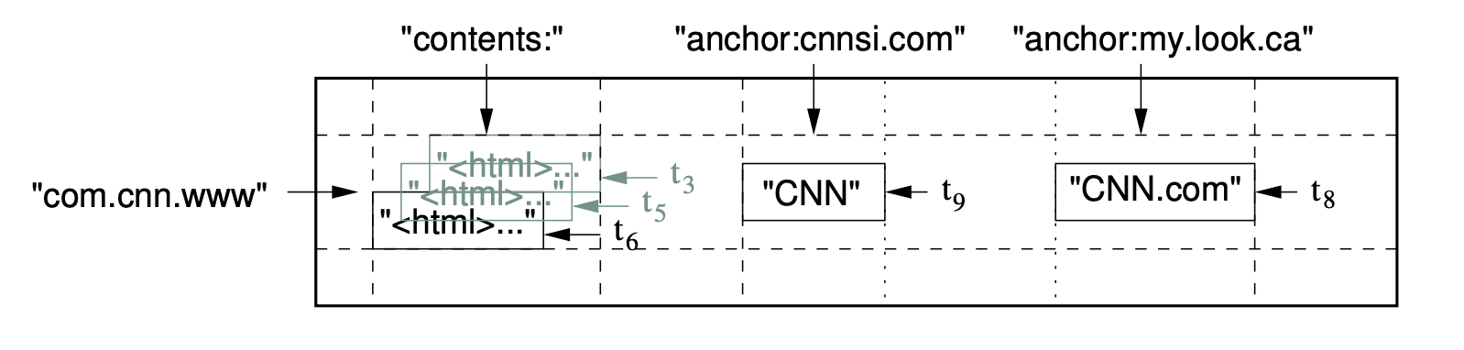
Data Model
Sparse, distributed, persistent multi-dimensional sorted map
Made up of rows, columns, and timestamps
Map index:
  (row:string, column:string, time:int64)→ string
Webtable example – storing large collection of web pages and related info

Slide 5
Rows
The row key is made up of arbitrary strings
Data maintained in lexicographic order by row key
Each row range is called a tablet, unit of distribution and load balancing
  Short row range -> small number of machines
Row naming recommendations:
  No predictable order – distributes writes evenly (i.e. username)
  Keep related rows close together for efficient group reads – examples:
    Webtable example -> com.google.maps/index.html
    Weather data (location followed by timestamp) -> WashingtonDC#201803061617

Slide 6
Columns
Column keys are grouped into sets called column families
  Data in column family usually of the same type
  Can be compressed together
  Small number of column families per table (hundreds at most)
  Column number unbounded
Column key syntax -> family:quialifier
https://www.cs.rutgers.edu/~pxk/417/notes/content/bigtable.html

Slide 7
Timestamps
Each cell can contain multiple versions of the same data – indexed by timestamp
Assigned 2 ways:
  Assigned by Bigtable; represents real time in milliseconds
  Explicitly assigned by client
Two per-column-family settings for garbage collection:
  Keep last n versions of a cell
  Keep new-enough version (i.e. last 7 days)

Slide 8
API
Mentioned in article:
  Create, delete tables and column families
  Changing cluster, table, column family metadata
Cloud Bigtable – client libraries
  C++
  C#
  Go
  Java
  Python

Slide 9
Building Blocks
Bigtable sits on top of distributed Google File System (GFS) to store log and data files
Google SSTable format is used internally to store Bigtable data
  Persistent, ordered immutable map from keys to values
  Key/value: arbitrary byte string
  Sequence of blocks (64KB - congurable)
  Block index at end of SSTable for locating blocks
  Index loaded into memory when SSTable opened
  Lookup performed in one seek
    Find appropriate block from in-memory index
    Read appropriate block from disk
  Option to completely map SSTable to memory

Slide 10
Building Blocks
Chubby – highly-available and persistent distributed lock service
  5 replicas using Paxos consensus algorithm
  Ensure one active master
  Store location of Bigtable data
  Discover tablet servers and finalize tablet death
  Store Bigtable schema information
  Store access control lists

Slide 11
Implementation - Architecture
Client Library
Client Library
1
Communicate directly with tablet servers for read and writes
Responsible for assigning tablets to tablet servers, detecting the addition and expiration of tablet servers, balancing tablet-server load, and garbage collection of files in GFS
Manages a set of tablets (10 – 1000), handles read/write requests, splits large tablets
All data associated with a row range
Client Library
Chubby
2
Master
Tablet Server
Tablet Server
3
Tablet Server
Tablet
Tablet
Tablet
Tablet
4
Tablet

Slide 12
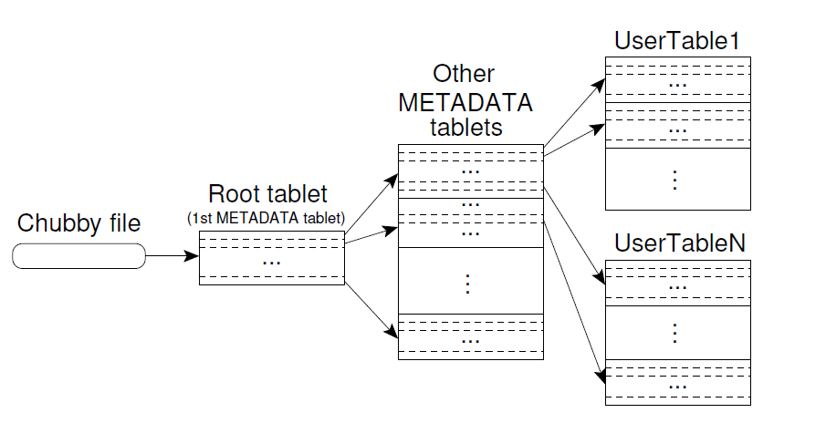
Tablet Location
Chubby file contains location of root table
  Contains location of all tablets in METADATA table
  Root table never split to limit levels of hierarchy
Client library pre-fetches and caches tablet locations
  If cache is empty, 3 network round-trips, including one read from Chubby
  If cache is stale, up to 6 network round-trips due to miss
  Reduced by reading data for more than one tablet whenever it reads METADATA

Slide 13
Tablet Assignment
Chubby is used to keep track of tablet servers
New tablet server:
  Tablet server creates and acquired exclusive lock in Chubby
  Master monitors directory for new tablet servers and assigns tablets
Removing tablet server:
  Tablet server stops serving tablets when it loses the exclusive lock (network partition)
    Master periodically asks tablet for status of lock

Slide 14
Tablet Assignment
Tablet server startup – acquire Chubby lock
  Uniquely named file in server directory
Master periodically asks tablet server for status of lock
Master unable to reach server
Master attempts to acquire lock on server’s file
  If master acquires lock, Chubby is live and tablet server is dead -> delete server file
Master reassigns tablets to another tablet server
Master
Chubby
4
3
2
1
Tablet Server

Slide 15
What if master can’t reach Chubby?
2
Master can’t reach Chubby, or session expires
Master kills itself
New Master started by cluster management system
Master gets unique master lock in Chubby
  Prevents concurrent master instantiation
Scan server directory for live tablet servers
Communicates with all tablet servers to discover assigned tablets
Scans METADATA table to learn set of tablets
  If a tablet is unassigned, assigns tablets
Master
Chubby
1
4
New Master
3
6
Tablet Server
Tablet Server

Slide 16
Tablet Serving
Persistent state is stored in GFS
Recent commits are stored in memory in sorted buffer called memtable
Write operation:
  Authorized by list in Chubby file
  Mutation written to commit log
  After commit, content inserted into memtable
Read operation:
  Authorized
  Read executed on merged view of SSTables and memtable
    SSTables and memtables are lexicographically sorted, merged view is formed efficiently

Slide 17
Compaction
Minor Compaction
  Memtable size reaches threshold
  Memtable frozen
  New memtable created
  Frozen memtable converted to SSTable and write to GFS
  Always creates new SSTable
Merging Compaction
  Periodically reads data from few SSTables and memtable to create new SSTable
  Discard old SStable and memtable
Major Compaction
  Rewrites all SSTables into one SStable
  Minor and merging compactions contain delete action info, major removes this delete data

Slide 18
Refinements
Locality Groups
  Clients group multiple column families into locality groups – generates separate SSTable for group
  Segregates column families that are not typically accessed together
  Example: page metadata in Webtable in different locality group than page content
    Application for metadata usually doesn’t want to read content
  Can be declared to be in-memory – lazily loaded into tablet server memory
Compression
  Clients can control whether SSTables for locality group are compressed (and format)
  Each block is compressed individually, so whole SSTable does need to be decompressed
Bloom Filters
  Client can specify use of Bloom Filter for locality group
  Stored in tablet server memory
  Can check if SSTable has data for row/column pair before going to disk
  Small amount of memory tradeoff for less disk seeks

Slide 19
Refinements
Immutability
  All SSTables are immutable
  No synchronization of access needed
  For data to be removed, use marked-and-sweep garbage collection
    Master coordinates this to remove obsolete SSTables
  Only mutable data structure accessed by read and write is memtable
    Reduce contention by making it copy-on-write

Slide 20
Performance Evaluation Setup
N tablet servers
  1 GB memory
GFS cell of 1786 machines
  Two 400 GB hard drives each
N client machines
  Same number as tablet servers to ensure clients didn’t bottleneck
All machines hosted in same facility
  Round trip < 1 millisecond
R number of Bigtable row keys
  Chosen so benchmark read or wrote ~ 1 GB of data per tablet server

Slide 21
Performance Evaluation Benchmarks
Sequential Write
  Wrote single randomly generated string per row key
  Strings under different row key were distinct
Random Write
  Row key hashed modulo R before write
  Spreads writes uniformly
Sequential and Random Read
  Shadows operation of writes
Scan
  Scans over all values using Bigtable API
Random Read (mem)
  Similar to random read, but locality group for data is marked as in-memory
  Doesn’t need to go to GFS

Slide 22
Performance Evaluation Results

Slide 23
Performance Evaluation Results
Random Reads
  Slowest of all benchmarks
  Each read involves transfer of 64 KB SSTable block over network from GFS to tablet server
  Recommend smaller block size – 8 KB
Sequential Read
  Better than random reads
  64 KB block from GFS is cached on tablet server for future read requests
Random/Sequential Writes
  Consistent, high performance
  Tablet server appends writes to commit log and performs group commits
Scan
  Fastest since one RPC can return large number of values
  API call knows to get all data

Slide 24
Performance Evaluation Results - Scaling
Per-server throughput drops from 1 to 50 tablet servers
  Caused by imbalance in load, often due to other processes contenting for CPU and network
Random Read
  Worst scaling
  64 KB block transfer for every read
  Saturates shared network links

Slide 25
Real World Applications
As of 2006 – 388 non-test Bigtable clusters at google
Over 60 project at Google
Total of about 24,500 tablet servers
One busy group:
  14 clusters
  8069 total tablet servers
  1.2 million requests/second
Used by Google Earth, Google Analytics, Personalized Search

Slide 26
Personalized Search
Opt-in service to record user queries, stored in Bigtable
  Each user gets a unique user ID
  User ID used for row name
  Separate column family for type of action
    i.e. Web queries
  Time at which action occurred used as timestamp
  Replicated across several Bigtable clusters
  User profiles generated by MapReduce over Bigtable

Slide 27
Lessons
Large distributes systems a vulnerable to many types of failures
  Memory and network corruption
  Large clock skew
  Hung machines
  Extended and asymmetric network partitions
  Bugs in other systems (Chubby)
  Overflow of GFS quotas
  Planned and unplanned hardware maintenance
Removed assumptions about other parts of systems
  i.e. stopped assuming a given Chubby operation could return only a fixed set of errors
Importance of proper system level monitoring
  Hard to determine what is going on in the system or why there are problems
Large code base – keep the design simple

Slide 28
Bigtable Today
Bigtable is now a cloud service
Current architecture remains mostly the same, some name changes
  Nodes-> tablet servers
  Colossus -> Google File System
Apache HBase modeled after Bigtable to provide similar capabilities on top of Hadoop and HDFS

Slide 29
Questions?

