Slide 1
SAND: Towards High-Performance Serverless Computing

Slide 2
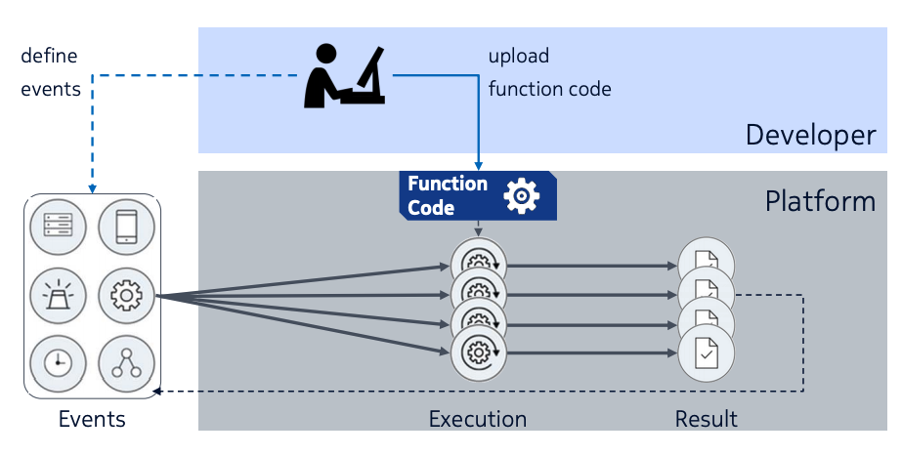
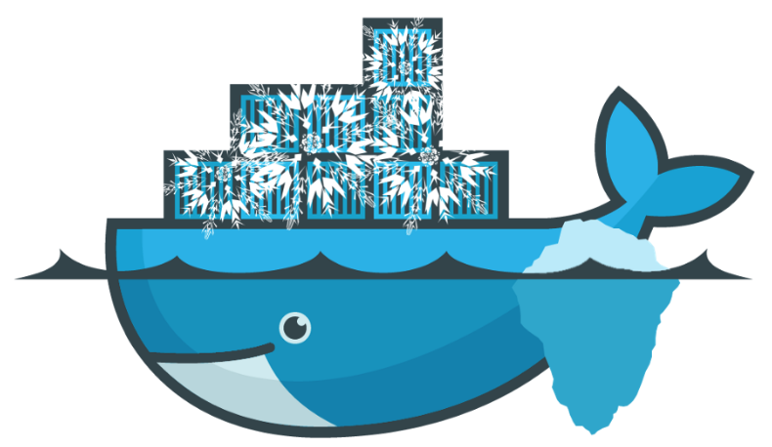
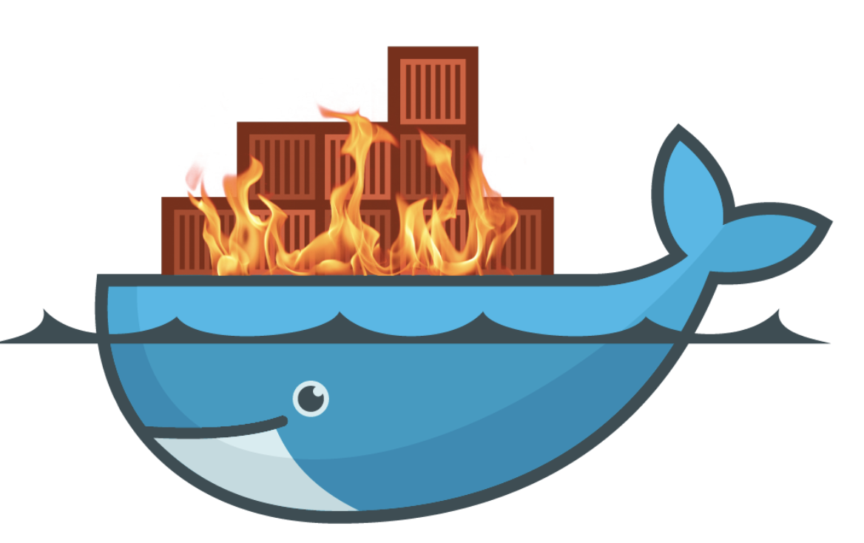
Background
Serverless computing
The new cloud computing paradigm
Existing serverless platform weakness
Startup latency
Cold container
Inefficient resource usage
Warm container standby
Function interaction
Notes:
Just upload the function to the platform
Most serverless use container to hold function
But feedback

Slide 3
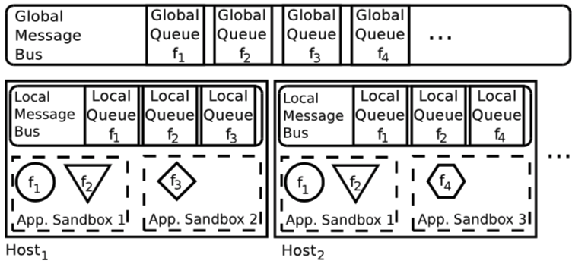
Design
SAND
Sandbox
Strong isolation in application-level
Weaker isolation between function in the same application
Hierarchical message bus
Global and local message bus

Slide 4
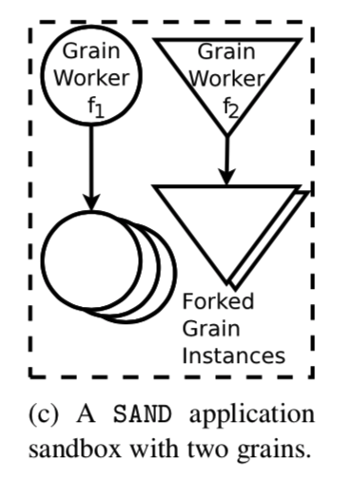
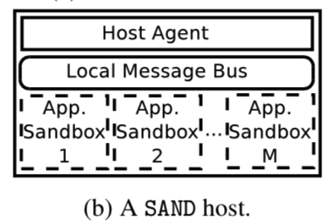
Design-Isolation(sandbox)
Sandbox-application container
Grain-function in the application container
Application runs in its own container
The functions belong to the same application run in the same container but in different processes(grain worker)
When the function be called, SAND forks a new process to execute this function

Slide 5
Design-Isolation(sandbox)
Advantages
Forking the process is quicker than start the container per function call
Shared the library
Memory footprint become more relax
Function interaction

Slide 6
Design-Hierarchical message queue
Global vs Local message bus
Global message bus
Deliver event message to different hosts
Backup of local message
Local message bus
Interacting functions in the same host(shortcut for those functions)
Accept,deliver, store event messages

Slide 7
Design-Hierarchical message queue
Advantages
Low latency in functions interaction
Fault tolerance (backup)
Parallelism

Slide 8
Design-Host agent
Host agent is a program runs in each host
Responsible for coordination between local and global message bus
Launching sandboxes
Spawn grain workers
Track the progress of the grain instances

Slide 9
Local & Global data layers
Similar to the message bus
Key-value store
Apache Cassandra

Slide 10
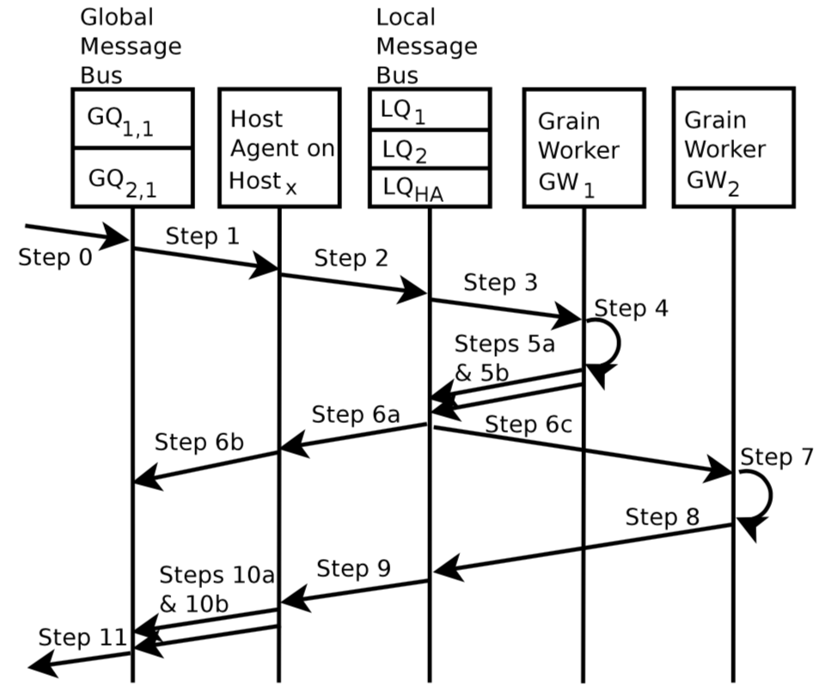
Workflow example
Step 0: send request
Step 1: host agent retrieve the event message
Step 2: HA publish it into LQ1(GW1)
Step 3: GW1 get message from LQ1
Step 4: fork the new process to trigger the function
Step 5a: grain instance publish message to LQ2
Step 5b: publish to LQHA
Step 6a & 6b: HA retrieve and publish a backup to GQ2.1
Step 6c: GW2 get message from LQ2
Step 10a: publish to global message bus

Slide 11
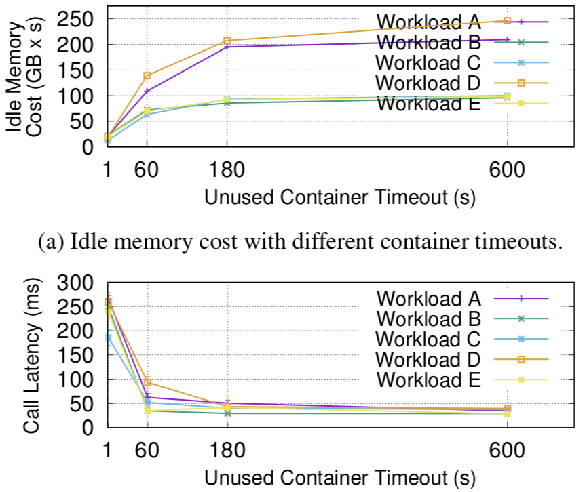
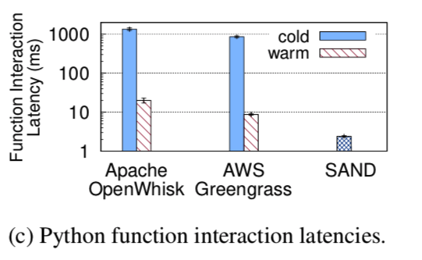
Evaluation
Idle memory
5 workloads. 2000 function each
Concurrent call
Function interaction latency
The workflow contains two functions.

Slide 12
Conclusion
SAND does not use any sharing nor cache management schemes.
Grain worker is a dedicated process
Hierarchical message queue could improve the failure tolerance and efficiency of functions interaction

