Slide 1
SCONE: Secure Linux Containers Environments with Intel SGX
CS 795
Pruthvik N Narayanaswamy

Slide 2
Motivation
Cloud provider does not trust users and use VMS to isolate users from each other and the host.
There is only one-way protection and users must implicity trust cloud providers.
Enter containers …
Benefits of low overhead, lightweight, easy deployment etc.
Existing container isolation mechanisms focus on protecting the environment from untrusted containers.
Users want to protect the confidentiality and integrity of their application data from unauthorized accesses not only from containers, but also from higher-privileged system software, such as the OS kernel and the hypervisor

Slide 3
Goals
Run Unmodified Linux Applications in containers in an untrusted cloud securely and with acceptable performance.

Slide 4
SGX : Software Guard Extensions
The SGX extension adds support for secure enclaves which shield application code and data from access by other software (including higher-privileged software)
Inside an enclave both code and data reside in an enclave page cache(EPC)
Only enclave can access enclave memory
Multiple threads can operate within an enclave, each with its own 4KB thread local storage
Some restrictions : syscalls not allowed inside enclaves

Slide 5
Performance Overheads ?
Privileged instructions cannot execute inside the enclave, so threads must exit the enclave to make system calls
On Intel Skylake CPUs, the EPC size is between 64 and 128 MB, therefore if applications with memory requirements exceeding the size of the EPC must pay for the costly encryption and integrity protection involved in moving pages out to DRAM.

Slide 6
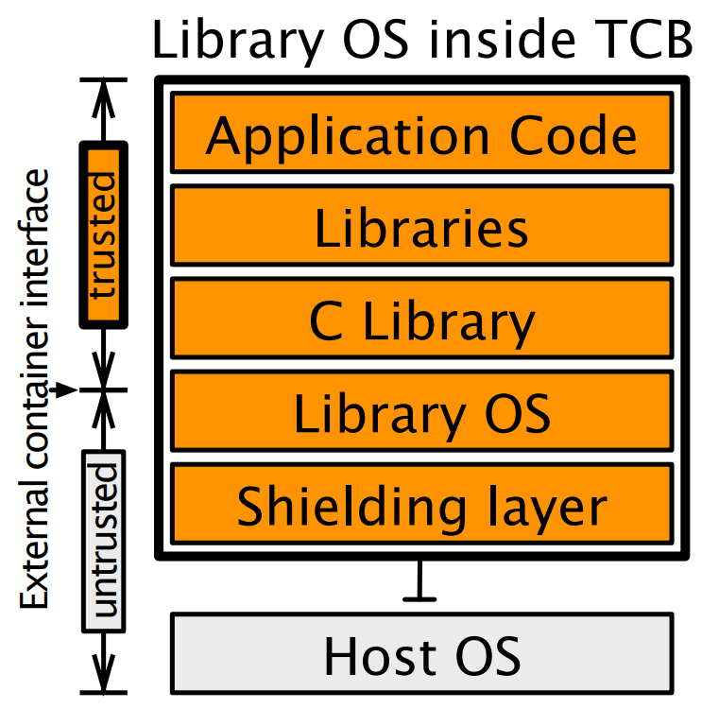
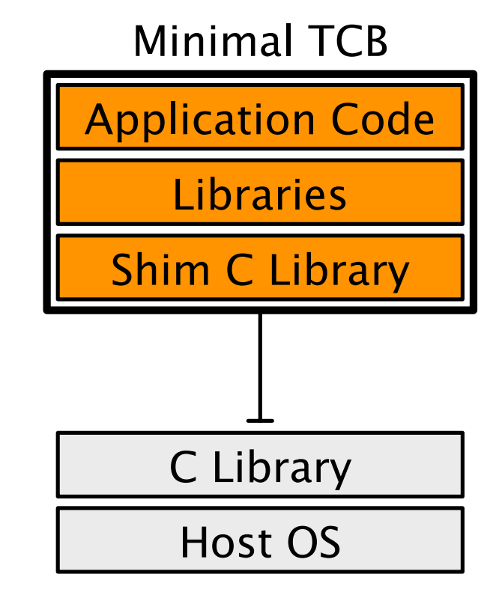
Challenges
Challenge 1 : Interface
What should be stored in the enclave ?

Slide 7
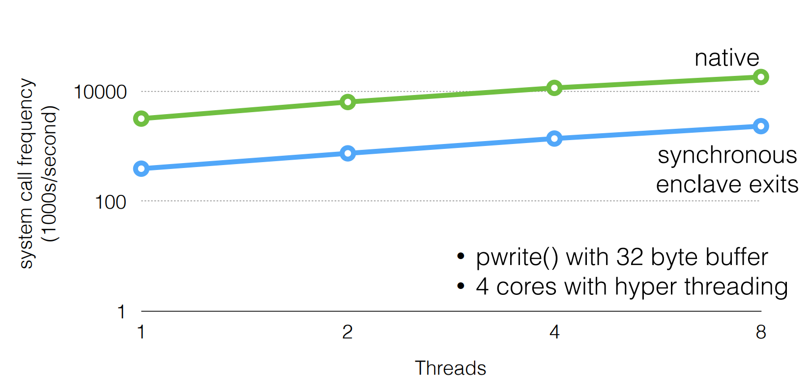
Performance Challenge

Slide 8
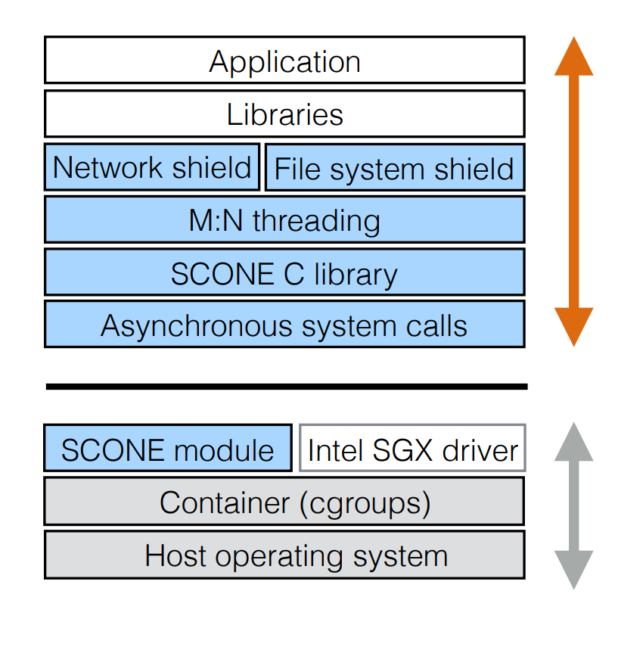
Scone Architecture
Enhanced C library = small TCB
Asynchronous system calls and user space threading reduce number of enclave exits
Network and file system shields actively protect user data

Slide 9
Shields
A file system shied protects the confidentiality and integrity of files, with transparent authentication and encryption.
A network shield ensures that all network communications use TLS, terminated inside the enclave.
A console shield protects the confidentiality of data sent via the stdin, stdout, and stderr streams.

Slide 10
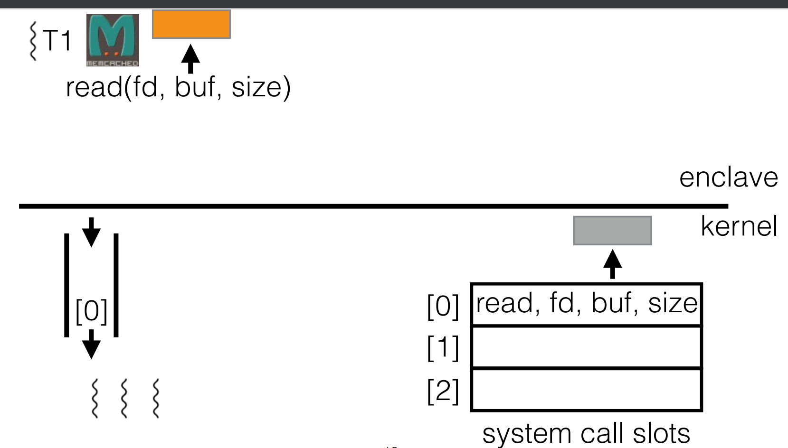

Slide 11
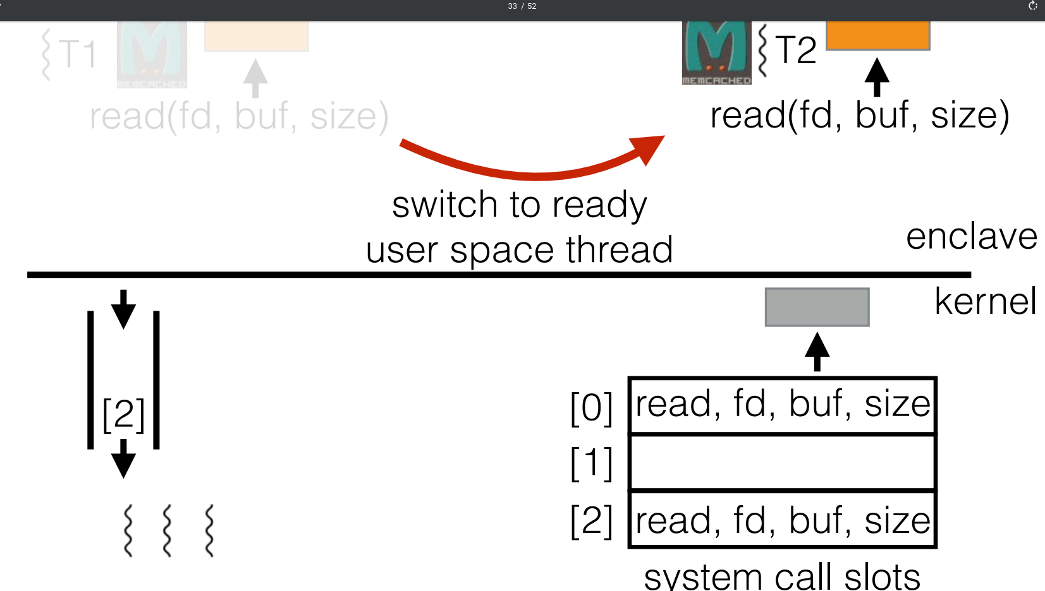

Slide 12
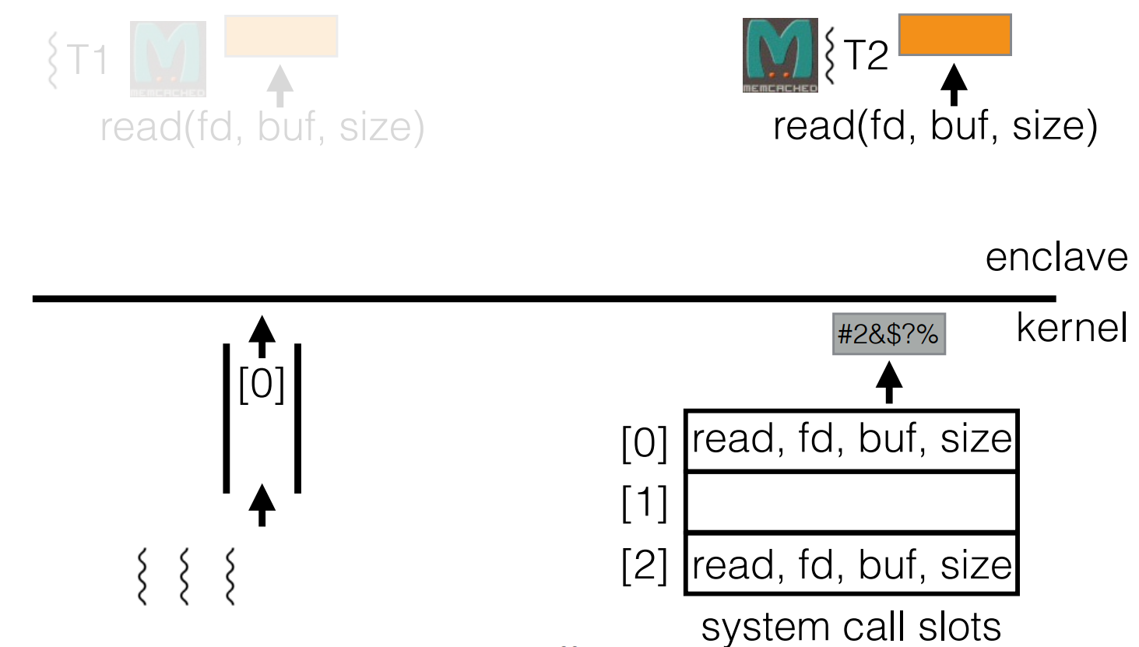

Slide 13
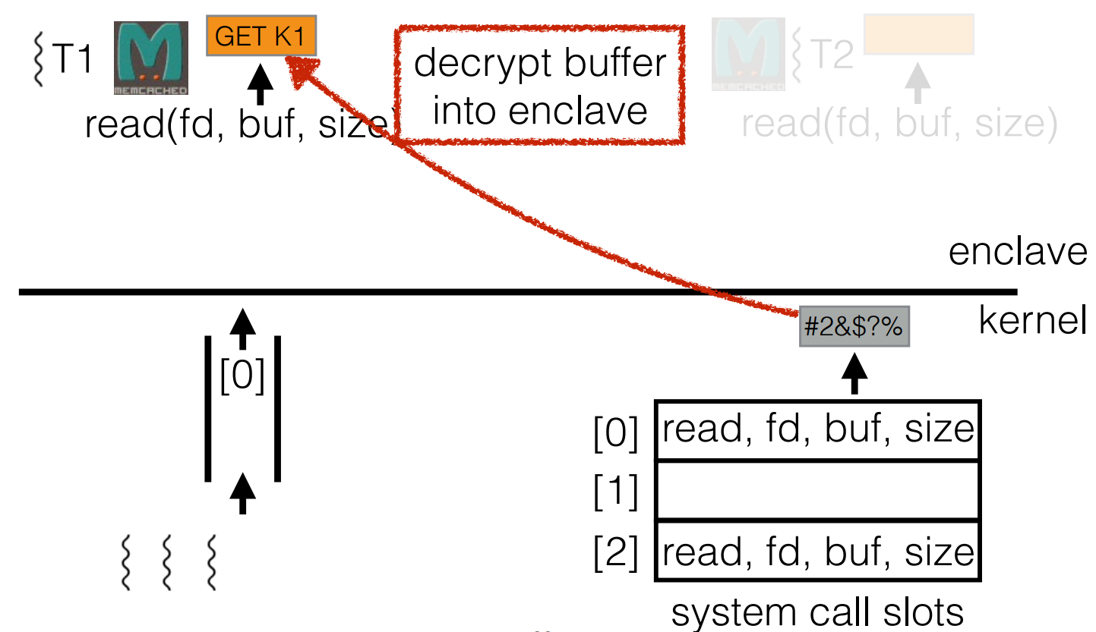

Slide 14
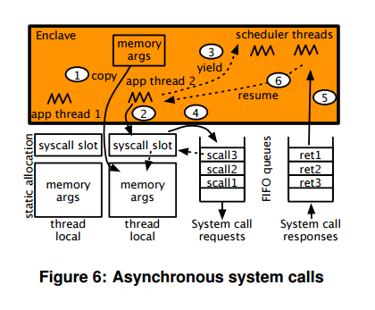
Async System calls

Slide 15
Integrate with Docker
Does not require changes to be made to the Docker Engine or the Docker API
Uses a wrapper around the Docker client, Scone client.

Slide 16
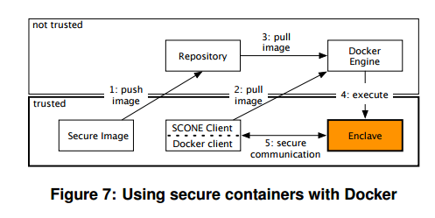
Workflow with Docker
When a container instance is created from the image, a startup configuration file (SCF) is sent to it via a TLS protected network connection. The SCF contains keys to encrypt standard I/O streams, a hash of the FS protection file and its encryption key, application arguments, and environment variables.

Slide 17
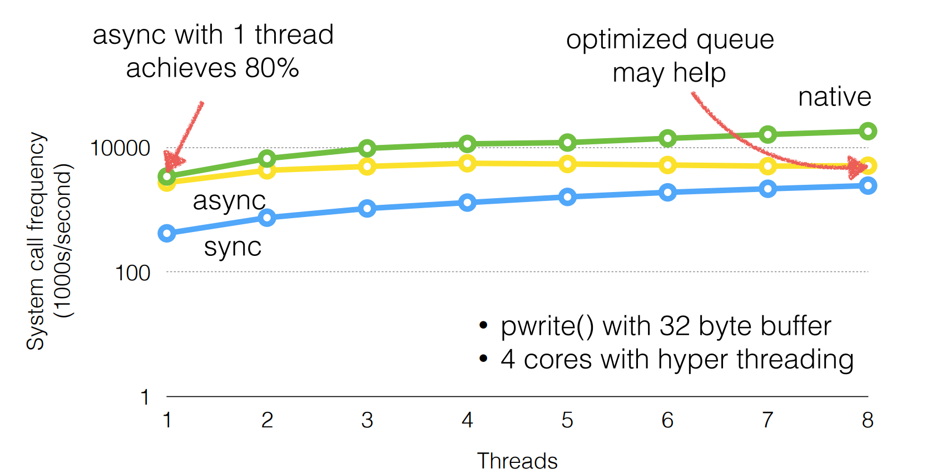
Performance Benchmarks

Slide 18
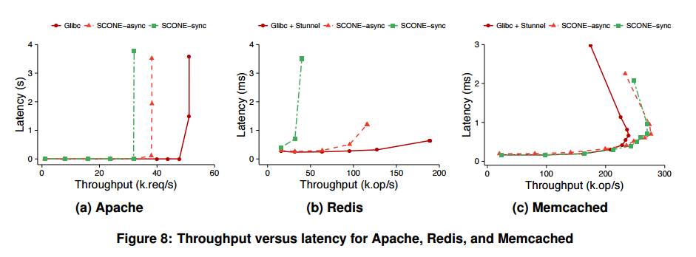
Application benchmark

Slide 19
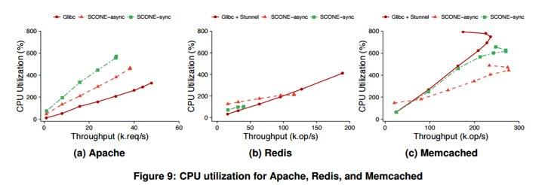
CPU Utilization

Slide 20
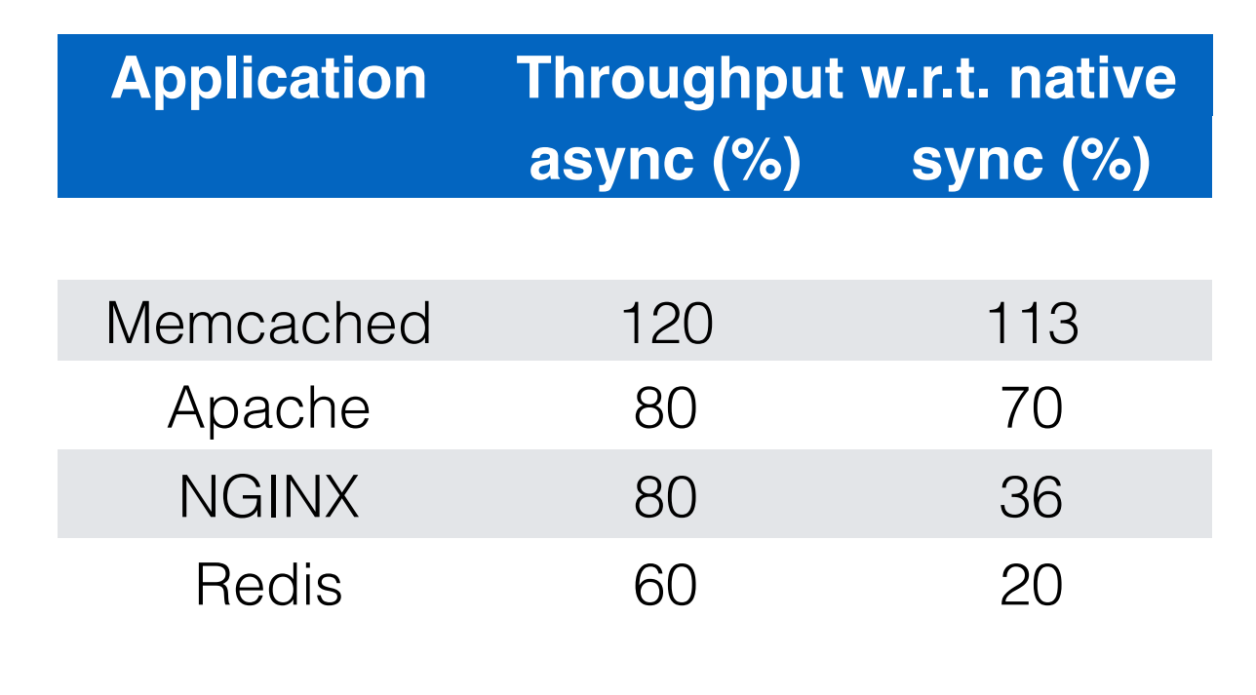
Application performance

Slide 21
Related Work
Software protection against privileged code
Initial work such as NGSCB and Proxos executes untrusted and trusted OSs side-by side using virtualization, with security-sensitive applications hosted by the trusted OS.
Subsequent work, including Overshadow, SP3, InkTag and Virtual Ghost, has focused on reducing the size of the TCB by directly protecting application memory from unauthorized OS accesses.

Slide 22
Trusted hardware
Secure co-processors offer tamper-proof physical isolation and can host arbitrary functionality.
Trusted platform modules (TPM) offer tailored services for securing commodity systems.
ARM TrustZone has two system personalities, secure and normal world. This split meets the needs of mobile devices in which a rich OS must be separated from the system software controlling basic operations.
Intel SGX

Slide 23
References
Anatomy of system call from https://www.usenix.org/sites/default/files/conference/protected-files/osdi16_slides_knauth.pdf

Slide 24
Thank you Questions ?

