Slide 1
SOCK: Rapid Task Provisioning with Serverless-Optimized Containers

Slide 2
Introduction
Container shortage: Cold start time.
Cold start is expensive. Tenant and provider want fast cold start time
High-level language like python has many runtimes
Two studies
The costs of Linux provisioning primitives
Study 876K Python projects from GitHub and analyzing 101K unique packages from the PyPI (Python package index) repository
Sock
Lightweight isolation primitives
Zygotes-provisioning strategy avoid the python initialization cost
Three-tier container caching

Slide 3
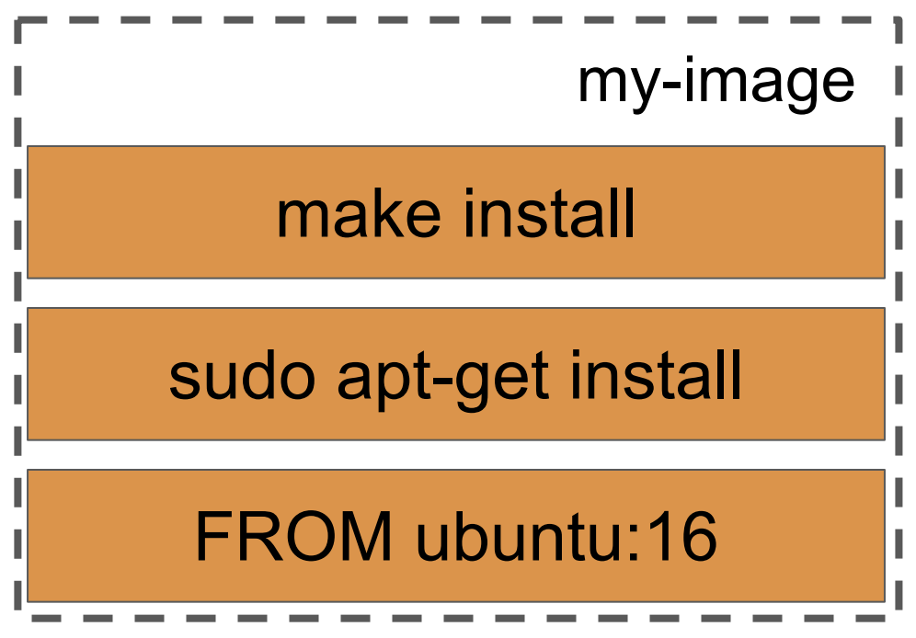
Container storage - File system
Docker typically uses union file systems (e.g., AUFS)
Simpler alternative is bind mounting which makes the same directory visible at multiple locations.

Slide 4
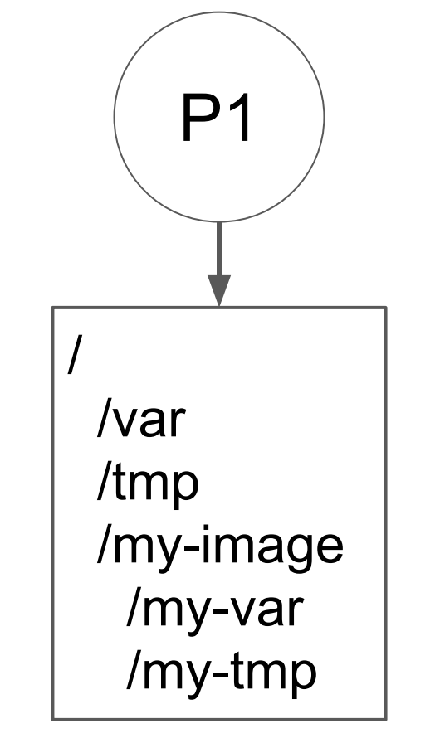
Logical isolation - Namespace Primitives

Slide 5
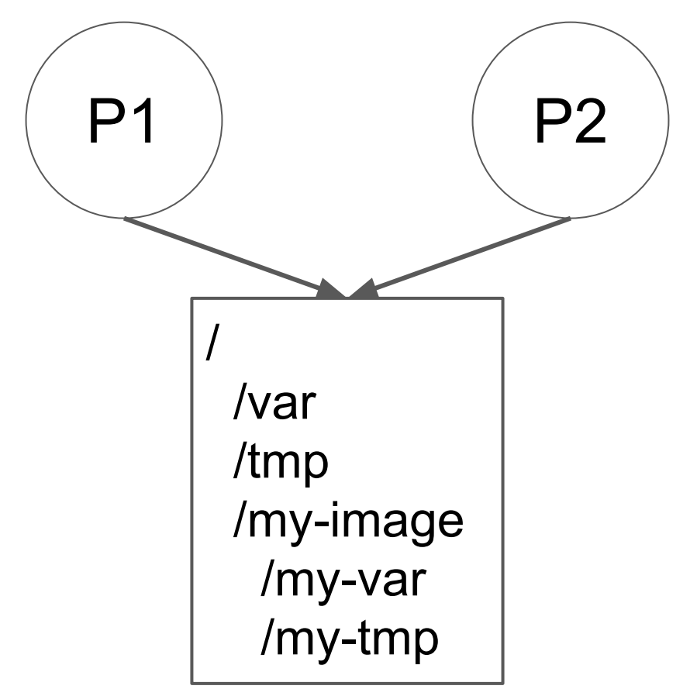
Logical isolation - Namespace Primitives
fork()
a.
C. unshare() call
b.

Slide 6
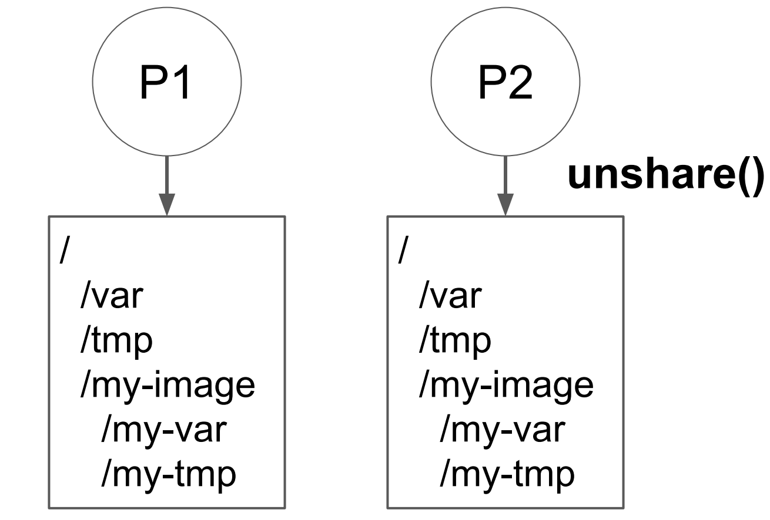
Logical isolation - Namespace Primitives

Slide 7
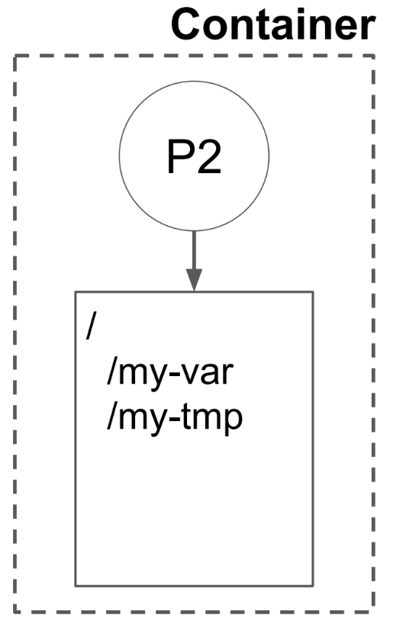
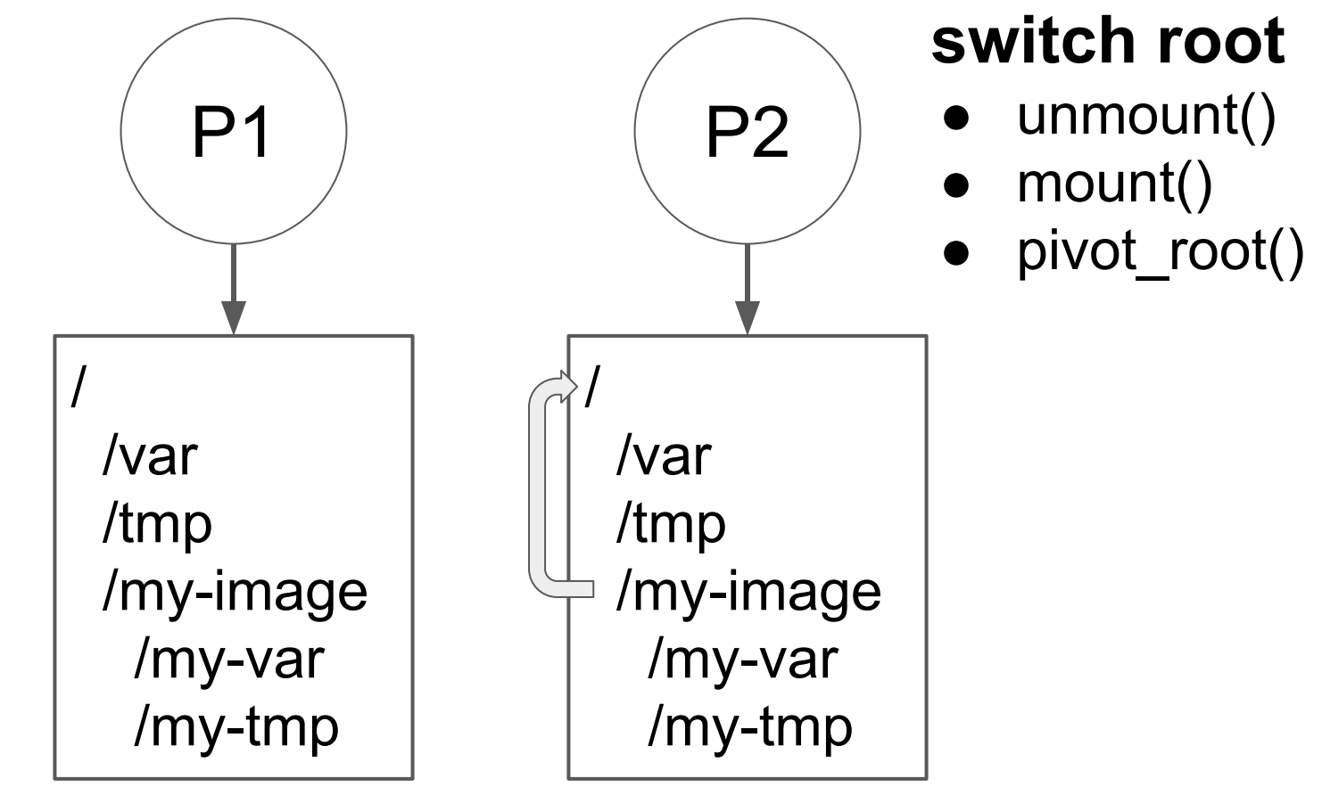
Logical isolation - Namespace Primitives

Slide 8
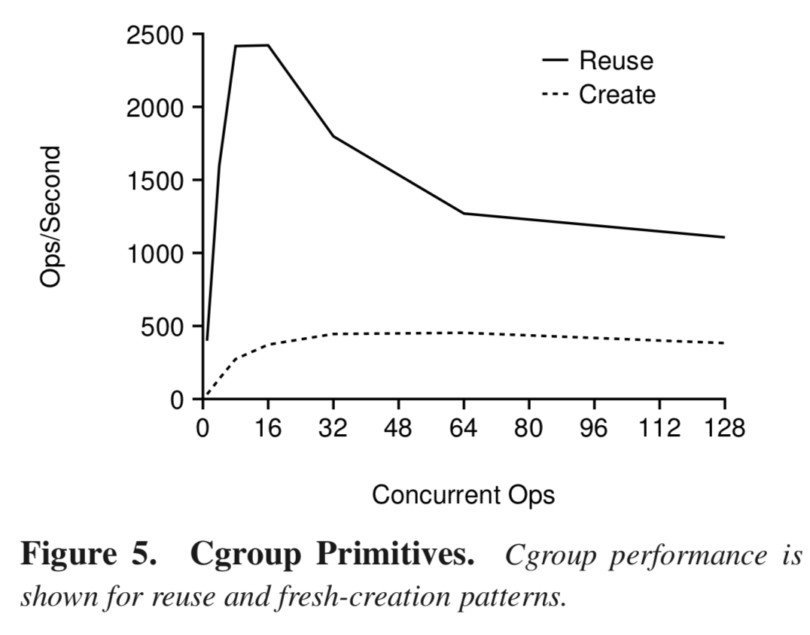
Performance isolation - Cgroup primitives
Linux use cgroup interface to achieve the performance isolation
Reusing the same cgroup is faster than the original one.
Reusing is at least twice as fast as creating new cgroups each time.

Slide 9
Zygote-provisioning strategy
Eliminate interpreter & package initialization cost
Pack more handlers into memory

Slide 10
Lean container
Storage: Sock use bind mounts + chroot
Communication: every sock container contains a Unix domain socket. This one handle message between OpenLambda Manager and processes in container
Isolation: pool of cgroup

Slide 11
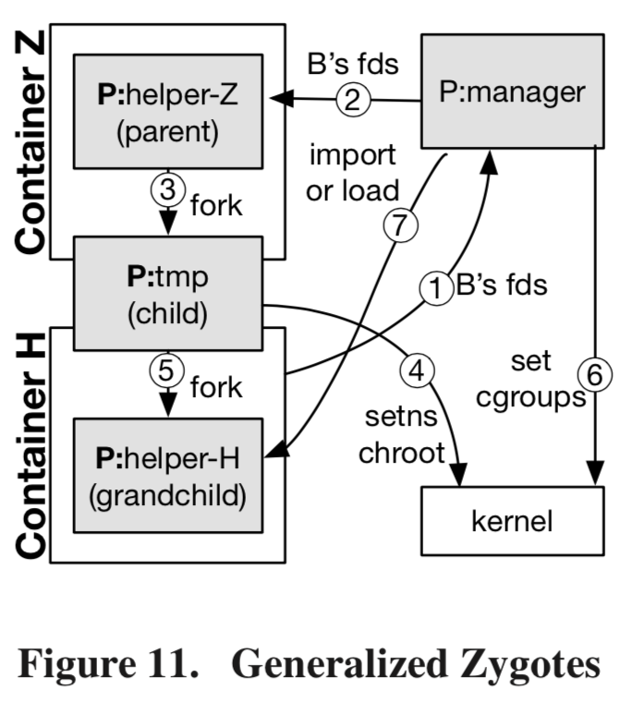
Zygote-provisioning strategy - Generalized Zygotes
Zygotes were first introduced on Android systems for Java applications
Low latency invocation for python handlers that import libraries.
Efficient sandbox initialization so that individual workers can achieve high steady-state throughput

Slide 12
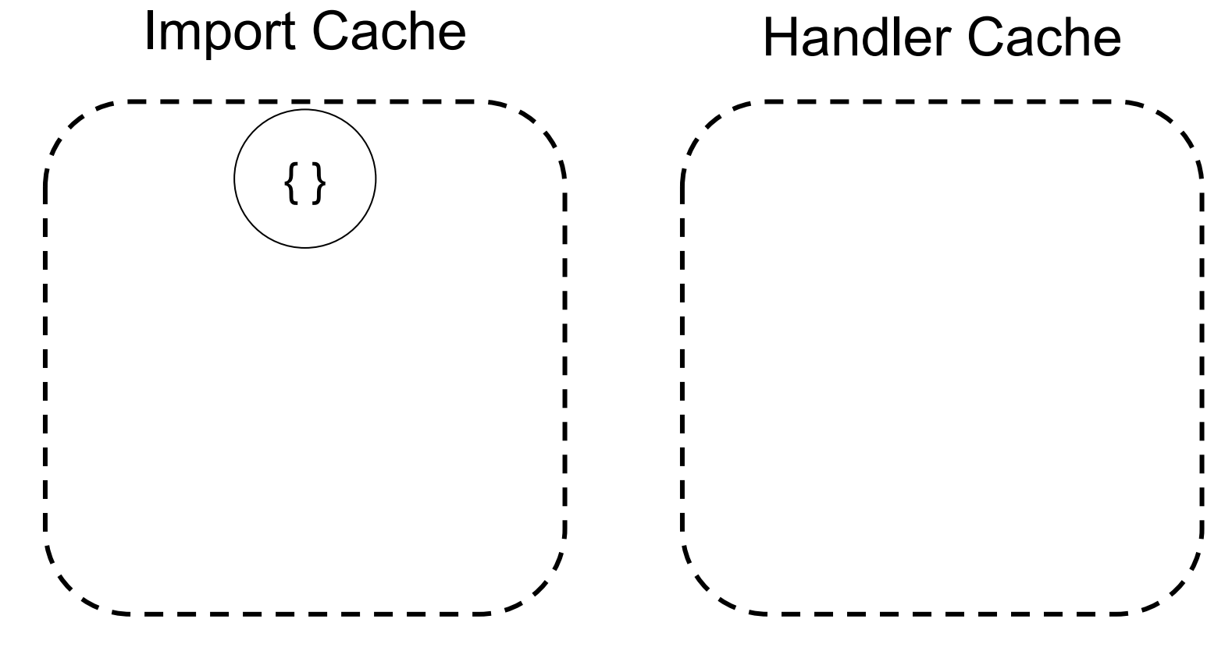
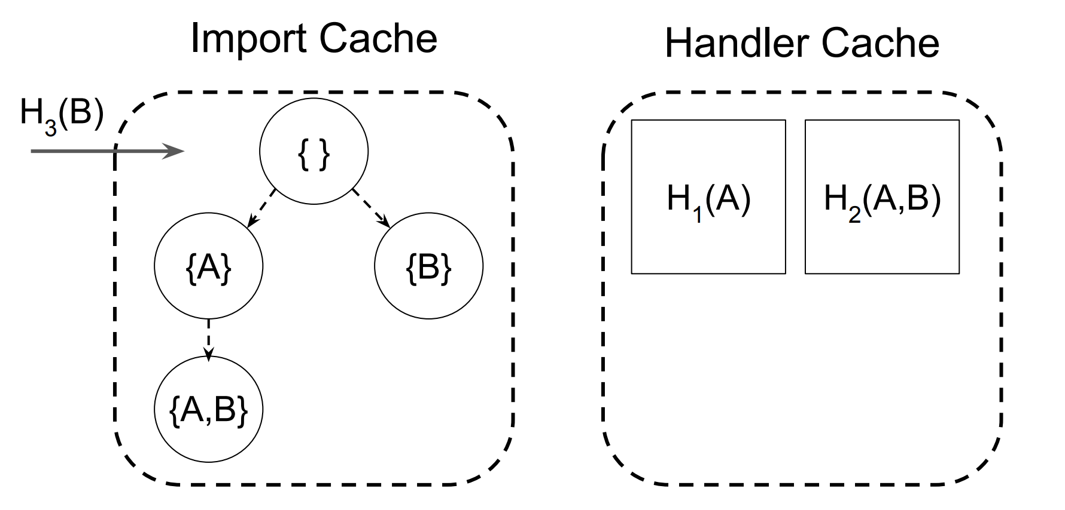
Package-aware caching system
handler cache maintains idle handler containers in a paused state.
Paused containers do not consume CPU but memory
Install cache: Reuse installed packages between lambdas
Imported cache: Reuse initialized Zygotes between lambdas
H1(A) H2(A,B) H3(B)
H₃(B)

Slide 13
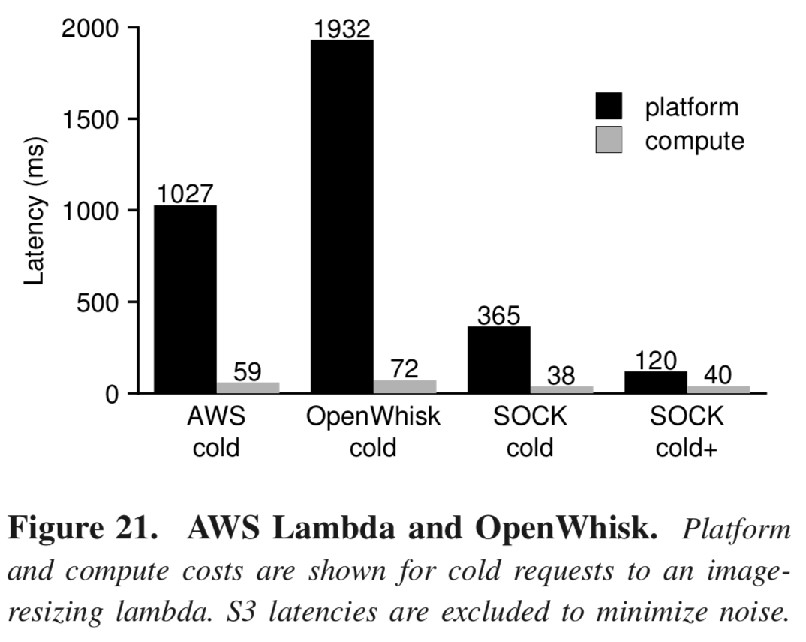
Evaluation
Case Study: image Resizing
Read an image from S3
Use the pillow package to resize it
write the output to S3
For each platform, we exercise cold-start performance by measuring request latency after re-uploading our code as a new handler.

