Slide 1
ZooKeeper
Justin Magnotti
9/19/18

Slide 2
What is ZooKeeper?
“Wait-free coordination for Internet-scale systems”
Favors high availability and high performance over consistency
Managed by Apache, originally developed by Yahoo!

Slide 3
Background/Motivation
Most coordination systems serve a single purpose
Create a flexible, simple, wait-free service
Distributed coordination is difficult

Slide 4
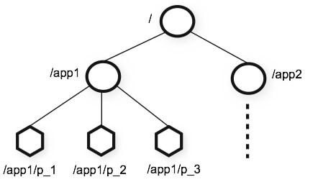
ZooKeeper Architecture
Hierarchical Namespace consisting of nodes

Slide 5
ZooKeeper Architecture
Client-server
Watches

Slide 6
ZooKeeper Architecture
Linearizable writes
FIFO clients
Non-specific primitives
Read-extensive

Slide 7
ZooKeeper Nodes
Regular or Ephemeral
Can be used to implement locking and other primitives
Watches
Helps with client caching

Slide 8
ZooKeeper API
create(path, data, flags)
delete(path, version)
exists(path, watch)
getData(path, watch)
setData(path, watch, version)
getChildren(path, watch)
sync(path)
Asynchronous

Slide 9
Primitive Examples
Configuration Management
Most common use
Rendezvous
Unknown configuration at startup
Group Membership
Ephemeral child nodes
Locks
Ephemeral nodes
Double Barriers
Start and End

Slide 10
ZooKeeper Applications
Commonly used as a configuration management service
Rackspace
Zynga
Yahoo!
Apache Hadoop MapReduce (Yarn)
Apache HBase
Apache Kafka

Slide 11
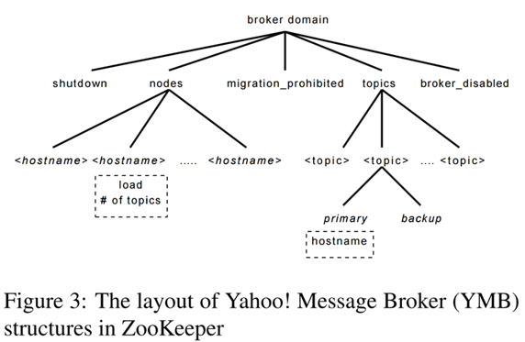
ZooKeeper Applications

Slide 12
ZooKeeper Service Implementation
Request Processor
Idempotent
Atomic Broadcast
Zab
Replicated Database
Snapshots
Client-Server
Fast Reads

Slide 13
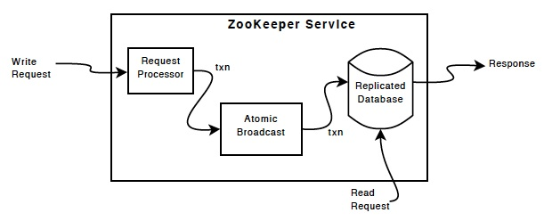
ZooKeeper Service Implementation

Slide 14
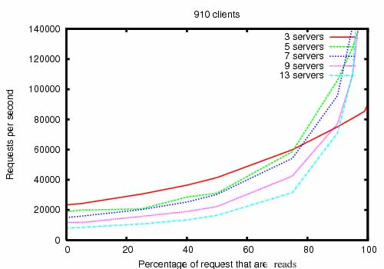
ZooKeeper Evaluation
Throughput

Slide 15
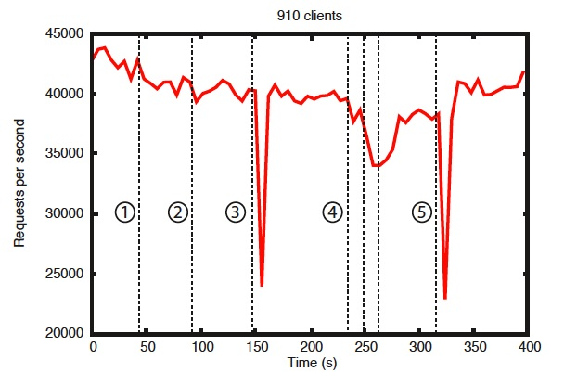
ZooKeeper Evaluation
Reliability

Slide 16
Related Work
Chubby
Distributed lock management
ISIS
Replication and fault tolerance
AFS
Cache callbacks

Slide 17
Conclusion
High availability
Fast reads
Flexible

