Slide 1
MobiSys 2017
Symbolic Execution of Android Framework with Applications to Vulnerability Discovery and Exploit Generation
Qiang Zeng
joint work with
Lannan Luo, Chen Cao, Kai Chen, Jian Liu, Limin Liu, Neng Gao, Min Yang, Xinyu Xing, and Peng Liu

Slide 2
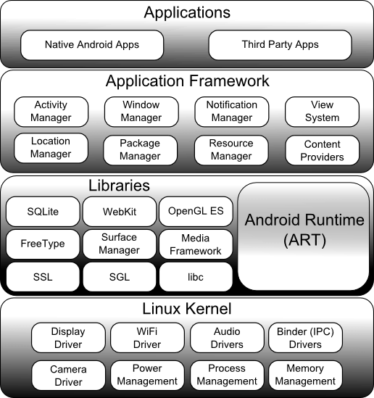
Android Architecture

Slide 3



Android Framework
Location Manager Service
App
Window Manager Service
Activity Manager Service
Android Framework
Package Manager Service
Libraries & Runtime
Telephony Manager Service
Linux Kernel
… …
Senor Manager Service

Slide 4
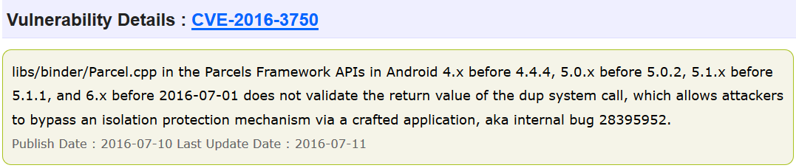

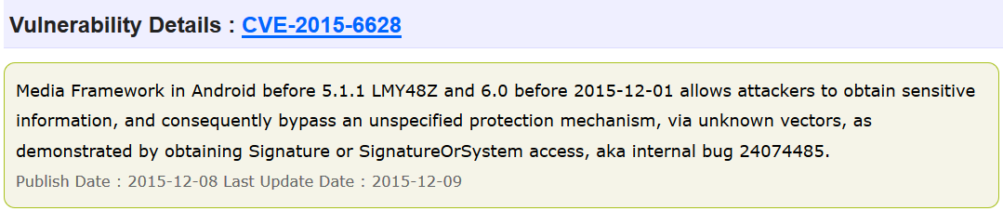
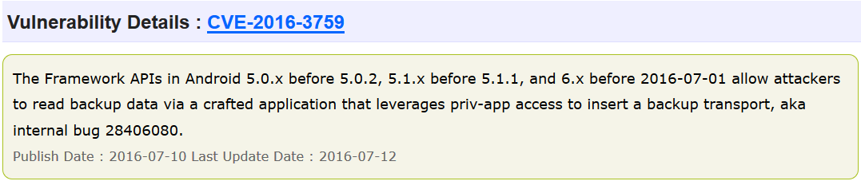
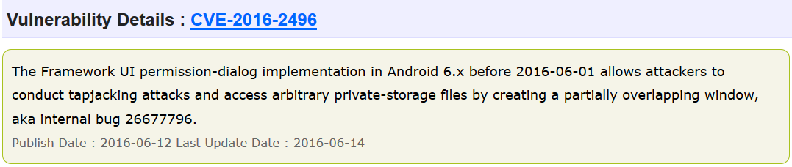
Android Framework is Vulnerable

Slide 5
Threats Caused by Framework Vulnerabilities
Vulnerabilities in Android Framework affect EACH android device
Stealing user passwords
Taking pictures in the background
Tampering with user data
… … …

Slide 6

Android Security Research
Most focus on Android apps
Very few techniques and tools for analyzing Android Framework
No tool available for automatically discovering vulnerabilities in Android Framework

Slide 7
Background: Symbolic Execution
Symbolic execution refers to execution of a program or function with symbols as parameters
  Systematically exploring all paths of a program
Much powerful than fuzzing
    Conventional vulnerability discovery uses Fuzzing, where inputs are randomly generated and path exploration is non-systematic
  Symbolic execution is the state of the art in vulnerability discovery

Slide 8

if (x < 0)
x is symbolic input
x < 0
int foo (int x) {
if (x < 0)
return -1;
assert (x != 0xFFF0000);
return x/2;
}
x >= 0
return -1
Symbolic branch
x == -1
if (x != 0xFFF0000)
Symbolic branch
(x != 0xfff0000)∧(x >= 0)
(x == 0xfff0000)∧(x >= 0)
return x/2
flaw detected!
x == 1
x == 0xfff0000

Slide 9


PoC exploit generation
Vulnerability discovery
Proving the vulnerability is exploitable
The first tool for symbolic execution of Android Framework
Symbolic Execution

Slide 10







How to Exploit a Framework Vulnerability
An exploit is a piece of code (or inputs) that takes advantage of a vulnerability in order to cause unintended behavior
System service call
Dalvik bytecode
App
App
a₀
AndroidManifest.xml
a₁
Android Framework
a₁
Resources
a₀
API
Access
An exploit is part of a malicious app
Libraries & Runtime
Symbolic inputs
Parameters of API
2) Variables storing configuration values of the malicious app
Symbolic inputs???
Linux Kernel

Slide 11

main () {
  forking system service threads;
  parsing all apps’ information;
  storing app information into memory;
  … …
}
Very complex !
The main thread first initializes Android Framework
Android Framework
Start here?
Main Thread
System Service Thread 1
System Service Thread n
App
… …
Path explosion!
API
API
API
API
Symbolic execution starts here!
memory

Slide 12
Challenge A:
State space explosion
Solution: Skipping initialization phase of Android Framework
Challenge B:
Execution context is missing
Solution: Phased Concrete-to-Symbolic Execution (PC2SE)
Challenge B
Challenge C: Identifying variables derived from malicious app
Solution: Slim tainting
Challenge C
Android Framework
Main Thread
System Service Thread 1
System Service Thread n
… …
Symbolic inputs
Parameters of API
Variables storing configuration values of the malicious app
API
API
API
API
memory
M

Slide 13
Phased Concrete-to-Symbolic Execution (PC2SE)

Slide 14

Decoupled architecture
Migrating execution context
App
Symbolic executor
Context query server
Symbolic executor
Android Framework
Heap memory snapshot
Context query client
Libraries & Runtime
Symbolic executor cannot obtain execution context?
Linux Kernel

Slide 15
Architecture of our system

Slide 16
Instrumenting bytecode instructions for heap migration

Slide 17
Example of a test driver

Slide 18
Migrating heap

Slide 19
Slim Tainting

Slide 20


Android Framework
Scattered!!!
Memory
M
M
Access pattern
Array-based
index
UID
App
Taint sinks
Taint propagation
Taint sources
Hash-table-based
Package name
key

Slide 21
Tainting propagation
(uid%100, 000 − 10, 000)

Slide 22
Evaluation
Effectiveness
  7 vulnerability instances
    6 instances of Inconsistent security policy enforcement
    1 instances of Task hijacking
Efficiency

Slide 23
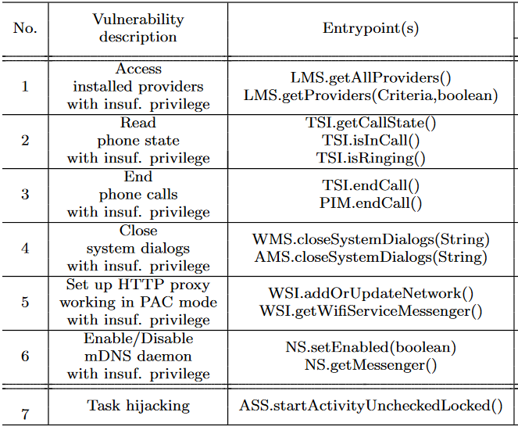
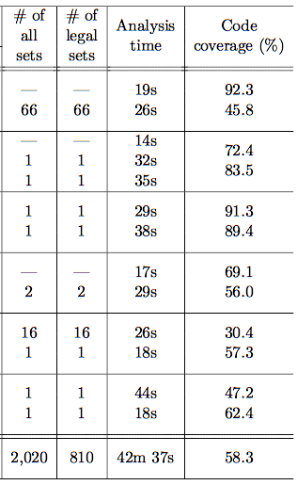

List of Vulnerability Instances & Analysis Statistics
New vulnerability instances

Slide 24
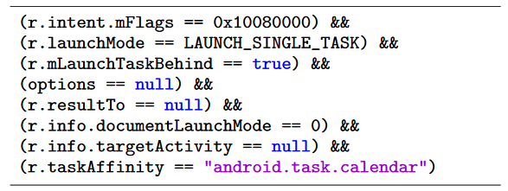
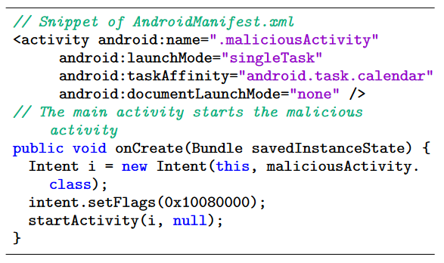
An Example of an Exploit
A set of concrete values
Configuration
An exploit
System service call

Slide 25
Code is open source!
https://github.com/Android-Framewrok-Symbolic-Executor/Centaur

Slide 26


